Slide 1




Clacks and Stirling Community Link Worker Project
Evaluation

Slide 2

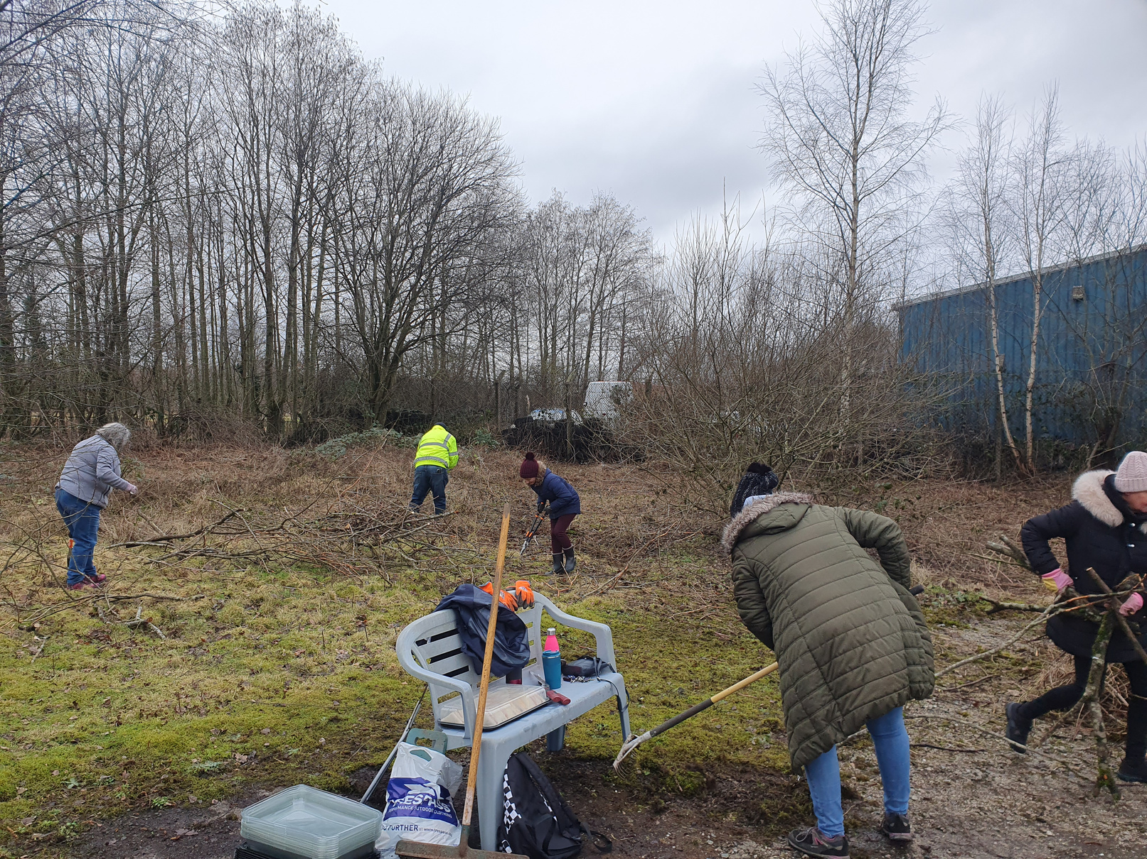

Table of Contents
01
Background
02
Data recording and evaluation
03
Patient Feedback
04
Questions and Answers
05
References

Slide 3
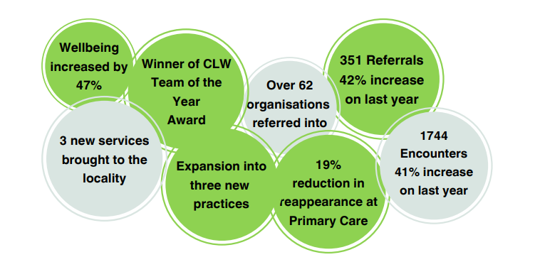
Background
CLW Project developed through partnership working between the Third Sector, NHS FV and Clacks and Stirling HSCP
CLW Project needs to provide regular reports to HSCP Forum, Localities and feed into strategic groups
Small team of 5 individuals
Notes:
The CLW project was developed through partnership collaboration with the third sector - in particular, Clackmannanshire Third Sector Interface (CTSI) Stirlingshire Voluntary Enterprise (SVE), NHS Forth Valley (NHS FV) and Clackmannanshire and Stirling Health and Social Care Partnership (CSHSCP).
CTSI and SVE, the Third Sector Interfaces (TSIs) in each of their respective local authority areas, are the employing organisations and the lead partners in the project, providing the necessary resources, training, and supervision to ensure effective service delivery and professional development for the CLWs.
Third Sector Interfaces work locally across Scotland to support the Third Sector by building capacity, acting as a source of knowledge, connecting partners and promoting the voice of the sector.
The Clackmannanshire and Stirling Community Link Workers (CLWs) work within GP practices in areas of high deprivation where there are health challenges. The areas were identified jointly with NHS Forth Valley.
It is a small team of 5 individuals and, between us, we cover 10 GP surgeries and are looking at the possibility of expanding in the Stirling area.
The CLW project needed to report to the HSCP and provide updates to the HSCP Forum, Localities and feed into strategic groups. It also needed to produce reports for the Steering group and for the practice managers.
The need for these reports, as well as to secure funding and demonstrate the value of the service to GP practices, meant that it was imperative that we looked critically at how we could best evaluate the success of the project. Some of the highlights from this evaluation work are shown in this slide.
I hasten to add that, we are a small team and I am not a statistician so please don’t feel that this is to try and tell you what you “should” be doing – it is mainly to give an example of what we have found helpful and promote discussion and sharing of best practices throughout the network.

Slide 4
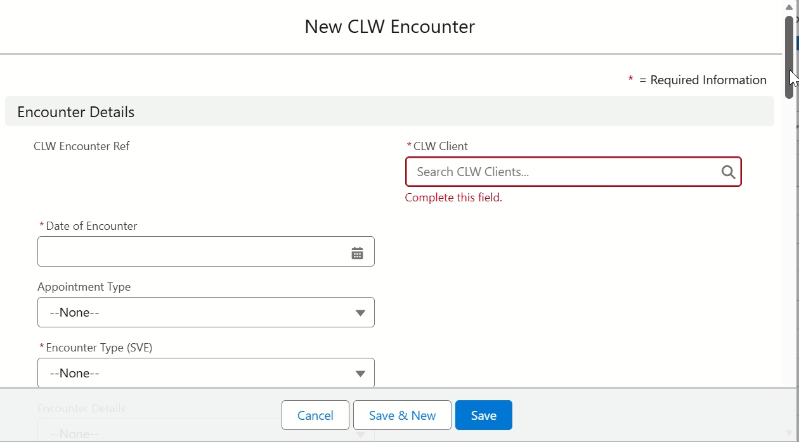
MILO
Notes:
A Salesforce System called MILO is used which records a wide range of data: this data supports the project to develop and demonstrate the benefits of the investments.
Some of the information gathered is: Referrals (including who is referring into the system), Appointments per CLW and practice, duration of appointments and a break down of onward referral pathways. (walk through video of Encounter)

Slide 5
Referral Data
Recording standard data allows more accurate comparison and allocation of resources
Example: 42% increase in referrals year on year and expansion into three new GP surgeries in Clackmannanshire
Strong ongoing referrals for Stirling with evaluation and plans to expand in progress
Wider range of referral sources
Notes:
The recording of this standard data allows more accurate comparison and allocation of resources.
One of the things that it allows us to do is to look at referrals and changes year on year: ie looking at referrals for the year initially: Overall, we have seen an increase of 42% in referrals year on year – We have also improved our evaluation tools allowing us to get a more accurate picture of who is making the referrals. From this data, while the percentage of referrals from GPs has remained consistent, it is clear that referrals are coming from a wider range of sources. This includes MH nurses, self referral, Practice nurses etc. This supports the aim to expand on range of referrals, improving sustainability.
It also allows us to track changes in referral numbers linked to an expansion in Clacks into 3 new surgeries.

Slide 6
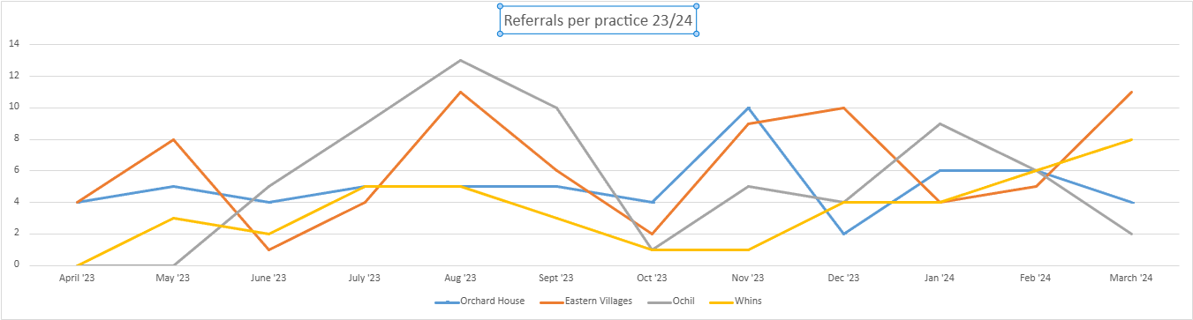
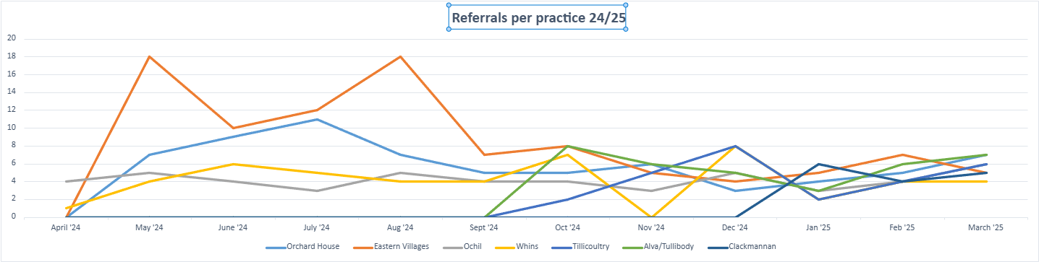
Referral Data (Cont)
Referrals per practice – Yearly trends
Similar trends with regards to busier and quieter periods for referrals over both years
Second graph shows data from expansion into new surgeries
Notes:
We analyze referral yearly trends – this has allowed us to look at allocation of resources and when it is more appropriate to undertake other work (ie more detailed evaluation work, training, research or outreach work)
This also led to the expansion into 3 more surgeries in Clackmannanshire and is informing the planned expansion into 2 more Stirling surgeries in the near future.
Busier and quieter times of the year are very similar across both reporting years. In the second of the graphs, it shows referral rates from the “new” surgeries included in the expansion of the project in Clacks. After an initial peak in referrals when the CLWs first started in these practices, they then followed the same trends as the others.
Referrals to the Eastern Villages continues to be high, reflecting the fact that this was the first established and longest-running CLW GP surgery.

Slide 7
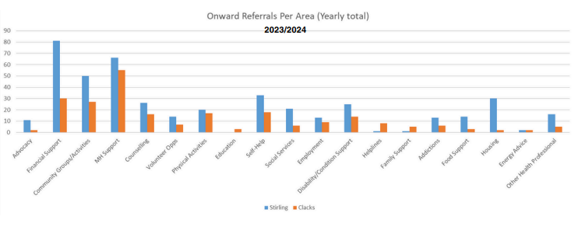
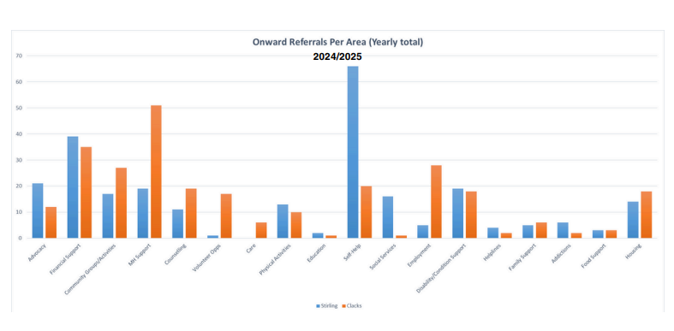
Onward referrals
Onward referrals for support with Mental Health remain high
Identified potential lack of support for low level MH or social isolation in Stirling
Top 10 onward referral organizations
Appointment time and non appointment time demonstrates how CLWs use their time
Notes:
One of the other areas that we actively record are Onward Referrals (we do this by type of support and further break down to each individual organization) This is helpful in looking at both:
Common reasons for onward referrals ie Mental health and allows us to further break the data down and look to identify “gaps” in services locally. For example:
Though Mental Health (MH) referrals were consistent between the two areas last year, this year it can be seen that Clacks has more emphasis on support through MH organisations while Stirling focuses more on Self Help and Wellbeing exercises. This could be either due to the differing skills of the CLWs or, we believe, it is due to the larger number of local organization in Clacks which help to support low level MH and social isolation but we are continuing to investigate this.
The data on referral types is further broken down to list a “Top 10” organisations who we regularly refer into: this allows us to ensure that we are not “overloading” one particular organization and also means that we can share this data for any funding applications etc that they may need to make in future, ensuring better partnership working between the CLWs and local charities or organisations
Another aspect that we look at (and is included in our annual report) is a break down of appointment duration and non appointment time. This year this shows that 44% of CLW appointments last more than 30 minutes and that, in 26% of appointment either a small or significant time commitment is required after the patient has left the appointment to complete some of these onward referrals, research options and contact or chase up previous referrals.
This helps to quantify the make up of a typical “Day in the life of a CLW” as well as helping to demonstrate the difference this makes to a patients wellbeing – this will be discussed later.

Slide 8
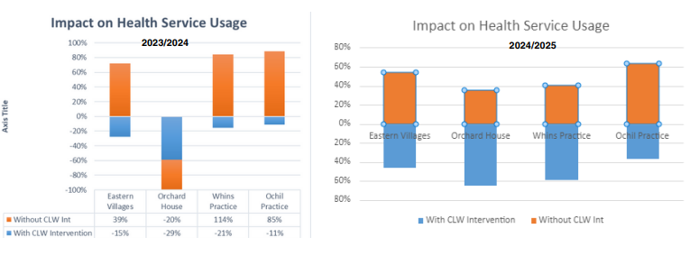
Health Services Usage &Cost Benefit Analysis
Analysis conducted on impact on Primary Health Care and potential savings through a Health service usage and Cost Benefit Analysis
Year 23/24 shows a 34.25% reduction and potential saving of £72000
Year 2023/24 had Shows 19% reduction in appointments (averaged across 4 practices) over a period of 6 months equating to £39,740 saving over a full year
Smaller reduction than evidenced last year coincides with increase in referrals for those with chronic conditions
Notes:
In order to try and demonstrate that CLW Project was good value for money, we looked at research conducted by NASP (National Academy for Social Prescribing)
NASP has published 13 evidence publications to date which suggest that social prescribing can reduce costs and pressure in the health care system. Recognising the urgent need to demonstrate the health economic benefits of social prescribing, they commissioned a rapid scoping review of 19 studies on the economic impact of social prescribing and 7 studies on the impact of social prescribing on health service usage.
The first of these “Building the economic case for social prescribing” led us to complete a “health serviced usage” evaluation and to then introduce a basic “cost benefit analysis” to try and assign a monetary figure to the benefits of having CLWs. (I have included links to the relevant papers in the final slide of this presentation for reference)
For the “health service usage” aspect, we followed the methodology demonstrated in the final report from Shropshires social prescribing evaluation. This was deemed to be the most robust example of health service usage analysis in the scoping exercise.
They compared service usage in the 3 months prior to the first consultation with the social prescribing advisor and over the three months between initial consultation and follow up. This data was then compared to a case-matched control group. In order to improve on the accuracy of the data, we extended this data and looked at the 6 months prior to consultation and 6 months after (so 12 month period in all)
In both the Shropshire evaluation and in our own evaluation, a statistically significant reduction was seen in visits to the GP for people using the social prescribing or CLW service. There was no statistically significant reduction in visits to the GP in the control group so it is therefore likely that the social prescribing service or CLW service had a significant reduction on the number of GP consultations for those working with SP/CLWs. Due to the inclusion of the control group, this data could described as showing causality between the two.
As can be seen in the graph in this slide based on a 20% sample of CLW patients, primary care had an average of a 34.25% reduction in appointments (based across all 4 GP surgeries over a 6 month period) for 23/24 and a 29% reduction in 24/25,
Once we had managed to demonstrate causality and a robust data set showing a reduction in primary care appointments, we then used data available in the GP contract to have an indicative cost saving, based on the average number of GP appointments in the 6 months after intervention at an average cost of £45per appointment giving a potential saving of £72000 last year and £39,740 this year.
I appreciate that this is not necessarily a “traditional” cost benefit analysis and doesn’t follow prince 2 practices, but is rather a basic one to give an indicative cost saving, based on the reduction in use of primary care support that is shown in this slide. There are a number of examples of different ways to evaluate the work of CLWs in these reports and are worth looking at.
As you can see, there is also the case that the “potential cost saving” has decreased this year – this has coincided with an increase in referrals from those with chronic conditions – we are currently looking at ways to better represent this in the data.

Slide 9
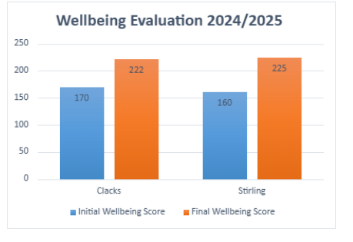
Wellbeing Evaluation
New Wellbeing evaluation introduced this year to better evaluate the impact of CLWs on individuals that they support
ONS4 Wellbeing evaluation tool used
47% increase in Wellbeing for those who had worked with CLWs
Notes:
After presenting the previous evaluation at our yearly meeting, the most common question we were asked was: “How do you know that you are not just reducing pressure on one service or organisation and adding pressure on another service or organisation within the 3rd sector?” In order to try to answer this question, and to accurately evaluate the true impact on the people CLW work with on a daily basis, a Wellbeing Evaluation was conducted.
The Community Link Workers looked at several evaluation tools used by various other CLW or Social Prescribing projects but ultimately decided to use ONS 4 Wellbeing Survey. This was due to a variety of factors, but most importantly, they felt that it did not cause additional stress or anxiety to the individuals they work with while providing robust evaluation material.
“ The ONS4 measures ask people to evaluate three aspects of their own well-being: How satisfied they are with their lives overall Whether they feel they have meaning and purpose in their lives Their emotions during a particular period (both positive and negative) These questions capture three types of well-being: evaluative, eudemonic, and affective experience.”
Wellbeing Evaluation. As can be seen in the graph above, in both areas there has been a significant increase in the Wellbeing “score” of the individuals supported by Community Link Workers. This strongly suggests that, when people move onto other supports, that they have already improved in their confidence, resilience and ability to manage their own Wellbeing and are ready for the next step in their journey

Slide 10



Case Study - Sarah
“I was referred to a few different places which helped me. I really appreciated the walking group, as I’ve made new friends there and I feel walking has helped a lot with my mental health.”
36-year-old nurse on sick leave due to high levels of stress and anxiety.
Financial difficulties as she was on sick pay.
Her son has suspected autism and ADHD – causing additional stress at home.
“The most valuable thing I got from the CLW was the advice around coping with my stress and anxiety better. I still get anxious and stressed, but it’s a lot more bearable now”
“I felt comfortable talking about my problems. Some of the plans we made in that first appointment gave me confidence that things could better”
Notes:
In addition to the evaluation tools I have discussed already, we also try to put across the personal story of how the people we see are affected and the difference it makes to them to get support from a CLW.
We do this through sound bites, quotes, case studies and the use of videos.

Slide 11
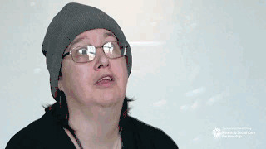

Emma's Story
https://www.youtube.com/watch?v=bm-1H3_dWx8
Emma's Community Links Worker Story - YouTube
Notes:
Emma had received support from our former CLW Danielle. She was kind enough to share her experiences of the CLW in a video and she also recently spoke and answered questions at our yearly event this year entitled “Where are we now?” The link takes you to Clacks and Stirling H&SCP Youtube page.
Emma was referred to the CLW following her mothers terminal cancer diagnosis. Through the support of the CLW she was able to better come to terms with the loss of her mother, grow her social connections, and in turn, improve her confidence. She has also become one of our Community Health Champions who are volunteers supported by the CLWs who act as “buddys” for people looking to take part in new activities/groups – showing them around, introducing them to other members and offering other support to try to reduce the fall off in attendance regularly seen

Slide 12
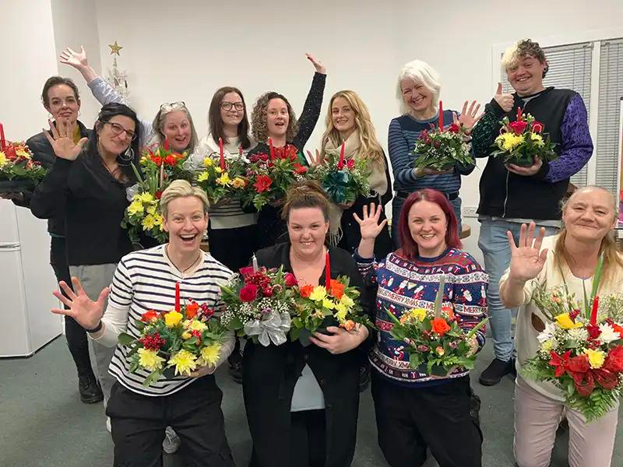
Thank You!
Questions?
CLW End of Year Report: Community Link Worker Project Report 2024/25
gemma@ctsi.org.uk

Slide 13
References
NASP – The impact of social prescribing on health service use and costs
Polley, M., Seers, H., Toye, O., Henkin, T., Waterson, H., Bertotti, M. and Chatterjee, H.J. (2023). Building the economic evidence case for social prescribing. Report — October 2023. London: National Academy for Social Prescribing Building the economic case for social prescribing report

