Slide 1

Scotland’s National Performance Framework

Slide 2
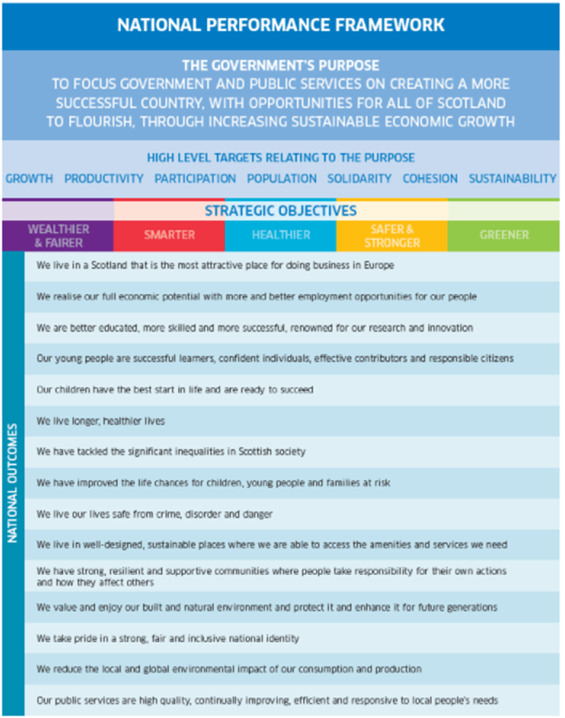

How it started
How it’s going
Scotland’s National Performance Framework

Slide 3
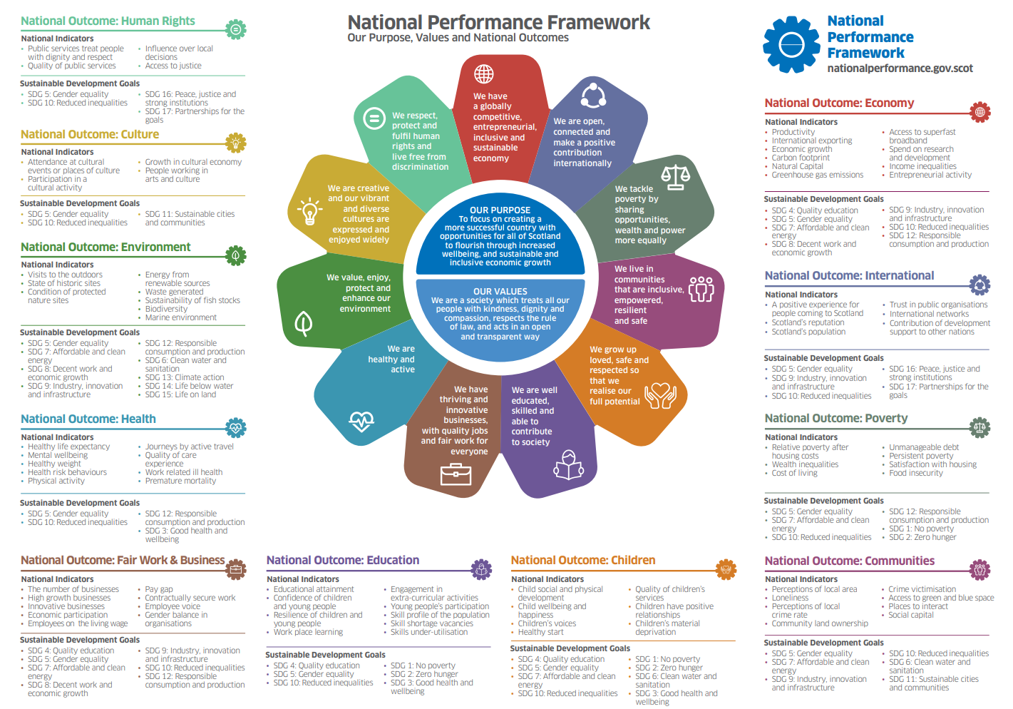

Slide 4
Statutory Review of National Outcomes
Required under the Community Empowerment Act 2015
Must begin a review of the National Outcomes before the expiry of the period of 5 years beginning with the date on which the National Outcomes were published
In carrying out a review, the Scottish Ministers must consult –
  Such persons who appear to them to represent the interests of communities in Scotland, and
  Such other persons as they consider appropriate
Following a review, the Scottish Ministers must consult the Scottish Parliament

Slide 5
Review Governance
Advice
Delivery, Assurance, Risk
Technical Advisory Group
Overall leadership
Project Board
DFM
Expert Advisory Group
NPF Unit
Policy Advisory Group

Slide 6
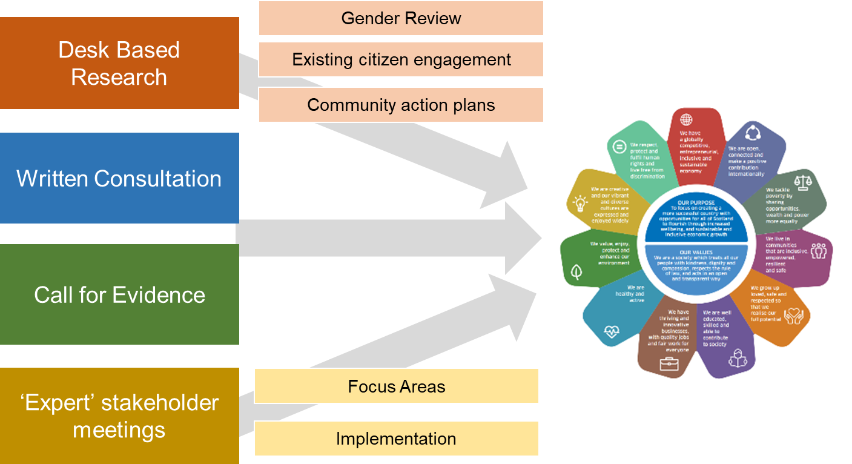
Review engagement plan

Slide 7
Timing and Next steps
Date | Action
Ongoing | Desk based research
March 2023 | Publish online consultation and call for evidence
May - June 2023 | Expert stakeholder meetings
June – July 2023 | Analysis of responses
August 2023 | Policy Development
Autumn 2023 | Cabinet approval (will depend on available timing)
December 2023 | Parliamentary consultation, with laying of statutory document
2024 | Publish reviewed National Outcomes

Slide 8

Review of National Outcomes
Jan 2024
Reviewed NPF published
Implementation Plan published (Commitment to FPAC)
User guides for NPF
Website
March 2023
Public engagement launched
Implementation

Slide 9
Are there any changes to the current set of 11 National Outcomes that you would propose?
Are there new National Outcomes that should be included in the National Performance Framework, if so why should they be included?
Are there any changes you would propose to the wider National Performance Framework on set of National Indicators?
What impact does the current National Outcomes have on your work?
What are the main obstacles and barriers in the further implementation of the National Outcomes?

Slide 10
Resources
Consultation: Review of the National Outcomes - Scottish Government - Citizen Space (consult.gov.scot)
Call for evidence: Review of National Outcomes: call for evidence - Scottish Government - Citizen Space (consult.gov.scot)
Contact the NPF Unit nationalperformance@gov.scot
NPF website: nationalperformance.gov.scot/
Subscribe to our monthly newsletter: https://scot.us14.list-manage.com/subscribe?u=666737b5304a9477cda644ee2&id=ce759906f9
Blog: blogs.gov.scot/national-performance-framework/
Twitter: @ScotGovOutcomes

