Slide 1
Caring: a social determinant of health
Richard Meade
Director, Carers Scotland

Slide 2
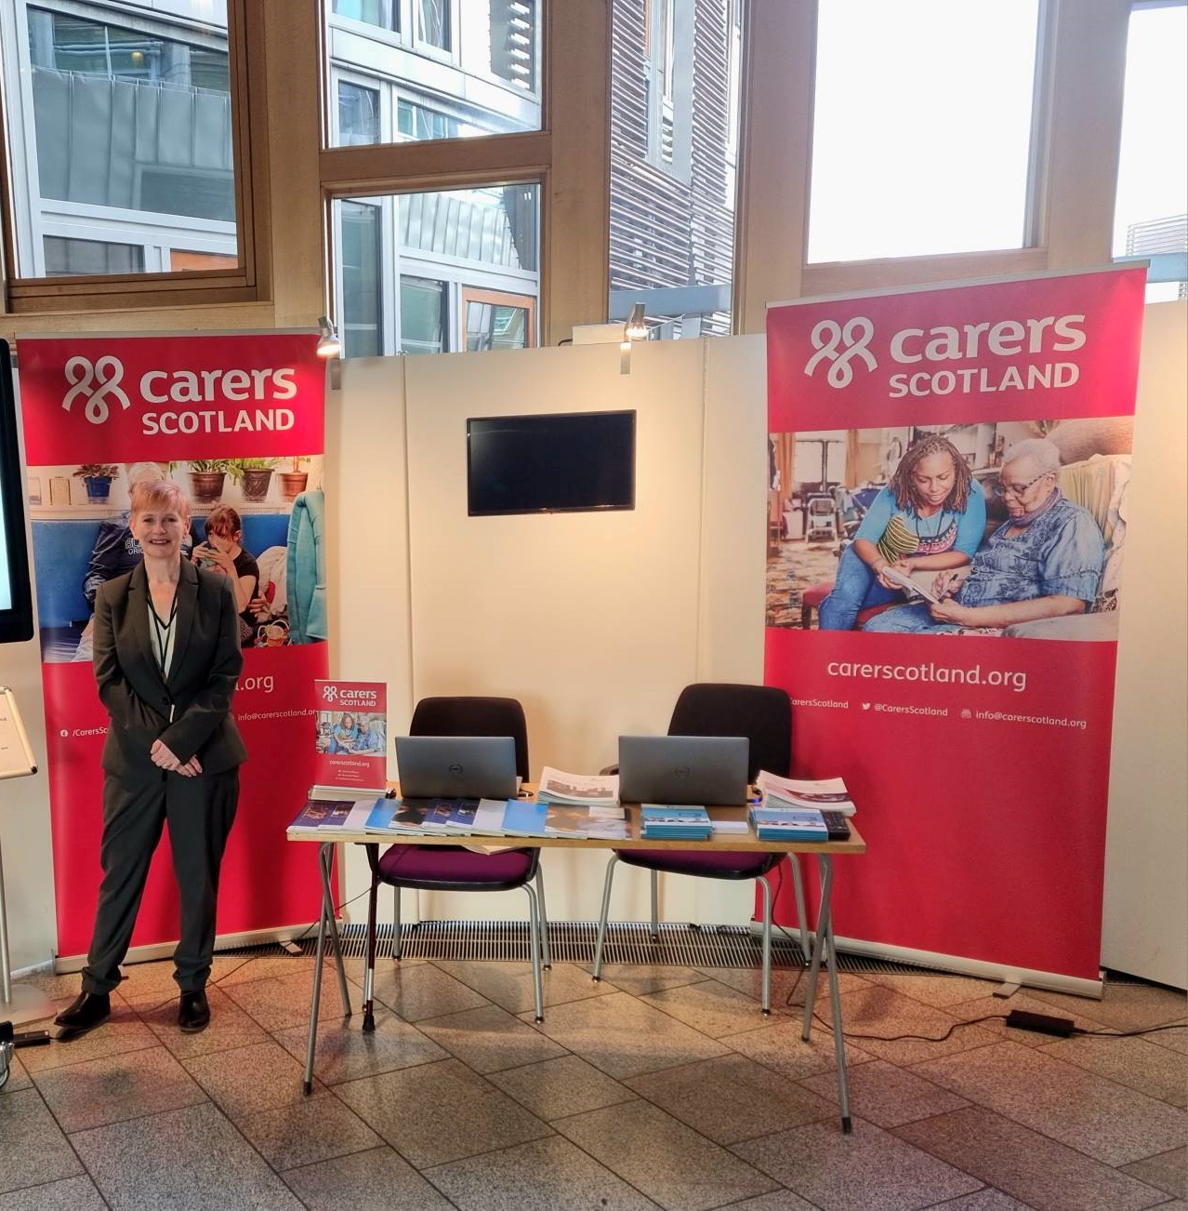
Carers Scotland
Our Vision: To create a society that recognises, values and supports carers
Policy, public affairs, campaigning
Training and Development
Information and Support
Carer Positive

Slide 3

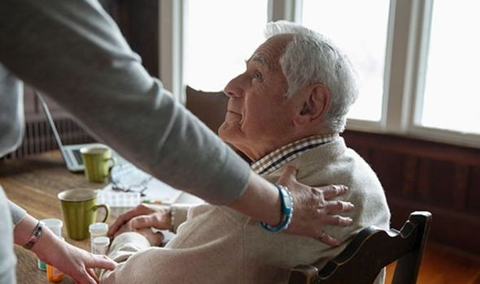
What is an unpaid carer?
An unpaid family member, partner or friend who helps a person with daily activities who wouldn’t be able to manage if they didn’t have help. This could be someone who is seriously ill, disabled or who needs extra help as they grow older.

Slide 4
Carers in Scotland
800,000 unpaid carers in Scotland – 17.5% of the adult population.
30,000 children and young people are providing care.
To replace unpaid care would cost £10.9 billion a year – or a whopping £43 million each day.
Caring will affect most of us. It is estimated that 3 in 5 of us will become carers at some point in our lives.
Around a 250,000 carers in Scotland juggle paid work with their caring role.
340,000 people begin a caring role each year in Scotland

Slide 5

WHO: Social Determinant of Health
“The social determinants of health (SDH) are the non-medical factors that influence health outcomes. They are the conditions in which people are born, grow, work, live, and age, and the wider set of forces and systems shaping the conditions of daily life. These forces and systems include economic policies and systems, development agendas, social norms, social policies and political systems”.

Slide 6

Poorer outcomes than non-carers
Carers are at greater risk of:
Stress, anxiety, depression
Physical health problems – pain levels, bad backs
Multi-morbidity
Severe disease – heart conditions
Premature death

Slide 7
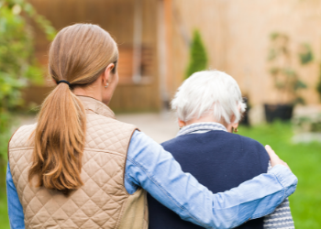
The Pandemic Effect
Exacerbated inequalities for carers
1.1 million people provided care during the pandemic – lots of first-time carers.
70% of carers did not get any break or respite

Slide 8
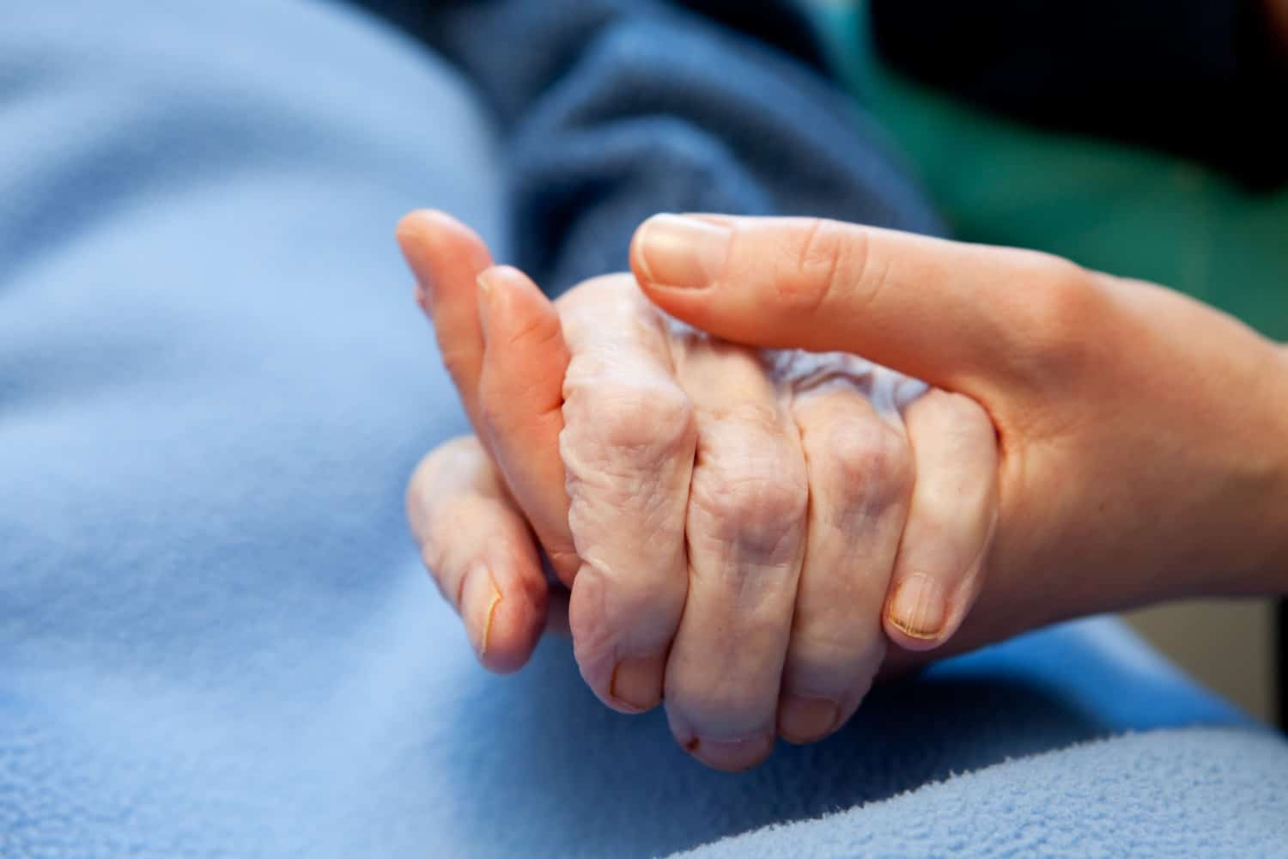
The State of Caring in Scotland: health and wellbeing
1 in 5 of carers reported bad or very bad physical health – 25% of those caring 35hours+
27% of carers reported bad or very bad mental health – rising to 1/3rd of those caring 35hours+
39% of carers have not had a break from caring in the last 12 months.

Slide 9
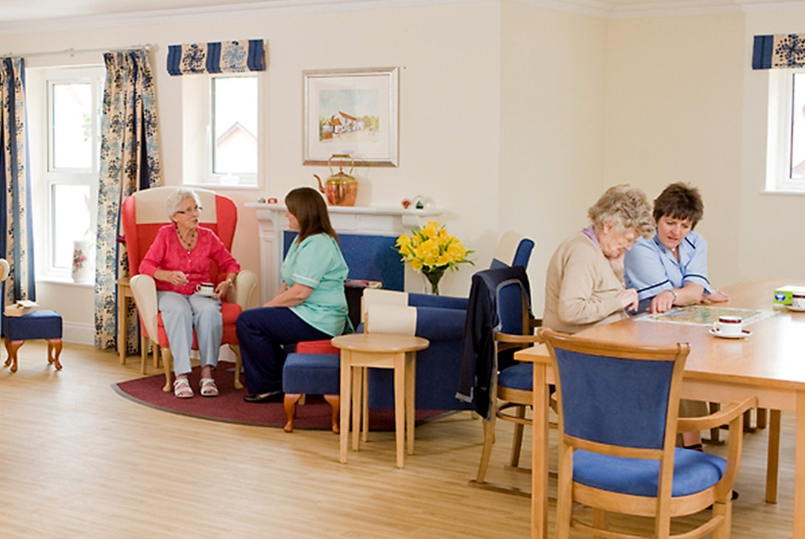
The State of Caring in Scotland: Services and support
27% of carers – reduced at home services
44% of carers – reduction in day care
4/5 not confident that they will return to previous levels.

Slide 10
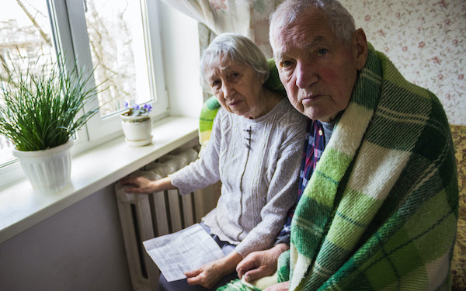
The State of Caring in Scotland: Cost of living
1 in 4 carers are struggling to make ends meet
9 in 10 carers have seen increases to energy and food bills
¼ are cutting back on food and heating

Slide 11
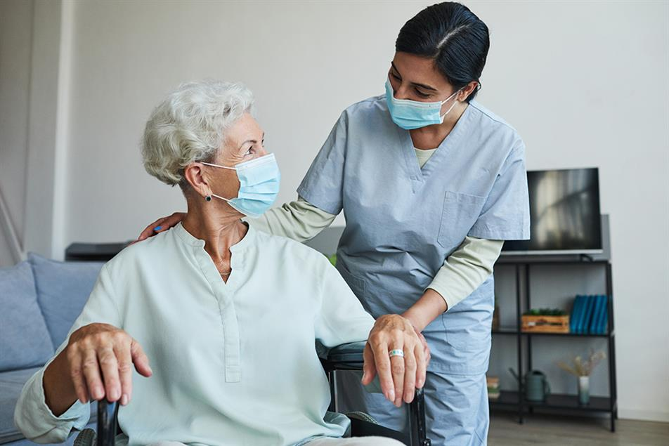
A growing crisis
Over 65s to grow by a third
Number of dependent older people will increase by 113% by 2051(JRF).
More carers, less statutory support, greater unmet need

Slide 12
What needs to happen
Caring must be considered a social determinant of health
More research
Increased investment in services
Greater financial support

Slide 13
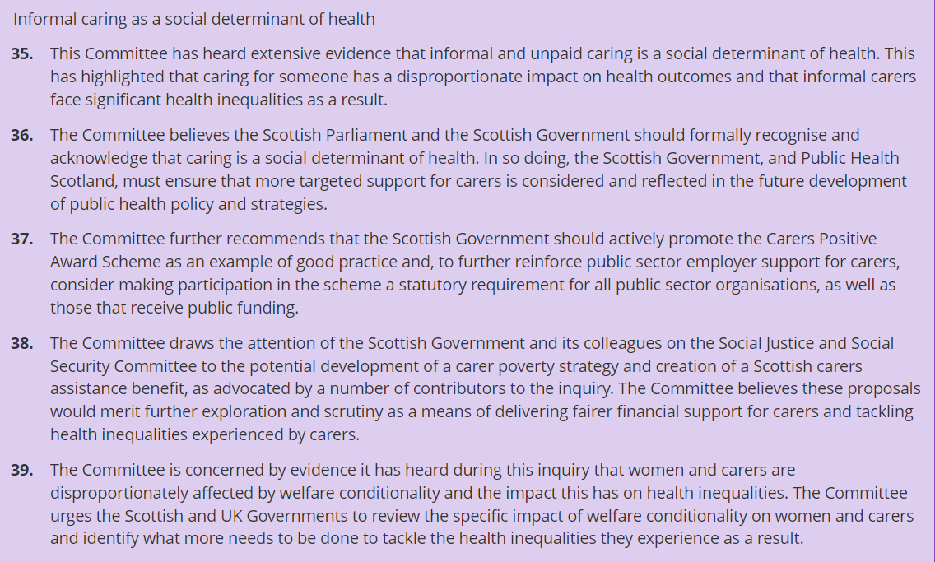
Health, Social Care and Sport Committee

Slide 14

What needs to happen
Caring must be considered a social determinant of health
More research
Increased investment in services
Greater financial support

Slide 15
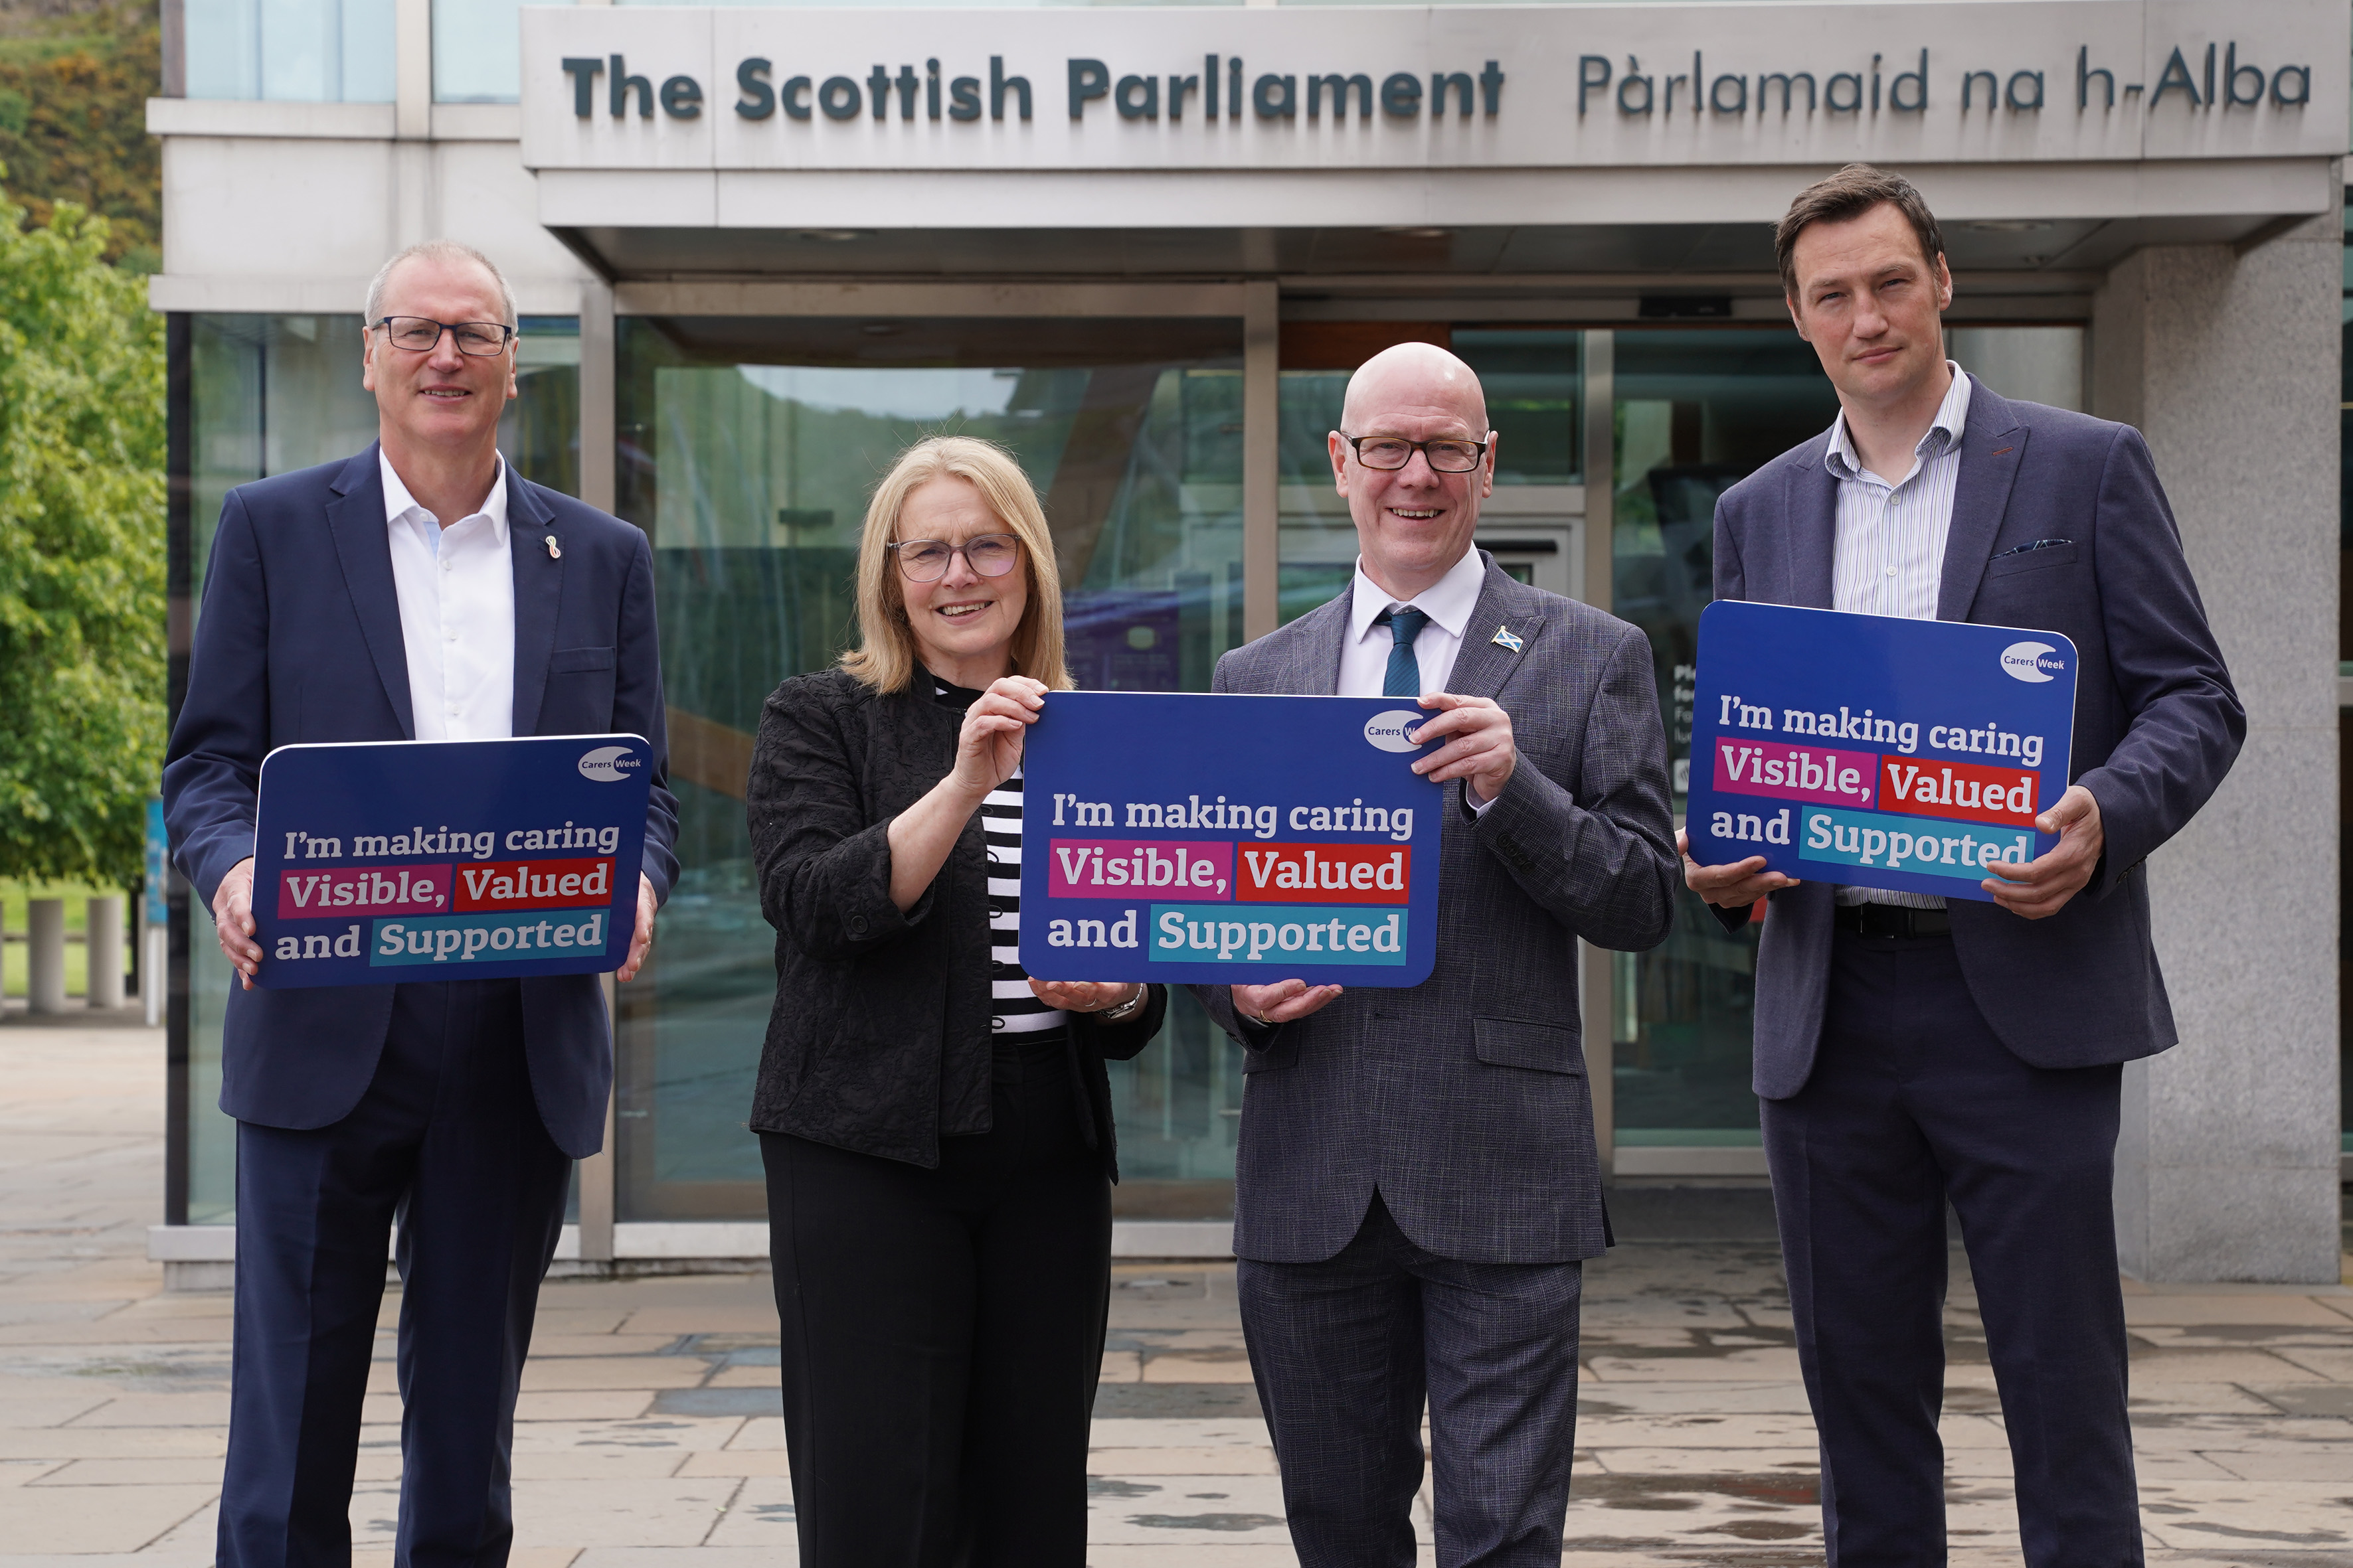
Scottish Government
Carers Strategy – due to be published
National Care Service – right to respite for all carers
Carers Assistance – new social security benefit replacing Carers Allowance.
A protected characteristic?
Is this enough?

Slide 16
Unpaid carers are in a public health crisis that needs action right now

Slide 17
Contacts
Richard Meade, Director, Carers Scotland
E: richard.meade@carerscotland.org
Fiona Collie, Head of Policy & Public Affairs
E: fiona.collie@carerscotland.org
Tel: 0141 445 3070
www.carerscotland.org
Facebook: carersscotland Twitter: @CarersScotland

