Slide 1
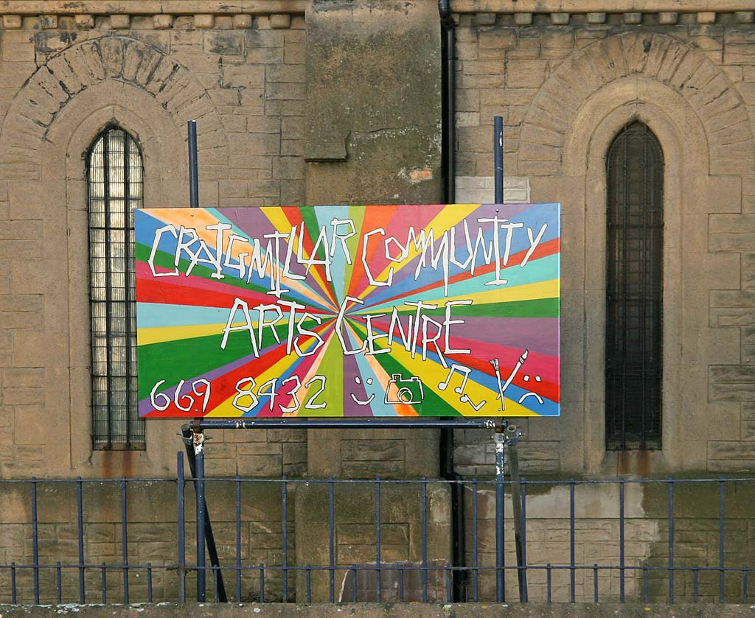
A community-based approach to addressing Health Inequalities
Dr Carey Lunan, GP

Slide 2
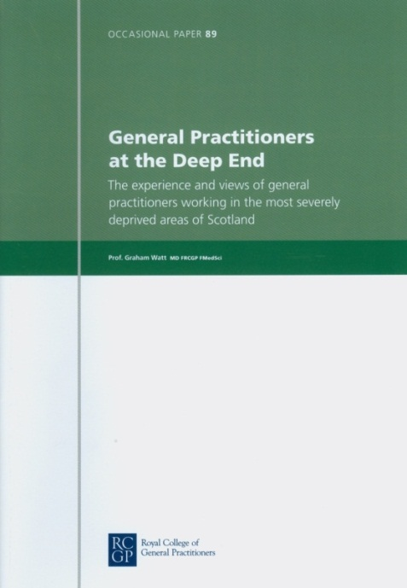
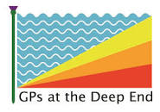
The Scottish Deep End Project
2009 - 2022
www.gla.ac.uk/deepend
@deependGP
  #equity
  #advocacy
  #meded
  #QI
Community of practice
Identity and voice
Research
Teaching & training
Engagement events
Roundtable discussions
Published reports (39)
Lobbying & Advocacy
Evidence base (projects)
GPs from100 general practices serving the most socio-economically deprived populations in Scotland

Slide 3
“Deep End” issues
ISSUES AFFECTING DEEP END COMMUNITIES
Unemployment
Benefits sanctions
Cuts to services
Drugs and alcohol
Child protection
Migrant health
Vulnerable adults
Bereavement
Higher cancer prevalence
Reduced life expectancy
Covid impacts
Cost of Living crisis
…
KEY POINTS ABOUT DEEP END ENCOUNTERS
Early multiple morbidity
Social complexity
Higher consultation rates
Shortage of time
Reduced expectations
Lower enablement
Poor health literacy
Translated appointments
Practitioner stress
Weak interfaces
…

Slide 4
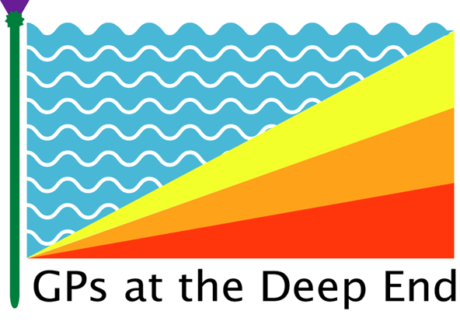
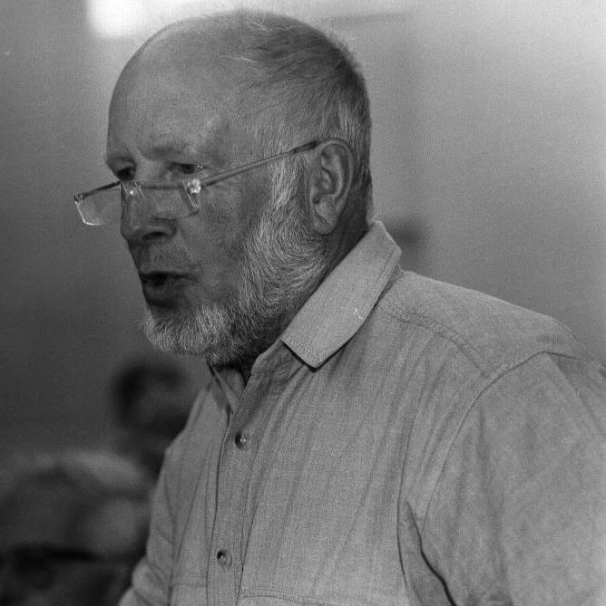
These features drive the INVERSE CARE LAW
“the availability of good medical care tends to vary inversely with the need for it in the population served. This inverse care law operates more completely where medical care is most exposed to market forces, and less so where such exposure is reduced. “
The Lancet, 1971.
Dr Julian Tudor Hart, 1927-2018
Notes:
The Covid 19 pandemic ‘landed’ in this context. It shone a spotlight on pre-existing health inequality and disadvantage – and also, for many, simply exacerbated it further.

Slide 5
BUT….
What are the enabling and unique features of general practice
wrt improving population health and addressing health inequity?

Slide 6
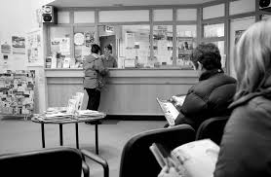
Population coverage
Contextual care
Continuity of care
Coordination of care
Inclusivity of care
Frontline experience
Professional autonomy
Team working
Advocacy role
Notes:
Indep contractor

Slide 7

A Global Pandemic, then, a Cost of Living Crisis.

Slide 8
Direct effects of Covid-19
‘‘Triple Whammy’ of risk:
  More likely to catch Covid19 (frontline jobs, less able to WFH, more crowded accommodation, more reliant on public transport etc)
  More likely to get sick or die from Covid19 (poorer underlying health; disease of ‘old age’ 10-15 yrs younger, reduced life expectancy,)
  Less likely to be vaccinated against Covid19 (logistical, social, financial reasons, also disadvantaged by a (chronological) age-related vaccine rollout)

Slide 9
Indirect effects of Covid 19
Worsening financial insecurity in the poorest households
Worsening food insecurity
Widening of the educational attainment gap
Higher levels of domestic violence
Child welfare concerns
Worsening mental health
Higher levels of drug-related deaths
Digital exclusion in a digitally-dependent world.

Slide 10
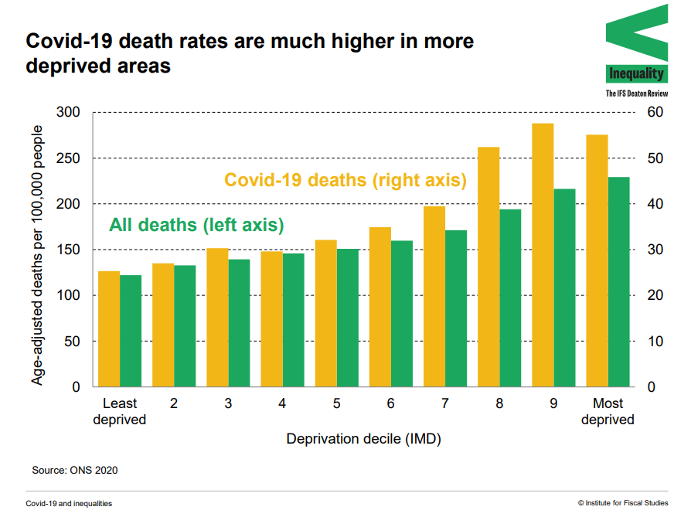
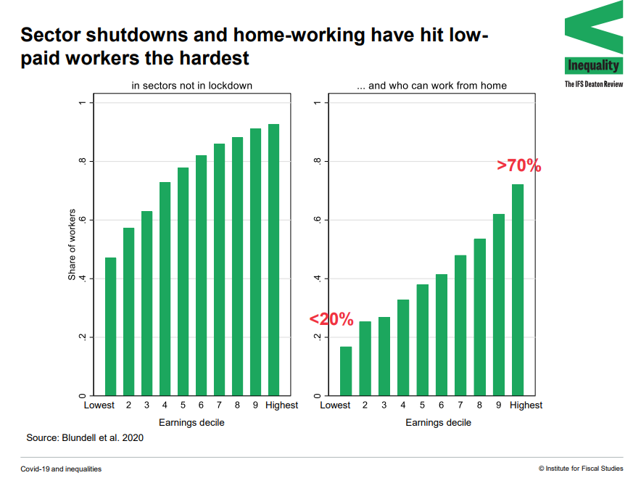
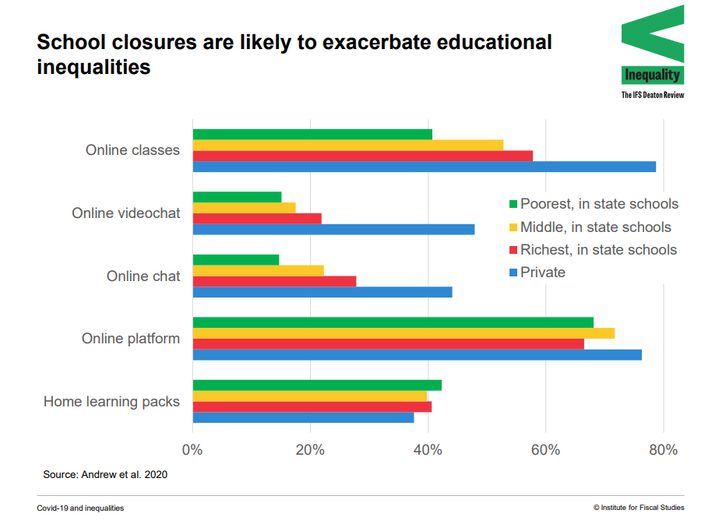
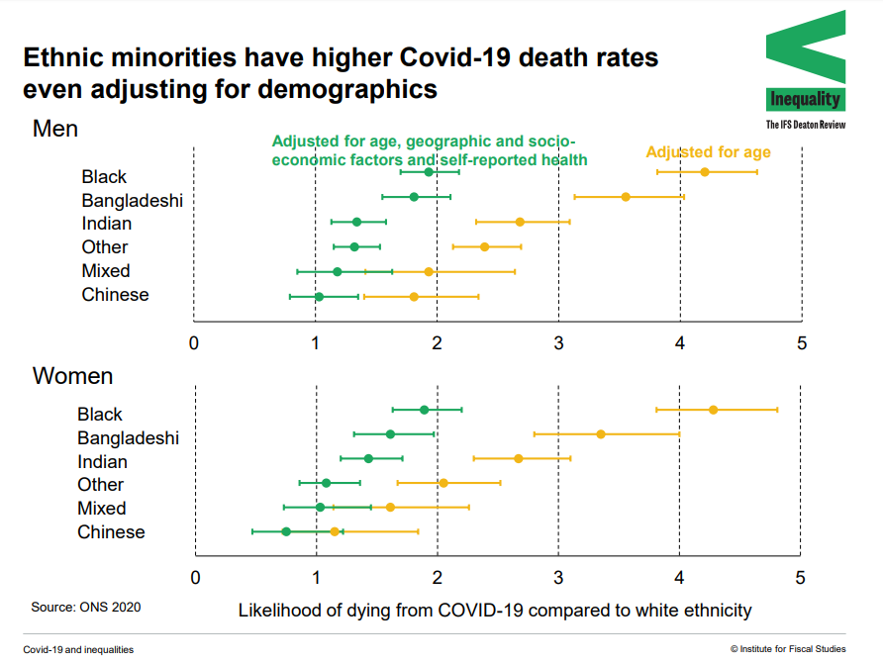
Source, IFS. Covid19: the impacts of the pandemic on inequality

Slide 11
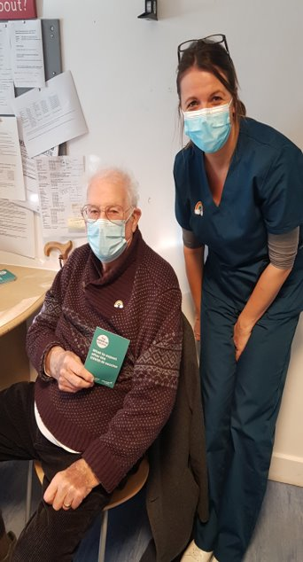
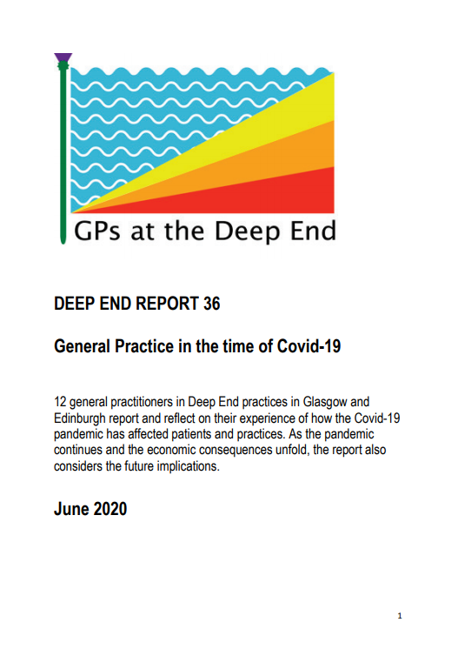
Covid19 and General Practice
We needed to think about who was ‘missing’
Digital exclusion a huge concern
The nuance offered by in-person consulting starkly felt
Many needed help with the public health advice
An already-complex system (NHS) got even harder to navigate
Medically vulnerable AND socially vulnerable
Collaboration, especially with third sector

Slide 12
What can we do to make a difference?
Build teams that promote social inclusion
Share practical resources with patients
Advocate. Lobby. Influence.

Slide 13
Building teams that promote social inclusion
Care coordinators
Community link workers
Welfare advisors
Mental health and addiction nurses

Slide 14
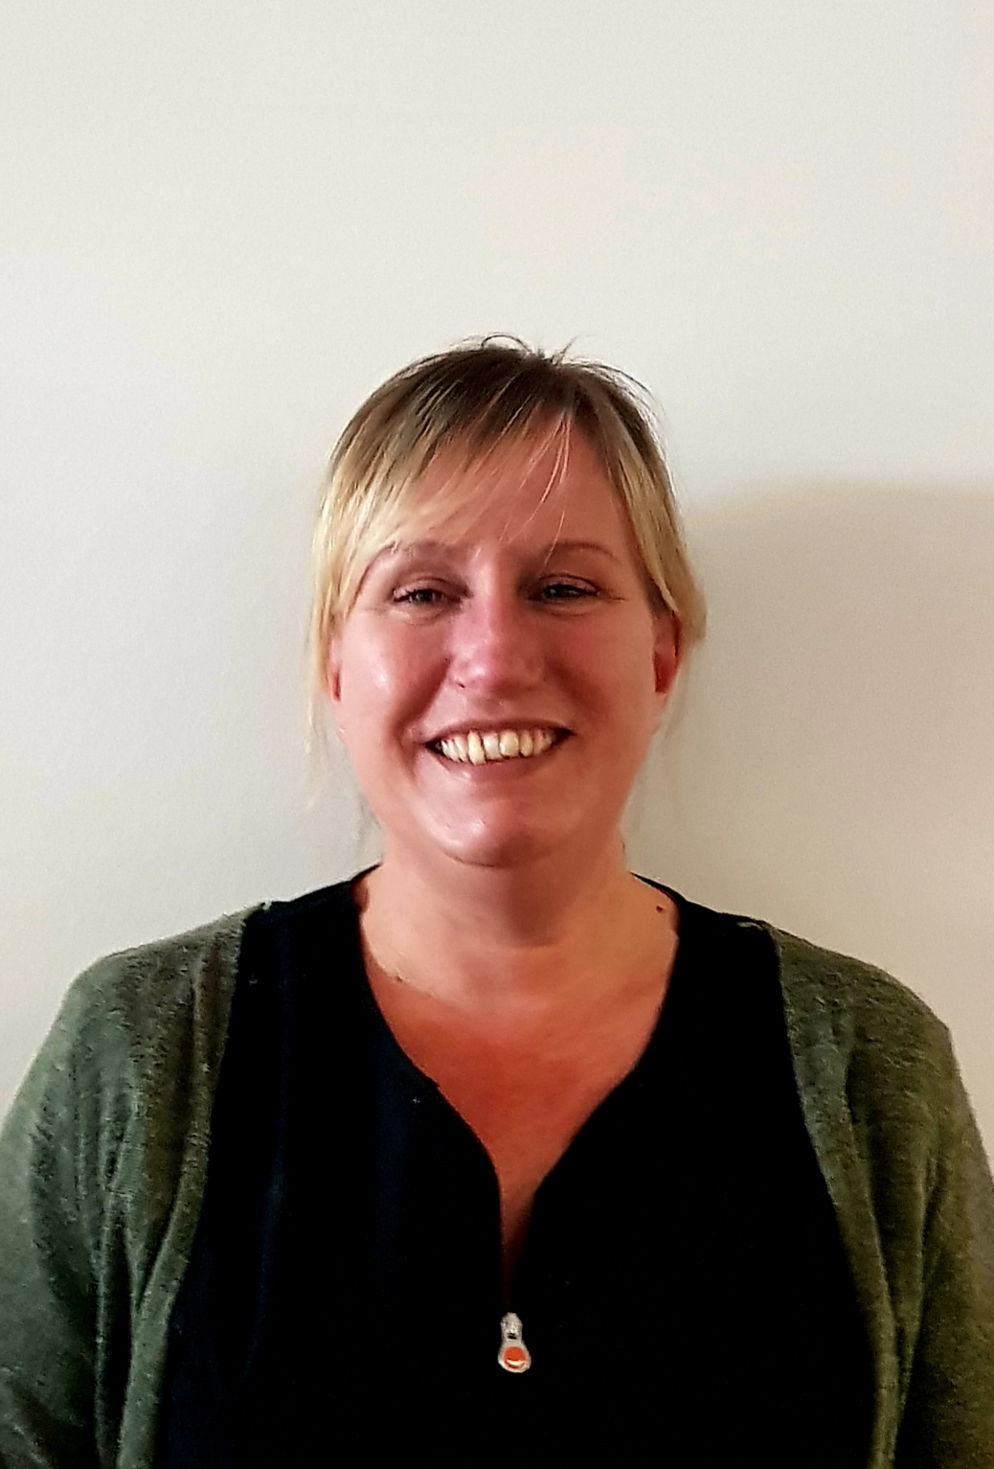
Care Co-ordinators
The frontline of the frontline
They know our socially vulnerable
Who was/is ‘missing’??
Care Coordinator ‘outreach’ calls during Covid
  Food security? Domestic security? Financial security? Awareness of how to access? Covid awareness and resources?
8/10 calls resulted in onward referral
see helpful RCGP resource
Suzanne, Care Coordinator,

Slide 15
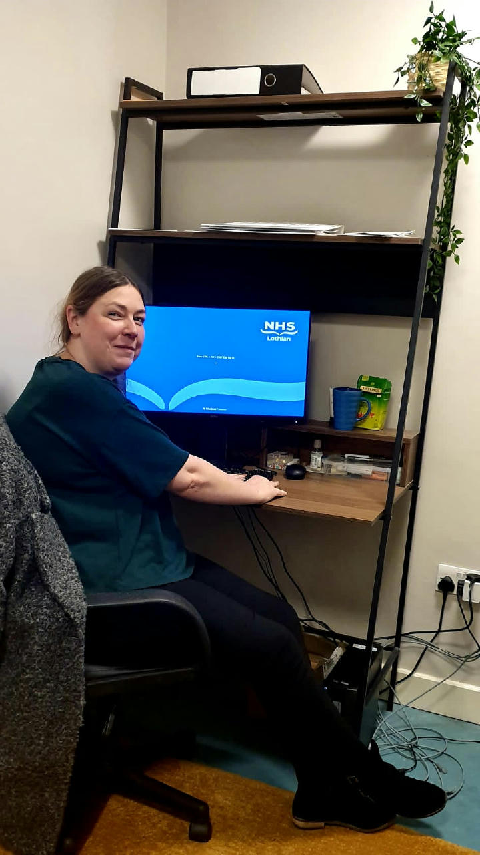
Community Links Workers
generalist social practitioners
based in GP practices, usually serving a socio-economically deprived community
tailored conversations based on individual needs
Expert knowledge of community resources and initiatives
“The CLW has made a world of difference to the practice. The CLW Programme offers hope, alternatives, and options that we didn’t have..”
Wendy, Community Link Worker

Slide 16
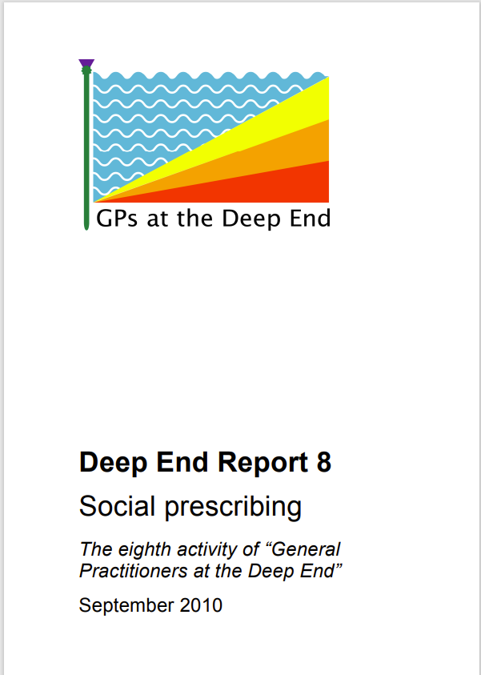
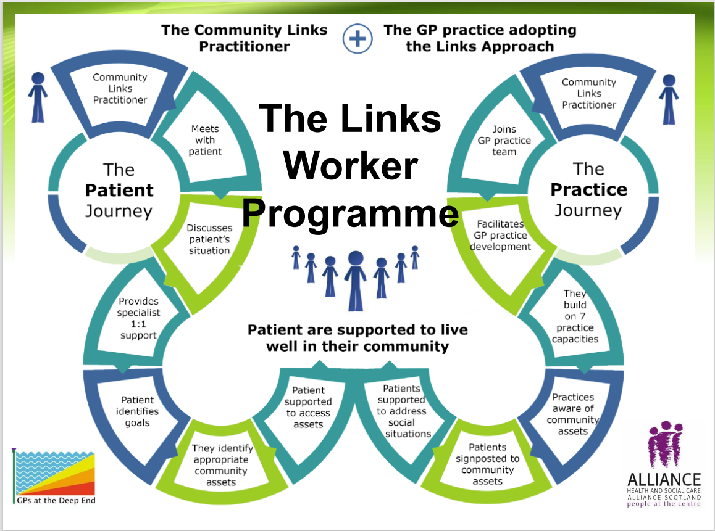
Community Links Workers: a journey
2010: a small survey of GPs’ knowledge and experience of social prescribing
2010 - 2011: The Scottish Government Health Department subsequently funded the Links Project, in which six practices worked together to increase their use of social prescribing
2017: Community Links Worker Programme - Partnership between general practice (the Deep End) and third sector (The Alliance for Health & Social Care)
2022: Establishment of a Scottish Community Link Worker Network (vhscotland.org.uk). 300 CLWs across Scotland
Notes:
Social prescribing = linking patients to relevant community resources for health

Slide 17
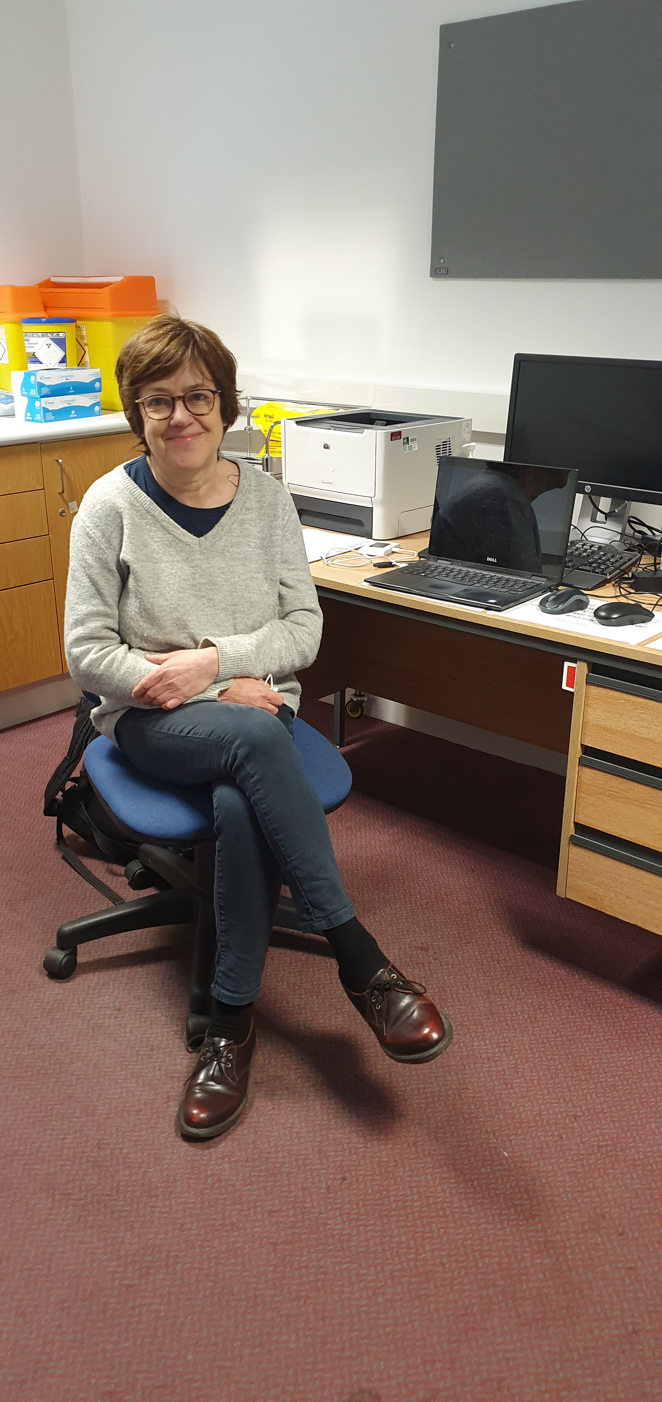
Welfare Advisors
Craigmillar – 6 sessions per week = 24 x 1-hour appointments
Waiting times to be seen = 1-2 weeks
Citizens Advice Edinburgh (CAE) cover 8 city practices (other providers too)
Headline figures from Sept 2021 – August 2022:
  546 clients, 1360 contacts
  180 financial gains for 107 clients, totaling £444,350.61
  key areas: benefits (72%), debt, utilities, housing…
Karen, Welfare Advisor

Slide 18
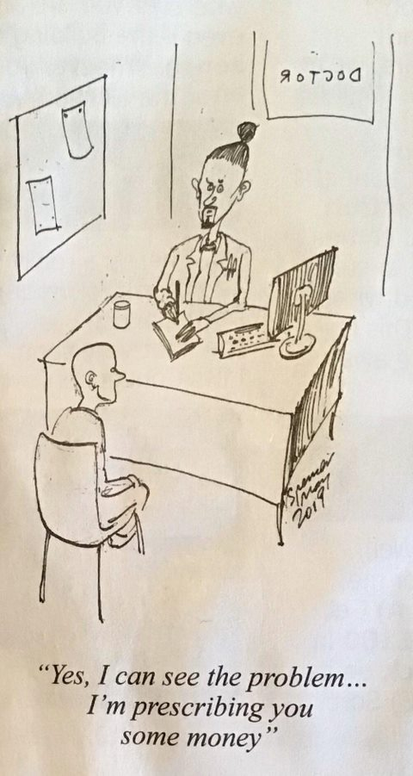
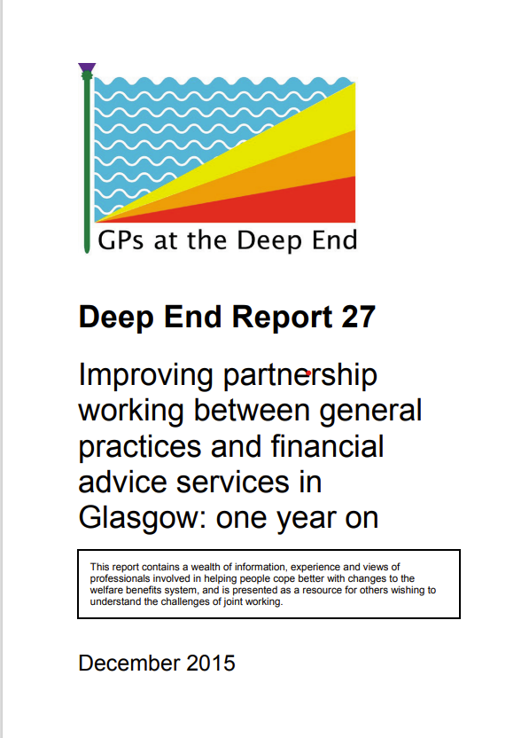
Welfare Advisors
Started as a Deep End project in 2016, Pathhead Glasgow
Welfare Advice and Health Partnerships (WAHP) integrate local authority or third sector welfare rights and money advice services into NHS services.
Embedded advisors can provide advice on: income maximisation, social security, debt issues, housing, employability issues
Scottish Government commitment to provide 150 WAHPs in GP practices in areas of highest deprivation

Slide 19
Welfare Advisors
“As a result of having contact with advice workers in medical practices who have access to medical records, patients/clients experience improved health and wellbeing, feel less stigmatised, and report increased feelings of self-worth. Individuals, particularly those who may be experiencing social and/or economic disadvantage have improved and earlier access to services. They also report increased self-motivation and confidence, resulting in an increased ability to use other services” (2017 evaluation)

Slide 20
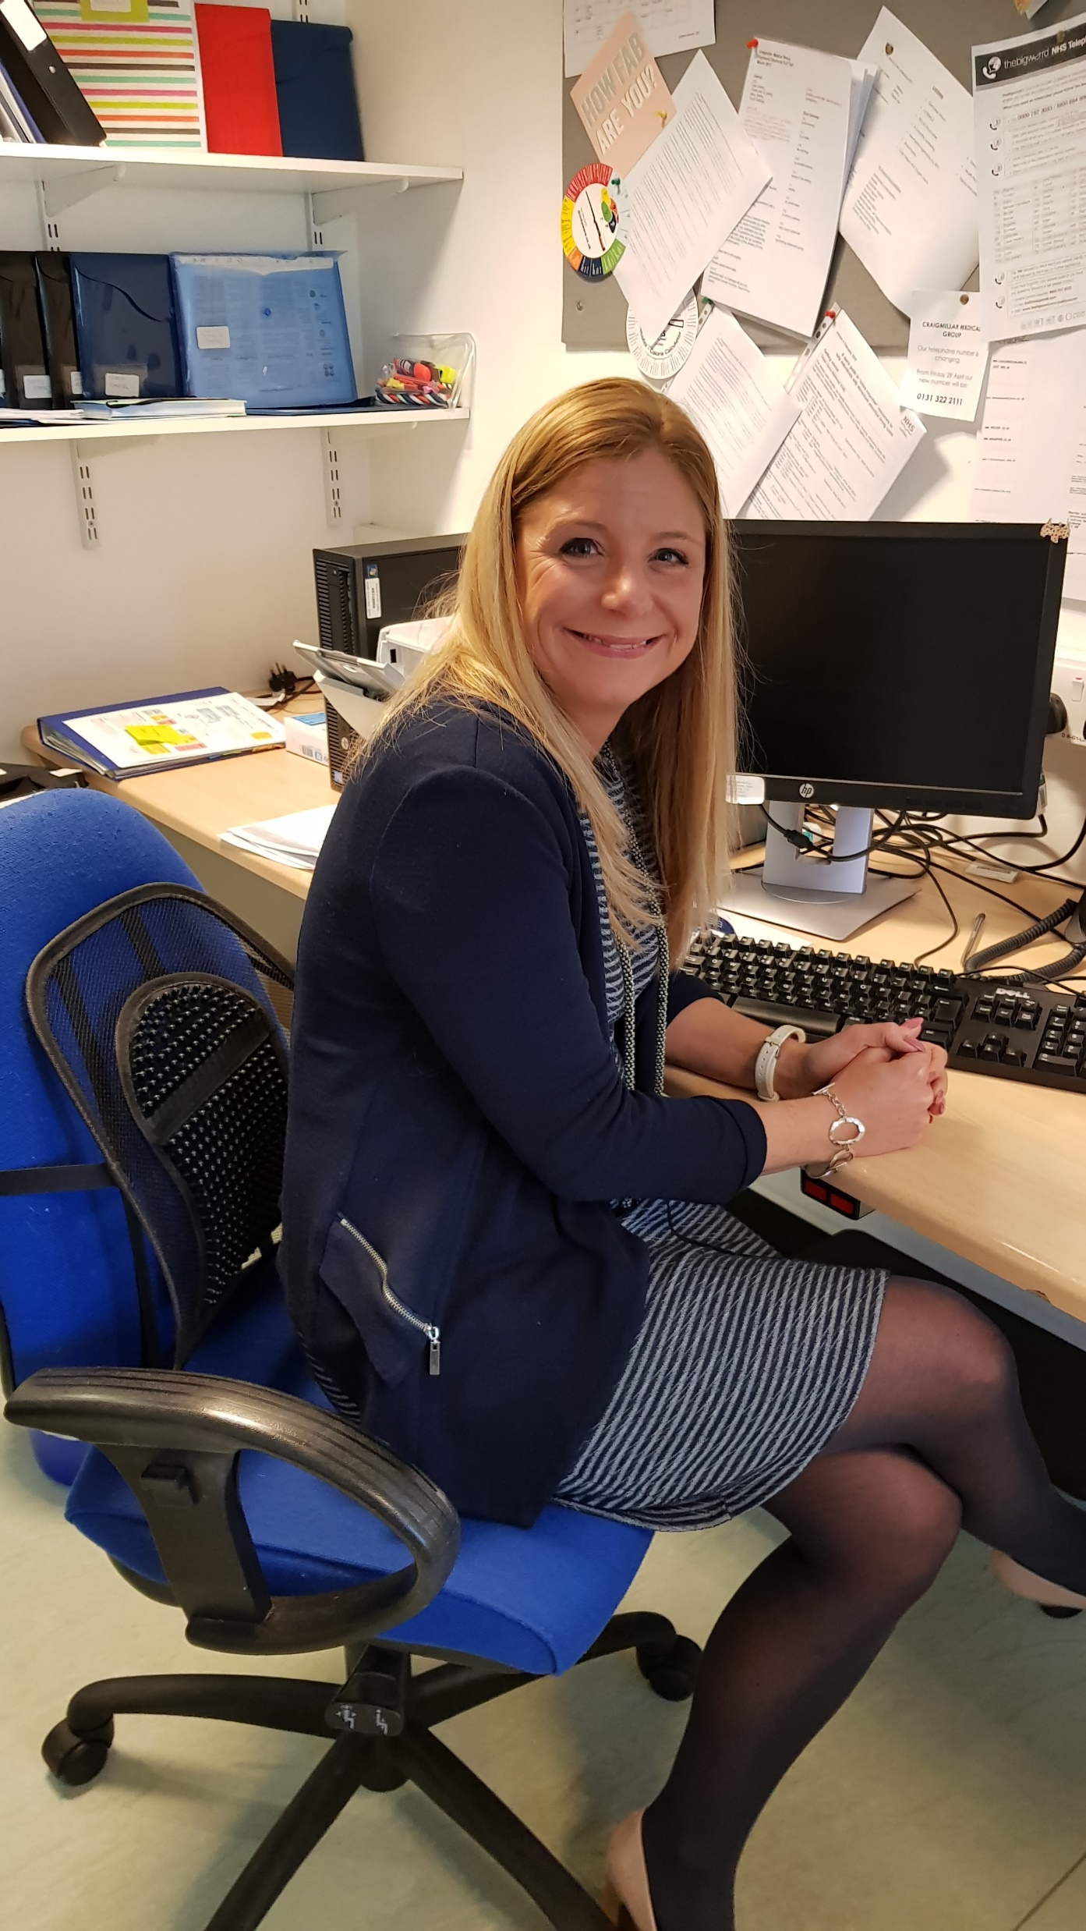
Mental Health and Addiction nurses
>30% of GP consults in ‘normal’ times (more than 8M/yr in Scotland)
Craigmillar: team of 3 practice based MH nurses
MH and addiction work
Ethos: accessibility, inclusivity, continuity.
Practice based evaluation
Work during Covid19?
  Vlogs, outreach.
https://www.craigmillarmedicalgroup.co.uk/mental-wellbeing/
Kat, lead mental health nurse

Slide 21


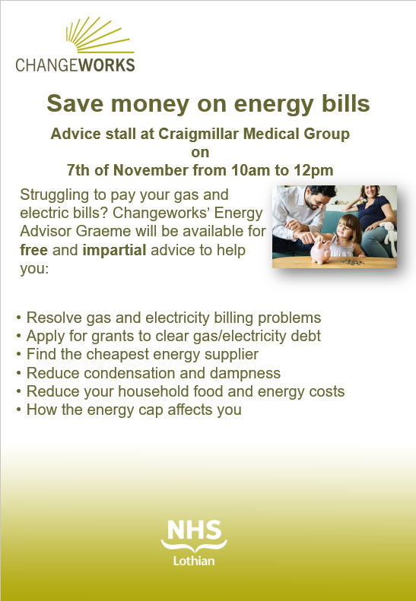
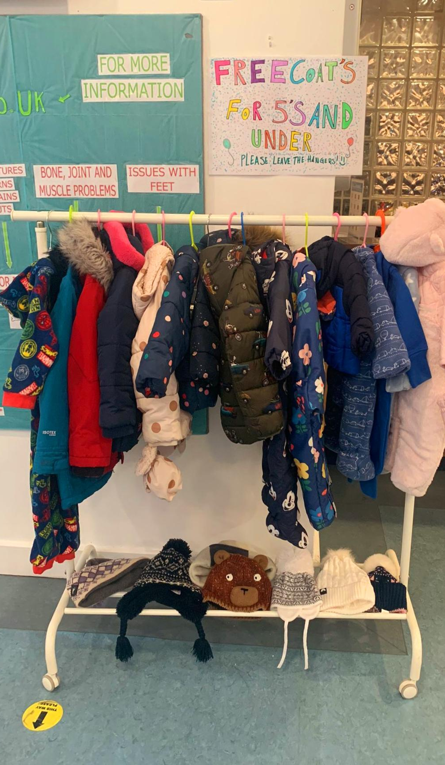
Sharing resources with patients
https://tinyurl.com/56bru3mu

Slide 22

Sharing resources with patients
Sensitive and effecting ‘signposting’
  Increasing awareness - Money Worries Video | Improvement Service or https://youtu.be/ge2XedoG_T8
Practice websites, waiting room screens, posters: easy access, low-stigma
  Cost of living crisis - Cost of Living Support Scotland (campaign.gov.scot)
  Wellbeing and money (PDF Booklet) - WellBeing and Mental Health (cope-scotland.org)

Slide 23
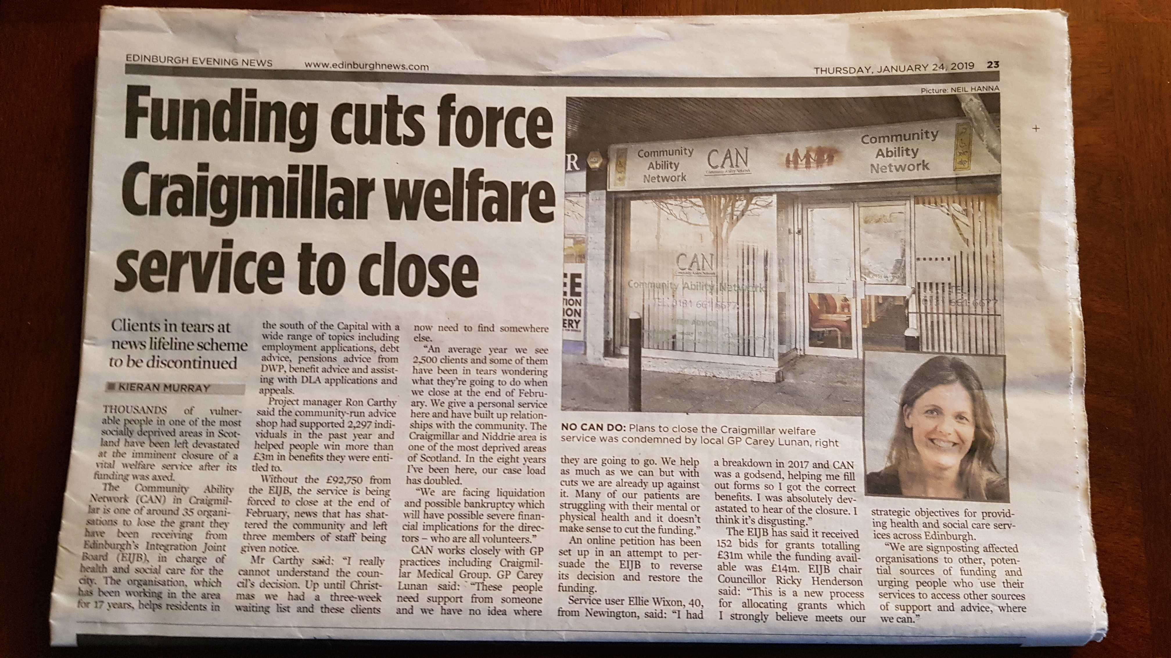

Advocacy, influencing and lobbying
By supporting patients to self-advocate
  (eg petitions in waiting rooms, template letters to MSPs)
On behalf of individual patients and communities
Through community engagement events & PPGs
As individuals, teams, and through our representative organisations
By considering who we vote for!

Slide 24

As professionals, what should we ask ourselves?
What have we learned?
What could we do better?
What are our training needs?
How can we collaborate more?
How do we ensure patient engagement?
What is our ‘collective voice’?
What, or who, are we missing?
How do we build back fairer?
How can we influence?

Slide 25
And what do we need to see from politicians?
Adequate resourcing of health and social care proportionate to need
Sustainable third sector funding
Cross-party approach to health
Meaningful workforce strategy
Reset the balance between generalist and specialist NHS services
Bolster the upstream capacity of community-based services
Commitment to health equity underpinning all recovery policy
Services should be best where they’re needed most – or health inequalities will worsen

Slide 26
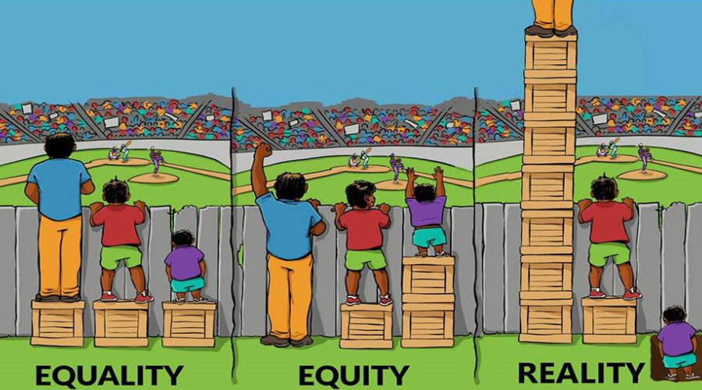
To avoid widening inequalities in health, the NHS must be at its best where it is needed the most.

