Slide 1
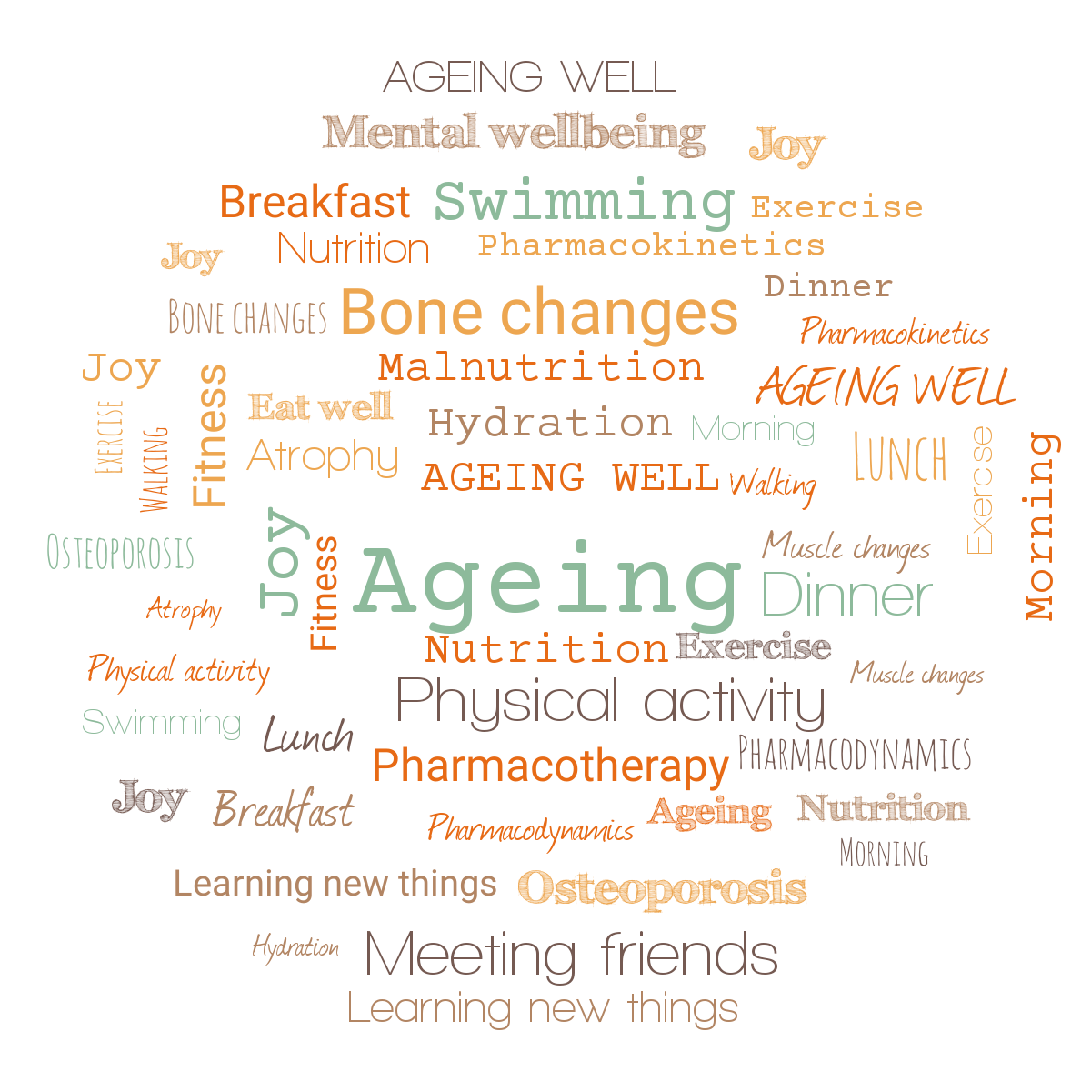


Ageing Well Series
Talk 3. Nutritional needs of ageing
Dr Jitka Vseteckova , Senior Lecturer health and Social Care, PhD, D.Prof, SFHEA,
Faculty WELS
The Open University

Slide 2
Today’s talk – in partnership with Voluntary Health Scotland
The world population is rapidly ageing & we are all ageing since the day we are born.
Physical and psychological/cognitive decline that happens at different speeds for different individuals.
Ageing processes are in general very difficult to predict.
Genetic predispositions we may need to take into account regarding the overall ageing the process is also co-defined by what we actually do about it.
USE IT OR LOSE IT - in other words, both cognitive and physical stimulation while ageing, help to preserve cognitive and physical functions we don’t want to lose. Especially during COVID-19 times.
The Five Pillars of Ageing Well

Slide 3
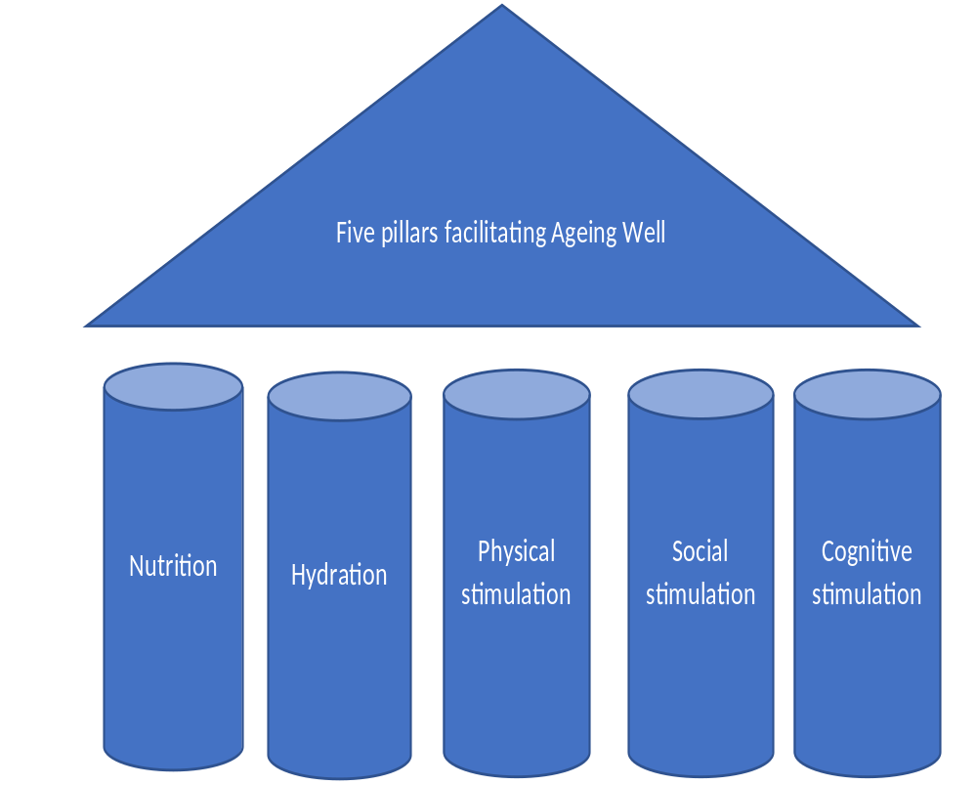

Slide 4
1. Are we prepared to live longer? (basic biomedical and psycho-social aspects of ageing, age-related conditions e.g. bone health, frailty etc. and overview of the next talks)
2. Ageing brain (basic facts on neurodegenerative conditions associated with ageing and age-related and non age-related memory loss)
3. Nutritional needs of ageing (What nutrients we tend to lose while ageing and what nutrients and diet/eating habits we should keep an eye on)
4. Pharmacotherapy while ageing (age-related changes in pharmacokinetics and pharmacodynamics – how the drugs behave in our body while ageing)
5. Move it and breathe (more detailed journey into age-related changes in muscles, tendons, bones and the importance of breathing well, exercising well and enough)
6. Standing tall (more detailed journey into age-related postural alignment changes affecting postural stability and balance, and ways to compensate for 'gravity of ageing')

Slide 5
All the way through the ‘Ageing Well’ talks we explore how using this knowledge might facilitate self-management, become partners in our care and delay the ageing processes for as much as we can.
The emphasis of the ‘Ageing Well’ series is on optimizing cognitive and physical well-being, physiological ageing and self-management. To a lesser extent, on pathological processes while ageing.
Promoting physical activity, social activity, networking, learning and healthy lifestyle
Building bridges

Slide 6
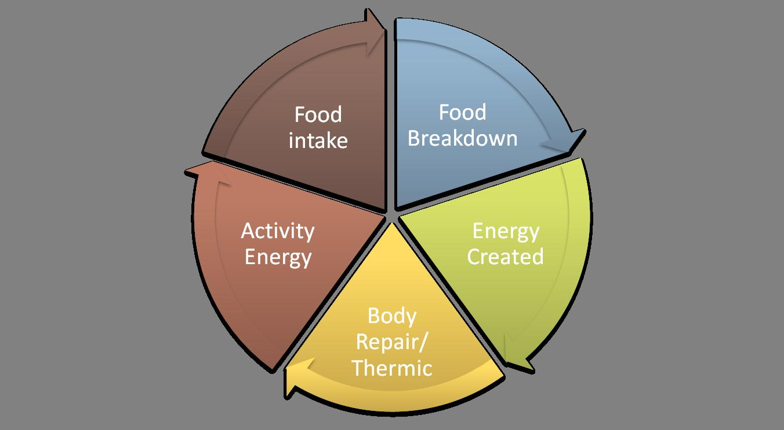
Why do we need food?

Slide 7
Metabolism & Nutrition & Energy
Metabolism is a term that is used to describe all chemical reactions involved in maintaining the living state of the cells and the organism.
Metabolism is closely linked to nutrition and the availability of nutrients.
Metabolism can also refer to the sum of all chemical reactions that occur in living organisms, including digestion and the transport of substances into and between different cells and tissues. https://en.wikipedia.org/wiki/Metabolism

Slide 8
Nutrition & Hydration & Physical activity are the key to good functioning metabolism.
Food provides a variety of substances that are essential for the building, upkeep, and repair of body tissues, and for the efficient functioning of the body.
Measure / variety
The major elements are supplied in carbohydrates, lipids/ fat, and protein. In addition, vitamins, minerals and water are necessary.

Slide 9
Carbohydrates
Foods supply carbohydrates in three forms: starch, sugar, and cellulose (fibres). Starches and sugars form major and essential sources of energy for humans.
Body tissues & brain (2% or body weight - 20%) depend on glucose for all activities. Carbohydrates and sugars yield glucose by digestion or metabolism.
Not enough – headaches, weakness, feeling sick, dizziness and irritability
Too much – high blood sugar levels, more insulin needed, we save more as fat, increased thirst, headaches & tiredness, brain functional connectivity, memory loss, impaired learning, concentration, linking to diabetes – depression, anxiety, cognitive dysfunction
Most people consume around half of their diet as carbohydrates. This comes from rice, wheat, bread, potatoes, pasta etc. NHS suggests between 30-50% wholegrains, potatoes, vegetables, fruits etc. https://www.nhs.uk/live-well/eat-well/

Slide 10
Proteins
Proteins are the main tissue builders in the body. They are part of every cell in the body. Proteins help in cell structure, functions, haemoglobin formation to carry oxygen, enzymes to carry out vital reactions.
Foods with the best quality protein are eggs, nuts, milk, soybeans, meats, vegetables, mushrooms and grains.
https://www.nhs.uk/live-well/eat-well/

Slide 11
Fat
Fats are concentrated sources of energy. They produce twice as much energy as either carbohydrates or protein on a weight basis. Fatty acids – body cannot produce itself, helps absorb vitamins (A, D, E, K)
Further functions of fats include:
helping to form the cellular structure; build and repair cell membranes (skin, hair, eyes & brain)
forming a protective cushion and insulation around vital organs;
providing a reserve storage for energy
Too much (in bloodstream) - high cholesterol, fatigue, shortness of breath, chest pain,
Not enough – worsened body temperature regulation, very little padding and protection for our organs, dry hair/hair loss, inability to concentrate, mental fatigue, constant fatigue
https://www.nhs.uk/live-well/eat-well/different-fats-nutrition/

Slide 12
Minerals & Vitamins
The minerals in foods do not contribute directly to energy needs but are important as body regulators and play a role in metabolic pathways of the body. More than 50 elements are found in the human body. About 25 elements have been found to be essential, since a deficiency produces specific deficiency symptoms.
calcium
phosphorus
iron
sodium
potassium
chloride ions
Copper, cobalt, manganese
zinc
magnesium
fluorine
iodine
Vitamins are essential organic compounds that the human body cannot synthesize by itself and must therefore, be present in the diet. Vitamins particularly important in metabolism include:
Vitamin A
Vitamins B B2 (riboflavin)
Niacin or nicotinic acid
Pantothenic Acid etc.

Slide 13
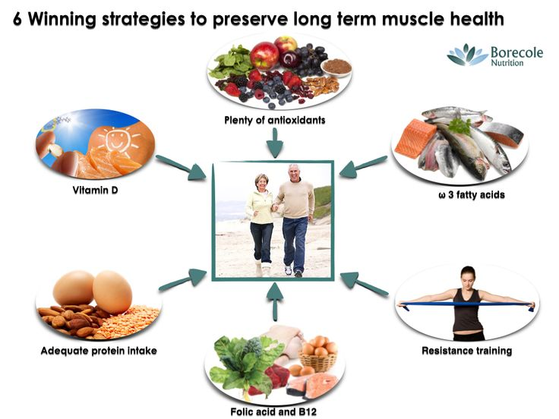

Slide 14
British Nutrition Foundation
Eat an enjoyable and varied diet
Watch your weight and waist size
Eat plenty of fruit and veg
May wish to opt for healthier fats
Include oily fish in your diet
Get enough fibre
Reduce your salt intake
Eat calcium-rich foods
Boost B vitamins
Keep well hydrated
Discuss taking vitamin D supplement if you are over 65 with your GP
Remember supplements and functional foods don’t replace a healthy diet
Be physically active
Go easy on alcohol
Look after your teeth
Don’t smoke
Get enough sleep
Keep your brain stimulated
https://www.nutrition.org.uk/healthyliving/healthyageing.html

Slide 15
Enjoyable and varied diet
Our sense of taste and smell can change as we age, which can affect our appetite and how much we like food.
Dental problems and ill fitting dentures
Less interested in food
Less hungry
Forgetfulness
Good & REGULAR nutrition - PRIORITY (will hep body work round the clock)
Make food time a social time, make foods as tempting and tasty as possible so that eating stays enjoyable.
Keep meals from becoming bland and uninteresting by varying colours and textures as much as possible. CAREFUL WITH SALT
Try adding herbs and spices such as mint, rosemary, cinnamon or paprika.
Certain medicines, smoking and alcohol may affect the way the body absorbs nutrients.

Slide 16
Excess weight and waist circumference
Our body composition changes and we tend to lose muscle and gain fat.
Many people also become less physically active as they age
As we get older our energy needs can decrease so it can be easier to gain weight
Hormonal changes as we get older also mean we become more likely to lay fat around the middle
This is because obese people who carry too much weight around their middle have a greater risk of developing heart disease, high blood pressure, some types of cancer (colorectal, PM breast, uterine, ovarial, oesophageal, gall bladder, kidney, pancreatic) and type 2 diabetes

Slide 17
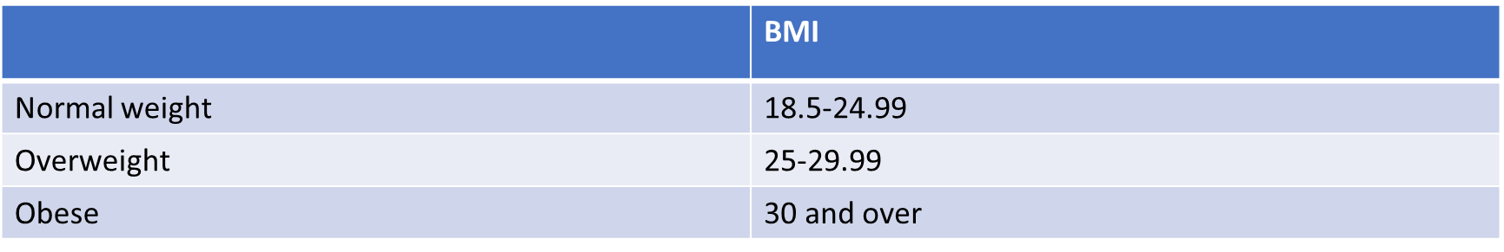
Weight is usually converted to Body Mass Index or BMI (weight (kg)/height (m2)). The standard World Health Organisation classifications for BMI:

Slide 18
Our BMI is a good starting point but we should also measure our waist.
People who carry too much weight around their middle have a greater risk of developing heart disease, high blood pressure, cancer and type 2 diabetes.
 | Your health is at risk if you have a waist size of: | Your health is at high risk if you have a waist size of:
Men | Over 94cm (about 37 inches) | Over 102cm (about 40 inches)
Women | Over 80cm (about 31.5 inches) | Over 88cm (about 34.5 inches)
Asian men |  | Over 90cm (about 35.5 inches)
Asian women |  | Over 80cm (about 31.5 inches
https://www.nutrition.org.uk/healthyliving/healthyageing/top-tips-for-healthy-ageing?start=2

Slide 19
Diabetes
Type 1 https://www.diabetes.org.uk/type-1-diabetes
Type 2 https://www.diabetes.org.uk/diabetes-the-basics/what-is-type-2-diabetes
One of the most undiagnosed conditions of our times.
One that causes massive complications if untreated/un-compensated
Main symptoms:
Going to the toilet a lot, especially at night, being really thirsty
Feeling more tired than usual
Losing weight without trying to
Genital itching or thrush
Cuts and wounds take longer to heal
Blurred vision

Slide 20
Diabetes Type 1
Type 1 diabetes is a serious, lifelong condition where the blood glucose level is too high because our body can't make a hormone called insulin.
About 8% (in the UK)
Insulin allows the glucose in our blood to enter our cells and fuel our bodies.
Our body still breaks down the carbohydrate from food and drink and turns it into glucose (sugar). But when the glucose enters our bloodstream, there's no insulin to allow it into the body's cells. More and more glucose then builds up in the bloodstream. Long-term: high glucose levels in the blood can seriously damage heart, eyes, feet, kidneys…
Our body tries to get rid of the glucose through our kidneys, and that makes us wee a lot – one of the main symptoms
Management: injecting insulin/using a pump; checking blood sugar levels; keeping a careful eye on FOOD & EXERCISE; if untreated severe complications (coma, death)

Slide 21
Diabetes Type 2
The vast majority of people with diabetes have type 2
Severely undiagnosed in the population
Starts usually with impaired glucose tolerance (the body’s response to glucose in the blood stream is impaired – less and less insulin created/injected into the system when needed) causing raising glucose levels in the bloodstream
Management: with the right treatment and care, the effects of diabetes and high blood sugar levels can potentially be reversed and certainly managed
healthier eating; EXERCISE; medication (serious side effects – especially if we are not hydrating well, we don’t exercise and don’t adjust eating habits and further exhausts kidneys and liver)

Slide 22
Living with diabetes
Would anyone like to share their own experience?

Slide 23
Salt
While some sodium in the diet is necessary for health, it can raise blood pressure (raised blood pressure is a major risk factor for stroke and heart disease). Salt (sodium chloride) is the main source of sodium in our diet.
Adults should not have more than 6g of salt per day. The food industry are reducing the amount of salt in many foods but a lot of the salt we eat is found in processed foods and it is important to look at the labels to select lower salt options.
A decreasing sense of taste as we age can encourage us to add more salt to meals for flavour.
Watch the amount we add at the table and use herbs, spices and a variety of different foods to flavour meals instead of adding salt.

Slide 24
Fibre
Eating plenty of fibre-rich foods, such as wholegrain breads, wholegrain breakfast cereals, brown rice, wholemeal pasta and some vegetables, fruit and pulses, will improve digestive health and can help to protect against heart disease, diabetes and some cancers.
High fibre foods helps us to stay fuller for longer so can be useful if we are watching our weight. But if you have a poor appetite, eat fibre rich foods in moderation as filling up on bulky foods may prevent you from getting all the nutrients you need. It is also very important to drink enough water when eating a diet high in fibre.

Slide 25
Calcium
Calcium is important for the development and maintenance of bones. We lose bone mass as we age, so it is important that we consume plenty of calcium. Less calcium - higher risk of osteoporosis (thinning of the bones) and reduced bone density.
As a result, it is particularly important that as we grow older especially as women we get plenty of calcium in the diet to minimise bone loss. Milk, cheese and yogurt are rich in calcium, but other sources include fish with edible bones (e.g. salmon, sardines), some green leafy vegetables like kale, calcium fortified soy products (e.g. soya drink, tofu), white bread and fortified breakfast cereals.
We should be able to get all the calcium we need from our diet, but if we do take calcium supplements, be careful not to take too much.
Calcium & Vitamin D

Slide 26
B vitamins
B vitamins have a range of important functions in the body, including contributing to healthy red blood cells, metabolism, nerve function, healthy skin, vision and reducing tiredness.
Sources of B vitamins in the diet:
Folate/Folic acid: some green vegetables, and fortified grains and grain products
Vitamin B6: fortified cereals, peanuts, pork, poultry, fish, milk and vegetables
Vitamin B12: animal products (such as fish, meat, eggs, or dairy); fortified breakfast cereals and other fortified foods such as soya drink.
Vitamin B12 protects neurons and is vital to healthy brain functioning. In fact, a lack of B12 can cause permanent damage to the brain and create memory problems. Older people have a slower nutritional absorption rate, which can make it difficult for you to get the B12 your mind and body need. If you smoke or drink, you may be at particular risk.

Slide 27
D vitamin
Department of Health recommends certain supplements for some groups of people who are at risk of deficiency. People aged 65 years and over and people not exposed to much sun should also take a daily supplement containing 10 micrograms (0.01mg) of vitamin D.
Vitamin D plays an important role in bone health (it is needed by the body to absorb calcium) and muscle function.
Low levels of vitamin D can increase the risk of falls followed by fractures.
Most of the vitamin D that your body needs is made in the skin from sunlight but our skin becomes less efficient in producing vitamin D from the sun as we age (fewer receptors in our skin) and our exposure to sunlight often declines, particularly for those who are less mobile.
People with darker skin are at higher risk of deficiencies than those with whiter skin.
Some vitamin D can also be obtained from dietary sources such as oily fish and eggs and fortified breakfast cereals, fortified fat spreads and fortified dairy products.

Slide 28
Alcohol
Alcoholic drinks can be enjoyed and are unlikely to be harmful for most people within the limits (max 14 units per week).
But very little research has been done, and there are some particular problems for the older person. For example, health problems in older age can make us more susceptible to alcohol and can interfere with the effectiveness of many medicines. Check with your doctor about whether it is safe for you to drink with your particular health problem or medication.
Hidden dehydration
Damage to brain cells with excessive drinking

Slide 29
Drinking too much can damage many parts of the body and increase the risk of health problems including: Stomach lining – ulcers or bleeding; Liver – cirrhosis; Cancer – mouth
Malnutrition - alcohol has calories but can not provide the essential nutrients a balanced varied diet provides to keep us healthy.
Excessive alcohol intake can also affect mental health including increasing anxiety, depression, confusion.
Excessive alcohol intake is toxic to brain cells, and alcohol abuse leads to memory loss. Over time, alcohol abuse may also increase the risk of dementia.

Slide 30
Sleep
Have increased levels of a hunger hormone called ghrelin and decreased levels of the satiety/fullness hormone called leptin, which could lead to overeating and weight gain
When we are sleep deprived we tend to eat more (more junkier food)
Sleep is necessary for memory consolidation, the process of forming and storing new memories so you can retrieve them later. Sleep deprivation reduces the growth of new neurons in the hippocampus and causes problems with memory, concentration, and decision-making. It can even lead to depression—another memory killer.
Sleep deprivation
https://www.nhs.uk/oneyou/every-mind-matters/sleep/?WT.tsrc=Search&WT.mc_id=Sleep&gclid=EAIaIQobChMIhI_Q1Iak5wIVQuDtCh3zhg4LEAAYASAAEgLuAvD_BwE

Slide 31
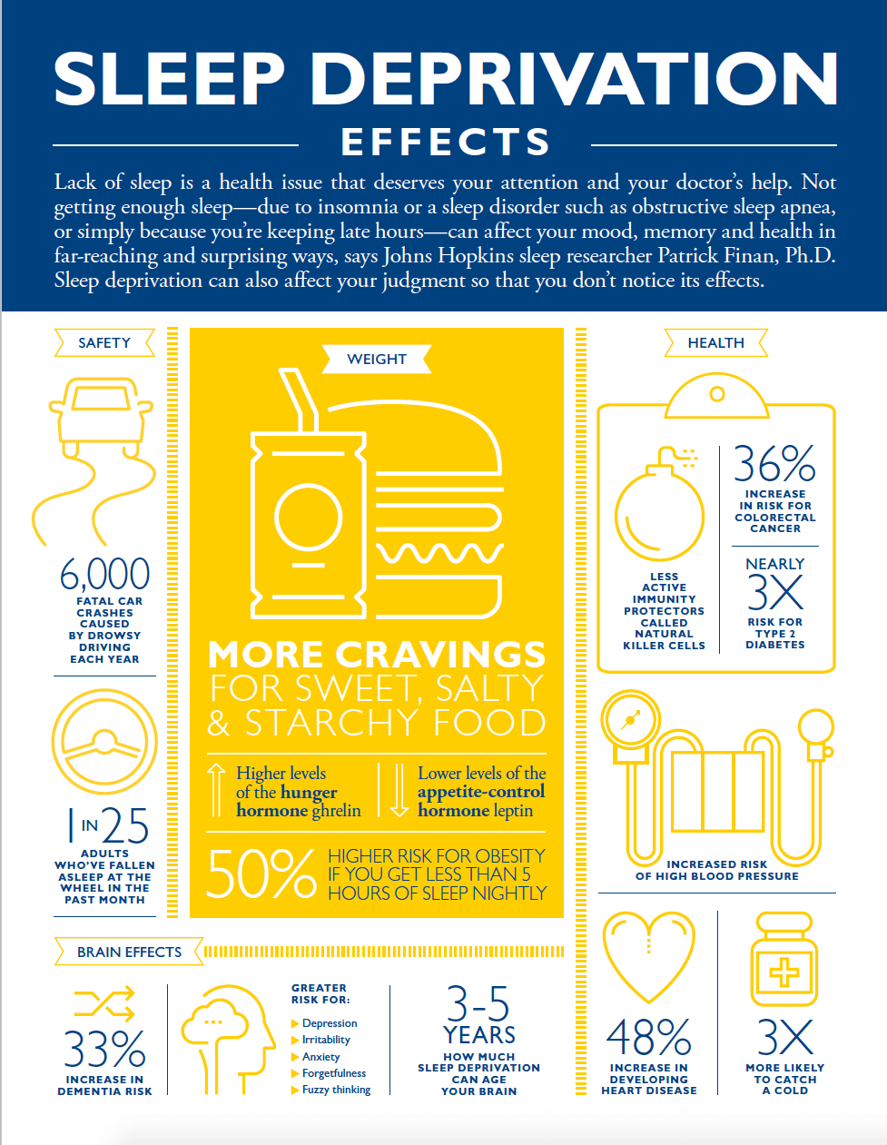
Memory issues
Thinking & concentration
Mood changes
Accidents
Weakened immunity
Higher blood pressure
Weight gain & risk for diabetes
Heart disease
Poor sexual drive
Worsened balance
https://www.healthline.com/health/sleep-deprivation

Slide 32
Thyroid problems
The thyroid gland controls metabolism: if our metabolism is too fast, we may feel confused, dizzy, and if it’s too slow, we can feel sluggish and depressed. In both cases it would affect our appetite.
Thyroid problems can cause memory problems such as forgetfulness (we may forget to eat and drink) and difficulty concentrating.
Hormonal supplements can reverse the symptoms.

Slide 33
Dehydration
Ageing produces a decrease in our thirst sensation so it is easy for dehydration to go unnoticed. So as we age, it is especially important to drink plenty of water and other non-alcoholic beverages.
Early signs of dehydration include dizziness, tiredness, headaches, drowsiness, memory loss, and other symptoms that look like dementia. Long-term mild dehydration increases the risk of kidney stones, constipation and cholesterol problems, as well as diminished physical and mental performance.
It’s important to stay hydrated (aim for 6-8 drinks per day, strict minimum 1.5 l / day). Be particularly vigilant if we take diuretics or laxatives or suffer from diabetes, high blood sugar, or diarrhoea.

Slide 34
Side effects of medication
Many prescribed and over-the-counter drugs or combinations of drugs can make us lose our appetite, cause cognitive problems and memory loss as a side effect especially if we don’t keep well hydrated.
This is especially common in older adults because breaking down and absorbing medication is slower. Common medications that affect memory and brain function include sleeping pills, antihistamines, blood pressure and arthritis medication, muscle relaxants, anticholinergic drugs for urinary incontinence and gastrointestinal discomfort, antidepressants, anti-anxiety meds, and painkillers.

Slide 35
Socialising
It is important to keep socially active – socialising over a meal is a great opportunity to enjoy our meal in a stimulating company
People who aren’t socially engaged are at higher risk for memory problems than people who have strong social ties.
Quality face-to-face social interaction can greatly reduce stress and is powerful medicine for the brain, so schedule time with friends, join a book club, or visit the local senior centre.

Slide 36
Exercising regularly
Increase life expectancy
Help protect against heart disease, stroke, diabetes, some cancers, depression and dementia
Helps us to maintain a good appetite and might help with getting better sleep
Helps us to keep mobile
Reduces bone loss and strengthen muscle – reducing the risk of falls causing fracturing bones
Improves our mood and sense of well-being.
Help with joint stiffness and pain associated with arthritis

Slide 37
The recommendation for older people is the same as for younger adults – at least 150 minutes of moderate activity a week in bouts of 10 minutes or more. One way to achieve this is to do 30 minutes of activity 5 days a week. https://www.who.int/dietphysicalactivity/factsheet_adults/en/
Starting a regular exercise routine, including cardio and strength training, may reduce your risk of developing dementia by up to 50 percent. What’s more, exercise can also slow further deterioration in those who have already started to develop cognitive problems. Exercise protects against Alzheimer’s by stimulating the brain’s ability to maintain old connections as well as make new ones.

Slide 38
No to Smoking
Smoking heightens the risk of vascular disorders that can cause stroke and constrict arteries that deliver oxygen to the brain.
Smoking can supress our appetite and make the food seem tasteless
Smoking speeds up the biological ageing process, increasing the risk of cancer, heart disease, diabetes, osteoporosis, cataracts and other age-related diseases. It also causes premature skin ageing and increases risk of eye damage and poor gum health. Stopping smoking improves health at any age.

Slide 39
Managing stress
Cortisol, the stress hormone, damages the brain over time and can lead to memory problems. But even before that happens, stress or anxiety can cause memory difficulties in the moment. When we’re stressed out or anxious, we’re more likely to suffer memory lapses and have trouble sleeping, learning or concentrating.
When stressed we may find it difficult to sit down and enjoy food, when we eat you may just snack - not nutritious & healthy enough

Slide 40
Things to remember
If you do decide to take supplements, it’s important to remember that supplements will not replace a balanced diet!
Supplements have to be taken with caution and our GP and Pharmacists should know we are taking them, which ones and how often.
For example according to some research, having more than an average of 1.5 - 2mg a day of vitamin A over many years may affect your bones, making them more likely to fracture. As a precaution, it may be advisable for people at increased risk of osteoporosis, such as postmenopausal women and older people, not to consume vitamin A at intakes greater than 1.5 - 2mg/day. (supplements containing fish liver oil, liver and its products like pate are particularly high in vitamin A).

Slide 41
Physical activity/exercise cannot be supplemented or substituted by anything.
New research indicates that walking six to nine miles every week can prevent brain shrinkage and memory loss. According to the American Academy of Neurology, older adults who walked between six and nine miles per week had more grey matter in their brains nine years after the start of the study than people who didn't walk as much. https://www.helpguide.org/articles/alzheimers-dementia-aging/age-related-memory-loss.htm
When it comes to memory or other function of our body, it’s “use it or lose it.” Just as physical exercise can make and keep your body stronger, physical & mental exercise can make your body & brain work better and lower or slow down the risk of functional decline associated with ageing.

Slide 42
Nutrition roadshows MK
https://www.eventbrite.com/d/united-kingdom--milton-keynes/nutrition/
Diabetes UK
https://www.diabetes.org.uk/
British Heart Foundation
https://www.bhf.org.uk/what-we-do/influencing-change/our-campaign-successes
Health watch
https://www.healthwatch
WHO – World Health Organisation
https://www.who.int/dietphysicalactivity/factsheet_adults/en/.co.uk/

Slide 43
British Nutrition Foundation
https://www.nutrition.org.uk/
NHS Eat Well
https://www.nhs.uk/live-well/eat-well/
Department of Health
https://www.gov.uk/government/organisations/department-of-health-and-social-care
That sugar movement
https://thatsugarmovement.com/high-blood-glucose-and-the-brain/
National cancer institute
https://www.cancer.gov/about-cancer/causes-prevention/risk/obesity/obesity-fact-sheet#how-many-cancer-cases-may-be-due-to-obesity

Slide 44
COVID-19 related
Vseteckova J, How to age well, while self-isolating (2020) https://www.open.edu/openlearn/health-sports-psychology/how-age-well-while-self-isolating
Vseteckova J, (2020) SHORT FILM - Ageing Well in Self-isolation https://youtu.be/LU4pXFgcGos
Vseteckova J, (2020) ANIMATION - Keeping healthy in Self-isolation https://youtu.be/M9yUC-MUugA
Vseteckova J et al (2020) The effects of self-isolation and lack of physical activity on carers https://www.open.edu/openlearn/health-sports-psychology/social-care-social-work/the-effects-self-isolation-and-lack-physical-activity-on-carers
Vseteckova J & King J (2020) COVID-19 Interview podcast for The Retirement Café: ‘Ageing Well Under Lockdown’ https://theretirementcafe.co.uk/077-dr-jitka/

Slide 45
AGEING WELL related
Vseteckova J (2020) Ageing Well Public Talk Series- landing page OpenLearn https://www.open.edu/openlearn/health-sports-psychology/health/the-ageing-well-public-talks
Vseteckova J (2019) 5 reasons why exercising outdoors is great for people who have dementia https://www.open.edu/openlearn/health-sports-psychology/mental-health/5-reasons-why-exercising-outdoors-great-people-who-have-dementia https://doi.org/10.21954/ou.rd.c.4716437.v1
Vseteckova J (2019) Depression, mood and exercise https://www.open.edu/openlearn/health-sports-psychology/mental-health/depression-mood-and-exercise?in_menu=622279 https://doi.org/10.21954/ou.rd.c.4716437.v1
Vseteckova J (2019) Five Pillars for Ageing Well https://www.open.edu/openlearn/health-sports-psychology/mental-health/five-pillars-ageing-well https://doi.org/10.21954/ou.rd.c.4716437.v1
Vseteckova J (2020) Ageing Brain https://www.open.edu/openlearn/health-sports-psychology/health/the-ageing-brain-use-it-or-lose-it

Slide 46
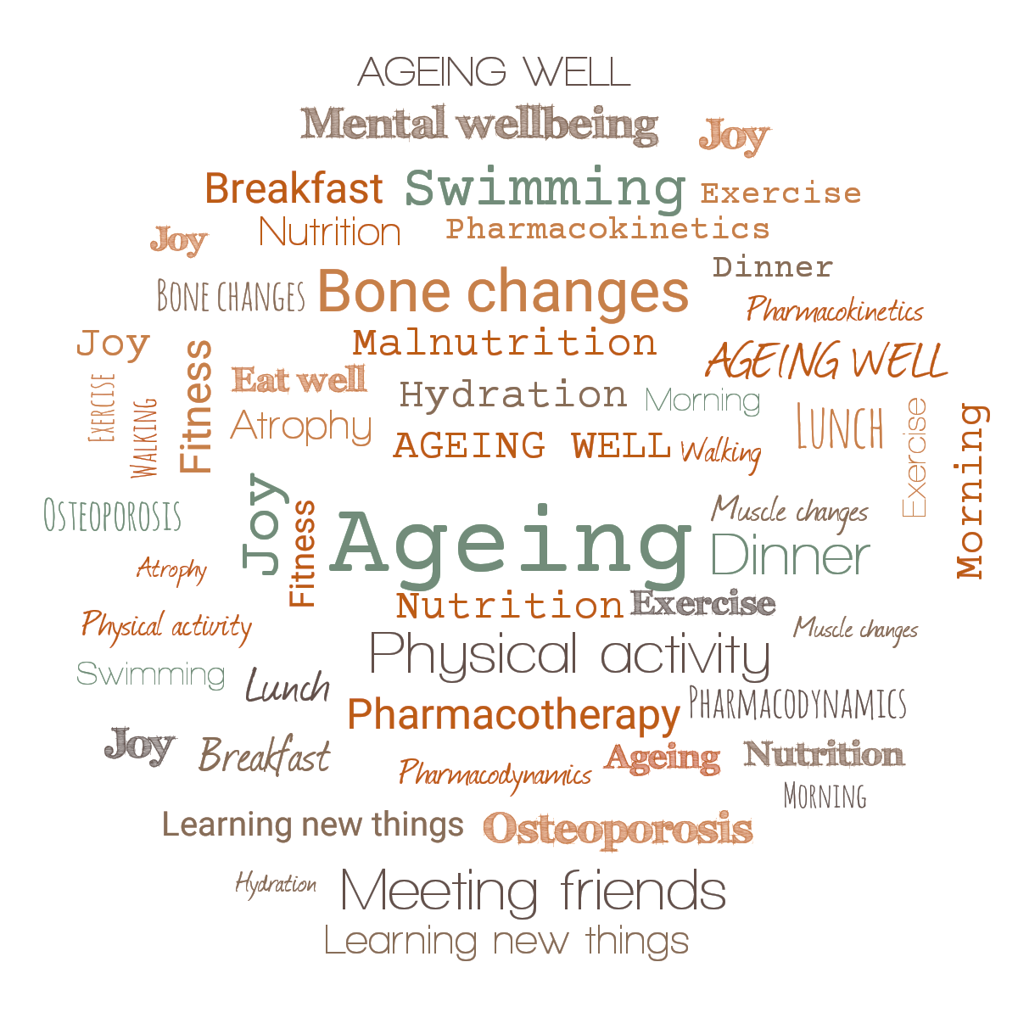

Ageing Well series of Public Talks
“Being mindful of eating well, hydration, physical activity, learning new things and social connections can delay the decline caused by ageing.
Come and join us for the series of public talks with the title ”Ageing Well”
Dr. Jitka Vseteckova
Senior Lecturer, Health and Social Care
Venue: Berrill Lecture Theatre, Walton Hall, Milton Keynes, MK7 6AA, talks held 11AM-1PM

Slide 47
Ageing Well series of Public Talks - topics
Are we prepared to live longer? (Jitka Vseteckova) September 23rd 2020
Advanced care planning (Barbara Gale & Erica Borgstrom) October 21st 2020
Ageing brain (Jitka Vseteckova & Stephanie Warren) November 18th 2020
Learning languages and digital technologies in older age (Ursula Stickler) December 2nd 2020
Care and caring in older age (Mary Larkin) January 20th 2021
Nutritional needs while ageing (Jitka Vseteckova) February 24th 2021
Pharmacotherapy while ageing (Jitka Vseteckova & Sonal Mehta) March 24th 2021
Mindfulness and ageing (Adele Pacini) April 14th 2021
Move it and breathe (Jitka Vseteckova & Declan Ryan) May 19th 2021
Standing tall (Jitka Vseteckova & Jason Gibb) June 16th 2021
The things we don’t talk about – Intimacy and ageing (Andreas Vossler) July 14th 2021
Useful resources:
https://ordo.open.ac.uk/collections/Ageing_Well_Public_Talk/4716437
https://www.open.edu/openlearncreate/course/view.php?id=5016

Slide 48







Thank you for supporting the ‘Ageing Well Public talk’ series

