Slide 1
COVID-19 and Health Inequalities
Diane Stockton
Social and System Recovery Programme Lead

Slide 2
The Bare Statistics

Slide 3
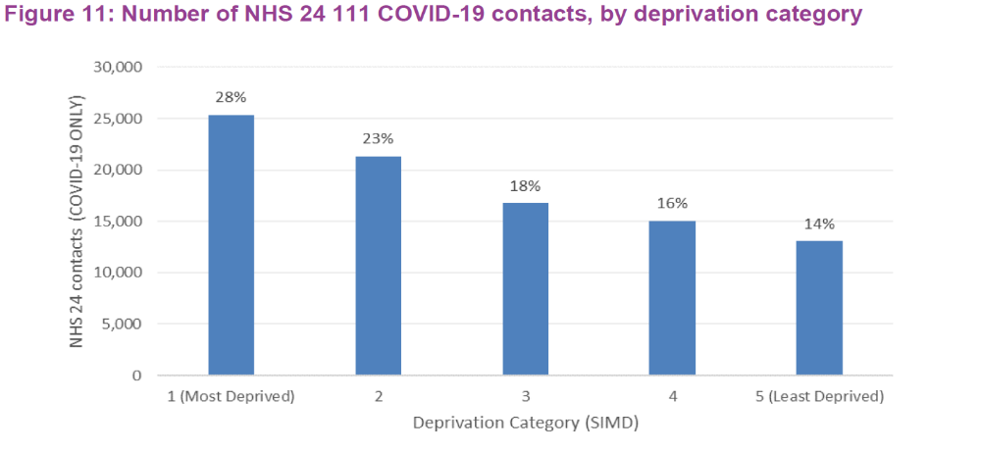
COVID19 and Inequalities (Scotland)

Slide 4
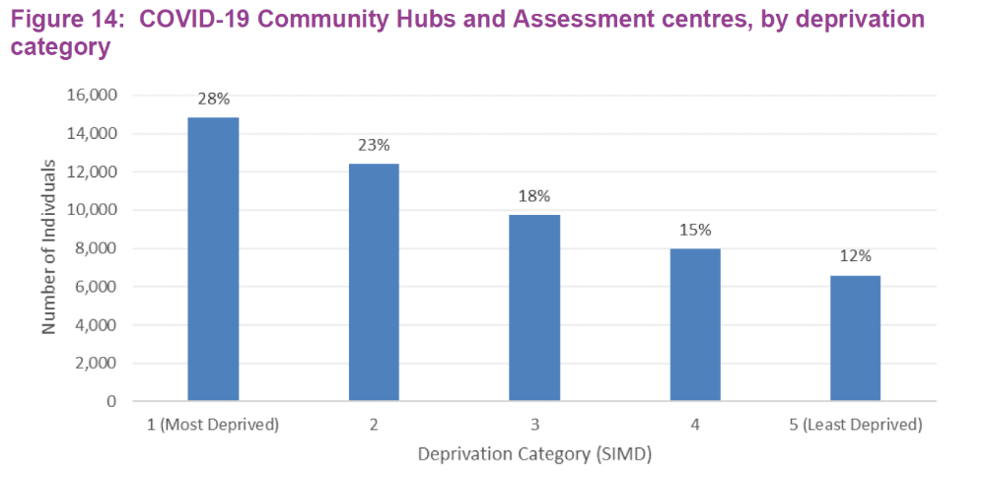
COVID19 and Inequalities (Scotland)

Slide 5
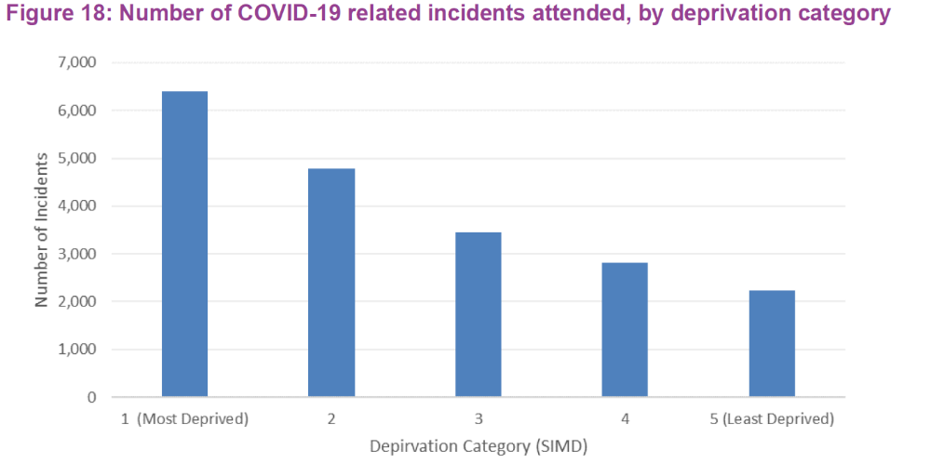
COVID19 and Inequalities (Scotland)

Slide 6
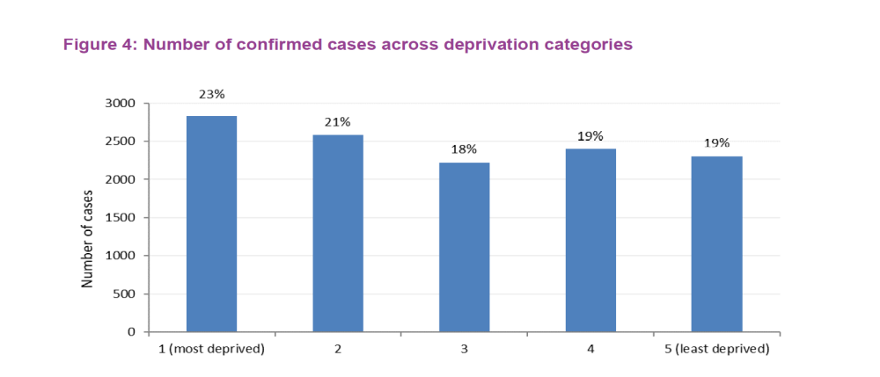
COVID19 and inequalities (Scotland)

Slide 7
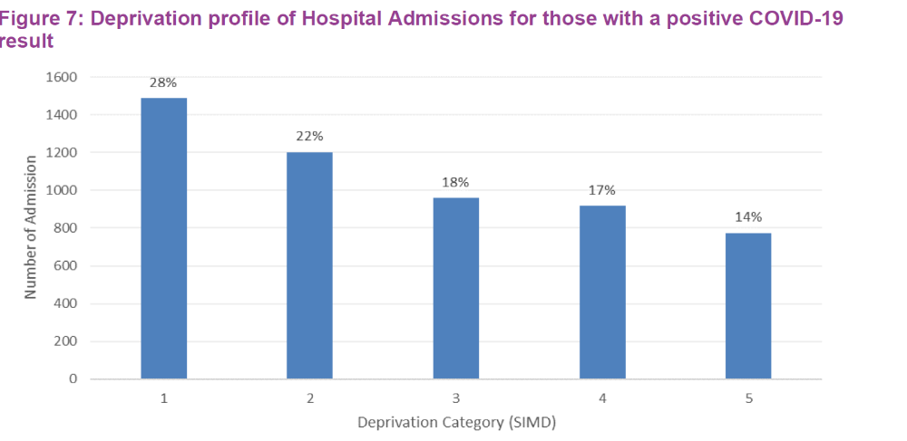
COVID19 and Inequalities (Scotland)
Notes:
Could be due to the workforce element (more of the deprived workforce are key workers) and also due to underlying risk factors varying across deprivation groups.

Slide 8
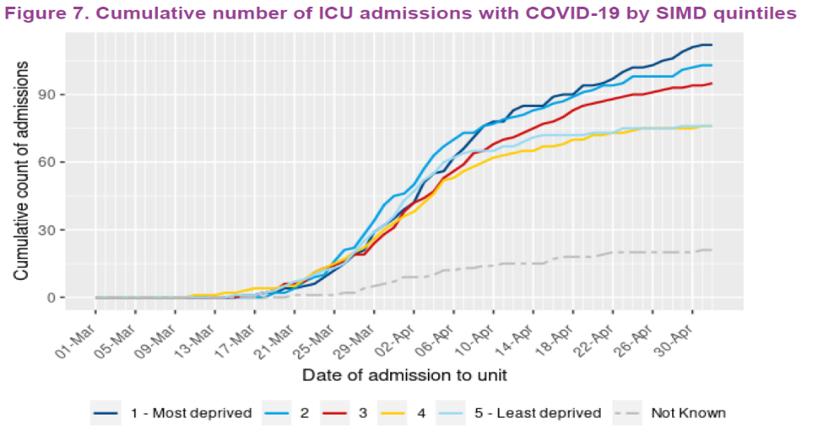
COVID19 and Inequalities (Scotland)

Slide 9
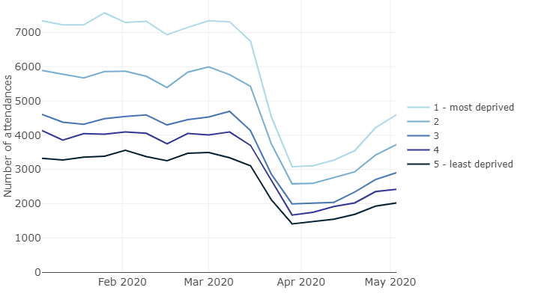
Number of emergency admissions (Scotland)

Slide 10
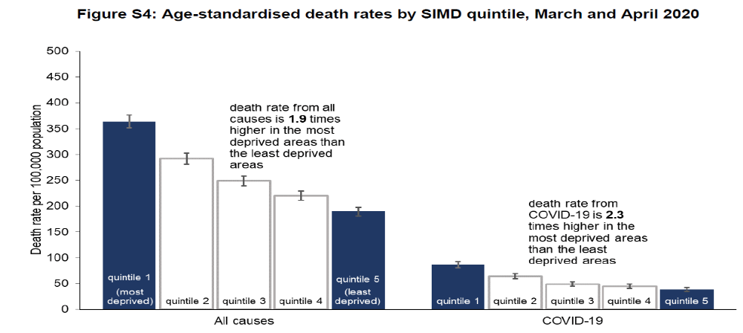
COVID19 and Inequalities (Scotland)

Slide 11
Further work in progress
Race and ethnicity – particularly Black and Asian communities
  Observed differences in England; Scottish data to be published next week
  Socio-economic disadvantage
  Disproportionately from high risk key worker jobs
  More likely to live in densely populated urban areas
  Particularly true in London
Vulnerable groups, including gypsy/travellers, drug users, homeless

Slide 12
Causes for the disparity in COVID
Risk of contracting
Disproportionately more likely to be in key worker jobs, and particularly, high risk key worker jobs
Less likely to be able to work from home (10% vs 50%)
More likely to have to travel on public transport to work
More cramped housing conditions in some cases
Outcomes
We already had significant and persistent inequalities in health outcomes
Pre-COVID there were unsustainable pressures on health and social care services impacting on poor health outcomes
The virus is more acute for those who already suffer poorer health
Notes:
Less than one in ten of the lower half of earners say they have the option to work from home during the lockdown, compared with half of the highest earners

Slide 13
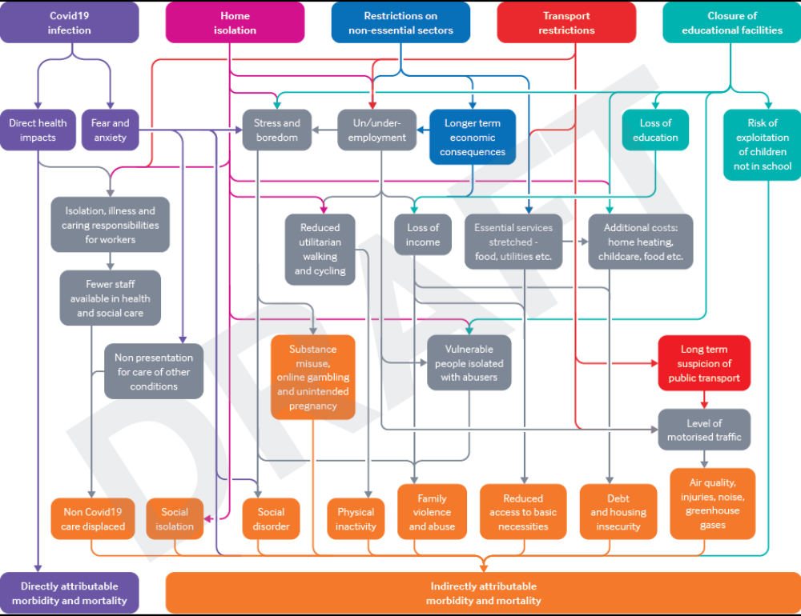
Figure 1 – The mechanisms through which the unintended population health impacts of the Non-Pharmaceutical Interventions (NPIs) may occur

Slide 14
Wider impact of lockdown
Those on low wages are seven times as likely as high earners to have worked in a sector that has been shut down
Increased food insecurity
Increase in poor mental wellbeing - job insecurity, isolation
Increase in domestic violence
Differential impact for those in rented accommodation (the average renter spends a third of their income on housing – compared with 17% of homeowners)
Loss of job opportunities for our 16-25 year olds
Notes:
Health impact assessment

Slide 15
The backdrop to the current challenge
Scotland’s relative poor health and wellbeing
Significant and persistent inequalities in health outcomes
Unsustainable pressures on health and social care services
Notes:
I will firstly describe our three key challenges and what I see as the solutions, then explore the opportunity we have to work together to reduce these challenges – and therefore prevent disease, prolong life and promote health.

Slide 16
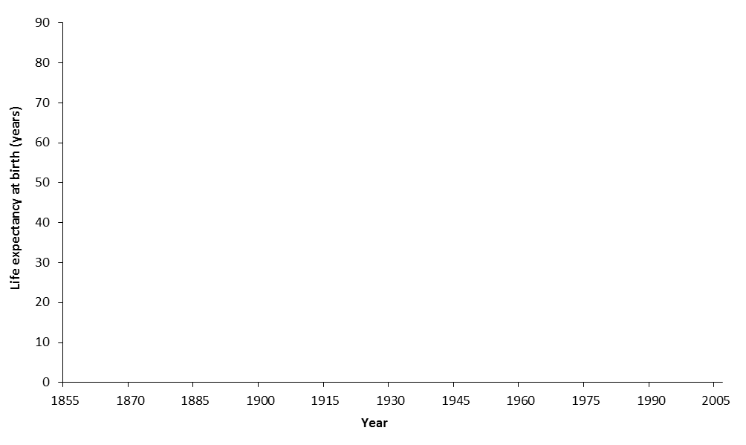
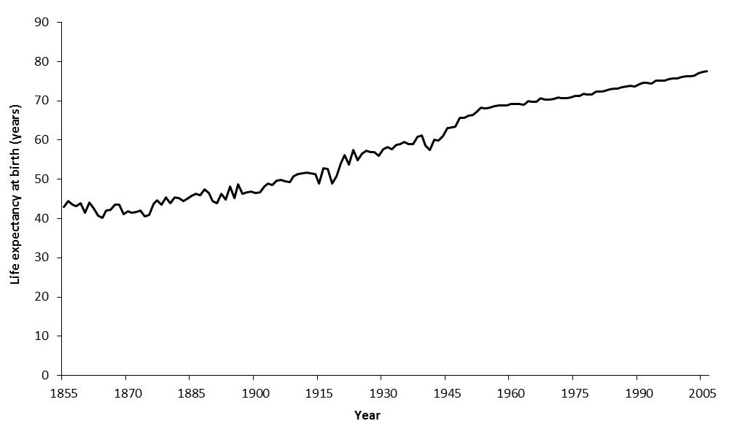
Infectious disease outbreaks, food supplies, wars
WWI and Spanish flu
Continuous improvement
WWII
Life expectancy in Scotland, 1855-2005
Notes:
This graph shows our life expectancy over time, so the average age we expect someone to live to based on when they are born.
This has been steadily increasing ever since WW2. So I, for example, can expect to live to an older age than my parents.

Slide 17
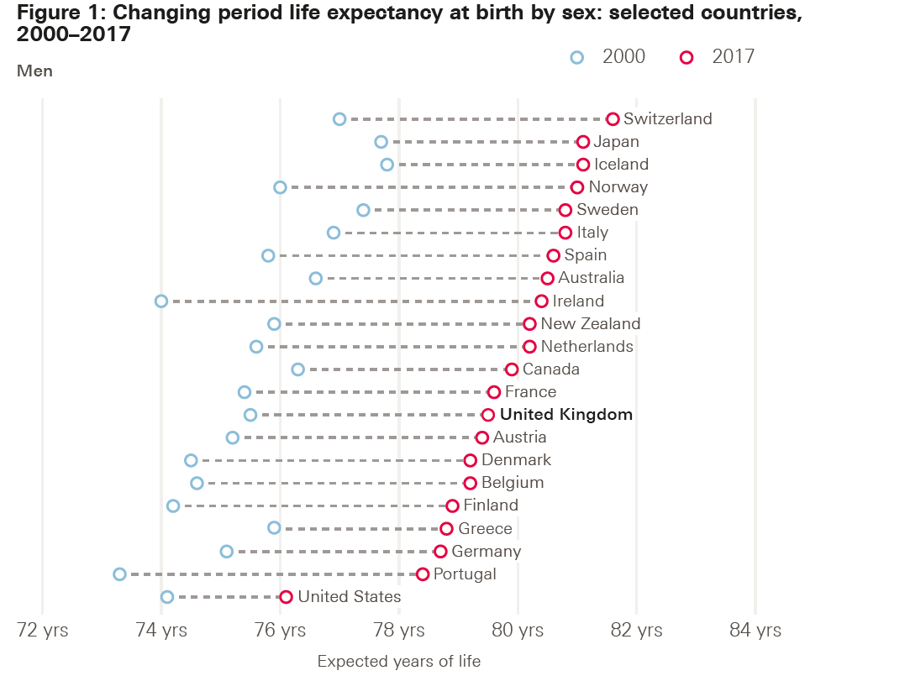
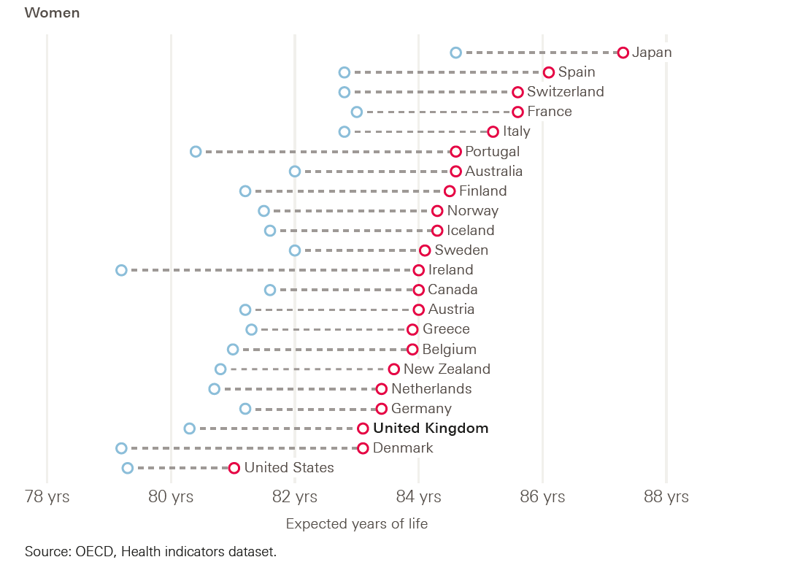
Notes:
Its worth noting, that the UK (and Scotland has the lowest life expectancy in the UK) lags behind many other high income countries, especially for me where our average life expectancy, although improving, is still 4 years lower than Japan which achieves the highest life expectancy.

Slide 18
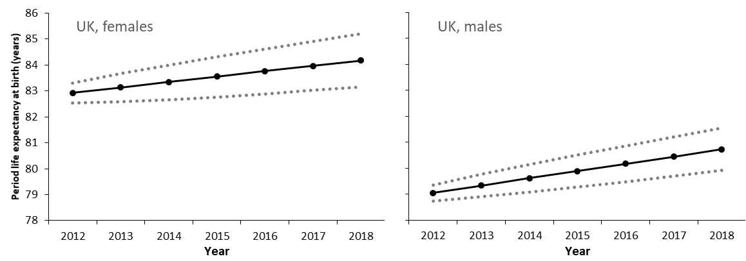
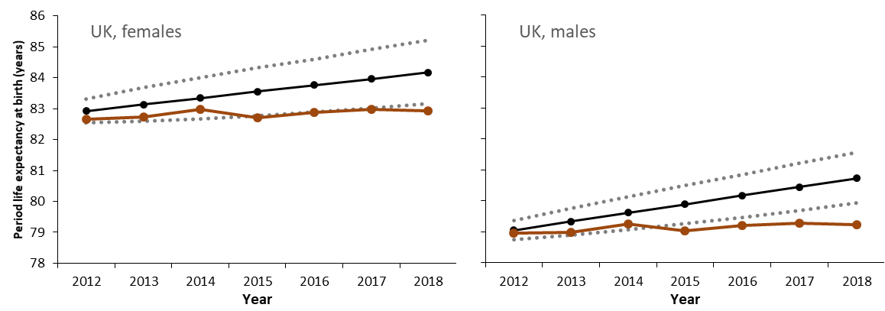
However, life expectancy has worryingly stalled
Notes:
Not because people in old age are dying earlier than previously.
Mortality rates have got worse for almost all age groups and almost all causes of death.
Drug related deaths have been particularly important for adults aged under 50 years
A slowdown in the rate of improvement in cardiovascular disease is the most substantive contributor in the changed trend for those aged 50-85 years (the biggest single cause of death in this age group).

Slide 19
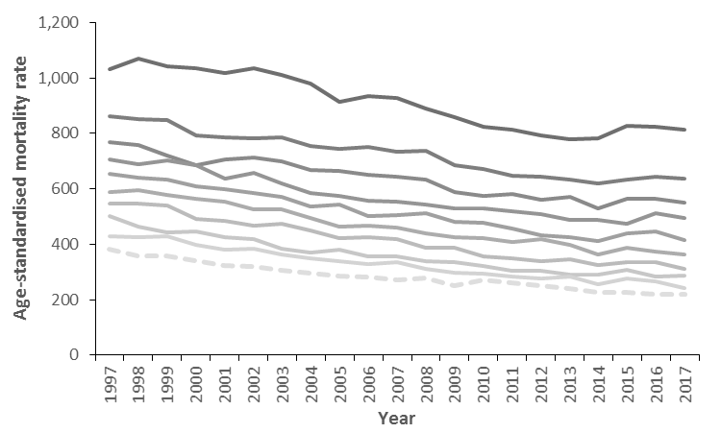
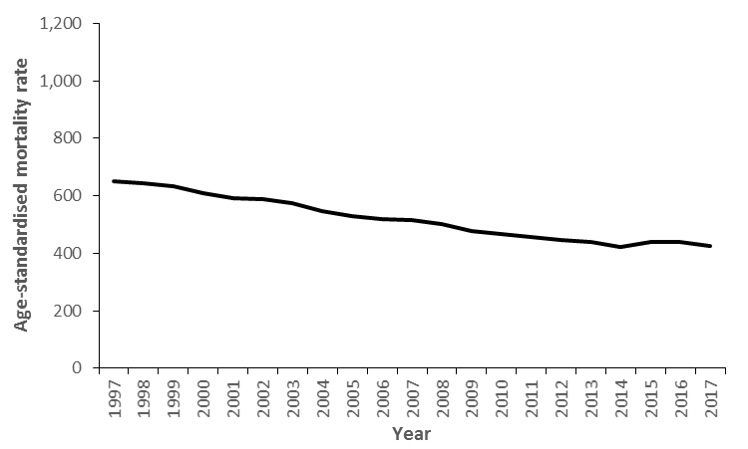
Along with a rise in inequalities : men & women <75 years
Most deprived 10th
Least deprived 10th
Notes:
Even more worryingly – there has been a rapid rise in unjust and avoidable inequalities.
Over 10 years the negative life expectancy contribution from inequality is approximately six completely unmitigated COVID-19 pandemics.

Slide 20
We have an economic theory for the pre-COVID life expectancy trends
Pressures on:
Social care
NHS
Local government
Public spending squeezed
Change to value and conditionality of social security benefits
Wages squeezed
Precarious work

Slide 21
We have an economic theory for the pre-COVID life expectancy trends
Pressures on:
Social care
NHS
Local government
Public spending squeezed
Change to value and conditionality of social security benefits
Wages squeezed
Precarious work
Decreased incomes
Increased poverty
Decreased security

Slide 22
We have an economic theory for the pre-COVID life expectancy trends
Pressures on:
Social care
NHS
Local government
Public spending squeezed
Poor housing
Poor nutrition
Less ability to maintain healthy behaviours
Risk of rough sleeping
Destructive coping mechanisms
Poor mental health
Social isolation
Change to value and conditionality of social security benefits
Wages squeezed
Precarious work
Decreased incomes
Increased poverty
Decreased security

Slide 23
We have an economic theory for the pre-COVID life expectancy trends
Pressures on:
Social care
NHS
Local government
Public spending squeezed
Poor housing
Poor nutrition
Less ability to maintain healthy behaviours
Risk of rough sleeping
Destructive coping mechanisms
Poor mental health
Social isolation
Stalling of most causes of death
Change to value and conditionality of social security benefits
Increased inequalities in mortality
Wages squeezed
Precarious work
Decreased incomes
Increased poverty
Decreased security

Slide 24
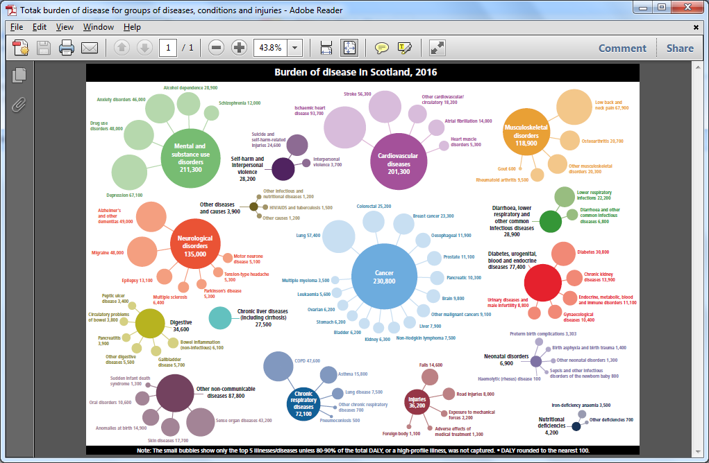
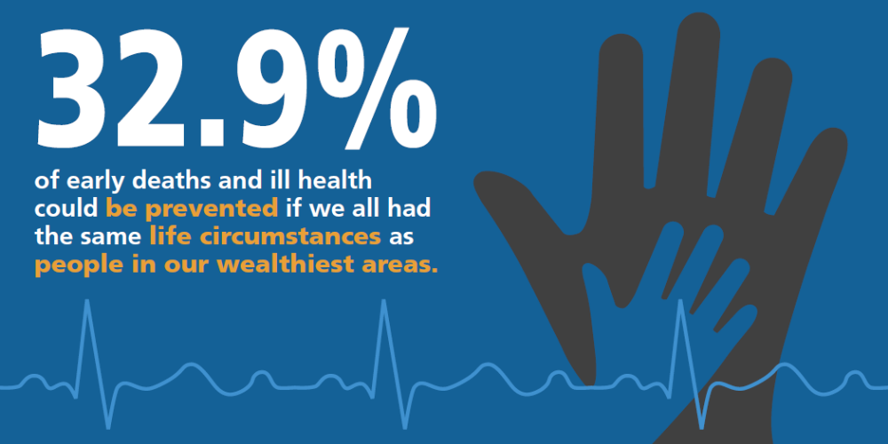
h
Notes:
The stalled life expectancy trends only tell half of the story. Improvements in ill-health and disability in Scotland had also stalled pre-COVID.
We are seeing a rise in mental health problems, musculoskeletal conditions and substance use issues
Again, this is very unevenly experienced with much higher rates of ill-health in our most deprived communities. These differences are NOT INEVITABLE and can be changed.
If all the communities in Scotland have the same health as our wealthiest communities we would have amongst the highest Life Expectancy in the world.

Slide 25
The backdrop to the current challenge
Scotland’s relative poor health and wellbeing
Significant and persistent inequalities in health outcomes
  Evidence suggests these will increased through the impacts of COVID19
  Increased financial insecurity and hardship
Unsustainable pressures on health and social care services
  Current unmet need – concern severe conditions coming through
  Build up of urgent care and capacity issues due to social distancing
  Building back to a different normal – more focus on prevention, community and primary care
  Decreases in physical activity; increases in alcohol consumption

Slide 26
Figure 1 – The mechanisms through which the unintended population health impacts of the Non-Pharmaceutical Interventions (NPIs) may occur

Slide 27
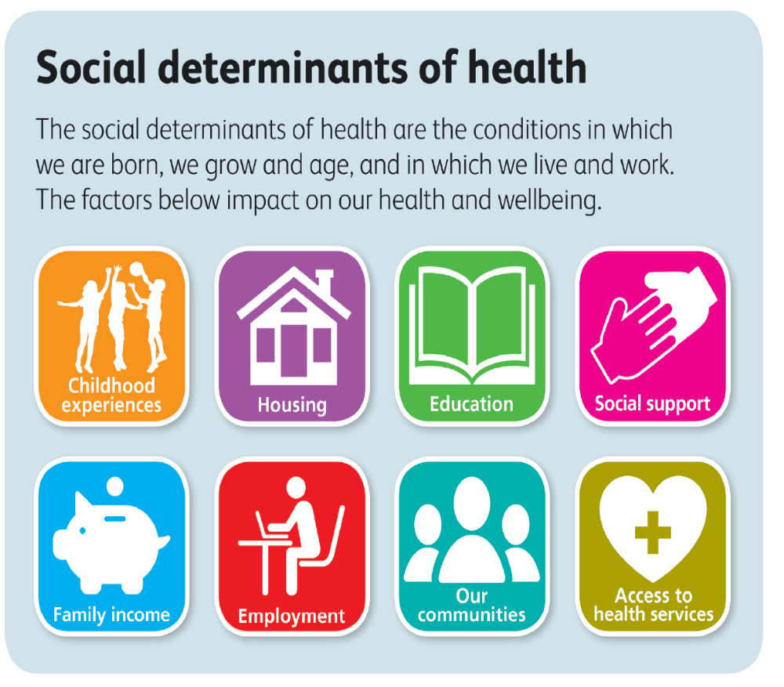
Our Social and System Recovery work programme
Notes:
The health of the population is largely due to societal influences across the economy, housing, work, transport, social support, etc. Although it is difficult to quantify the contribution of these accurately, the role of the NHS in preventing, mitigating or curing these health issues is modest compared to the influence of societal factors. That is why the partnership between PHS and Local Government is so important. It requires multi-stakeholder and multi-sectoral action across government and society …… engaging citizens, service providers, civil society, the voluntary sector, the media, planners, policy-makers and politicians.

