Slide 1

Scottish Rural Health Partnership: promoting collaboration for excellence in remote & rural healthcare
Karen O’Hanlon, Business Development Manager

Slide 2
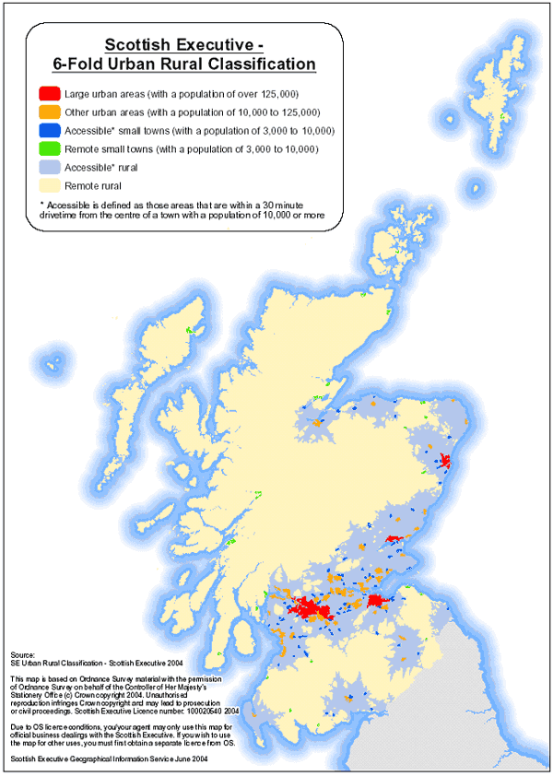
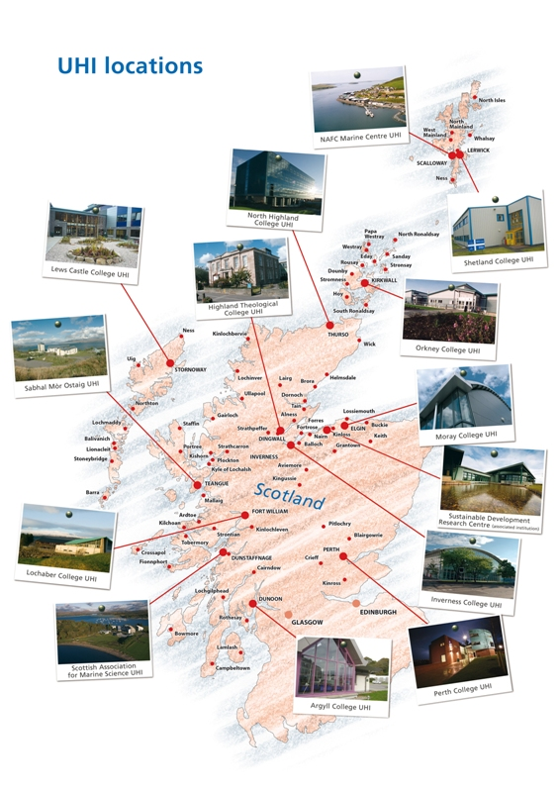
Notes:
Scotland is primarily remote rural or accessible rural – more than 95% of Scotland’s land mass
Home to 20% of the popn ~1 million people or Scotland’s 3rd city!
UHI represented across the Highlands and Islands
13 colleges and research centres, over 70 local learning centres, or online from wherever you are
A diverse range of courses, many taking advantage of our region's unique environment, landscape and culture
Includes School of Health and the Division of Rural Health and Wellbeing

Slide 3
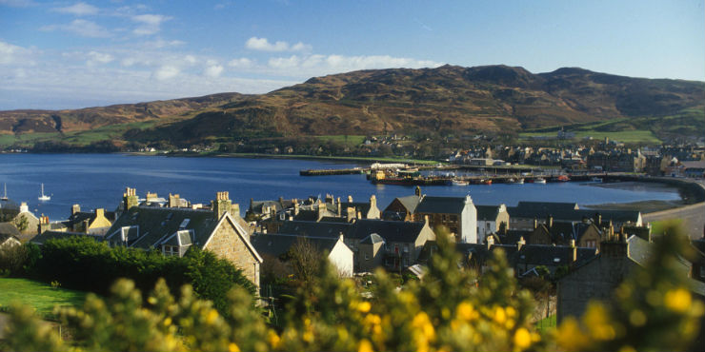
Aim
To provide a single source of knowledge about remote & rural healthcare, to foster collaboration, innovation and idea sharing between educational, academic, industry, community and NHS members, and to influence and shape remote & rural healthcare policy.
And, become bid ready and avoid unnecessary duplication (the Ecosystem)
Notes:
Come back to this later

Slide 4
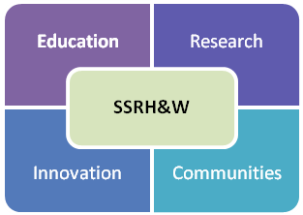
Knowledge
exchange
Research
Participation
Education
Programmes
Knowledge
Exchange
Industry
Participation
International Interaction
SRHP
Innovation
Growth
Public sector Involvement
Policy
Development
Notes:
4 areas of activity in the middle and around the outside a mix of activities/outputs
Wide remit, diverse range of members and stakeholders including the 3rd sector, community groups and charities

Slide 5
Rural Health USPs
Ageing population
Chronic disease
Mental health
Recruitment and retention of health and care workers
Integration of health and social care
Sustainability of service and cost effectiveness
Increasing use of technology and reduction in travel
Shifting towards a model of ‘co-production’
Ensuring community voices are heard
Notes:
We’ve identified some the rural USPs in the Highlands and Islands
Some of the things that in combination make us different from larger urban areas
differentiators
I’m sure some of these will be familiar to manty of you, one or more not uncommon but in remote and rural areas dealing with all these issues simultaneously – what’s makes accessing and delivering care challenging

Slide 6
Themes
Through our themes, we aim to address some of the key issues/USPs by providing information, links to relevant websites, useful resources, toolkits and research
Aspects of remote and rural healthcare that we are very interested in include:
  Healthcare workforce recruitment & retention
  Rural mental health & healthy ageing
For 2019/20, the focus of our work will be around these 2 themes
Notes:
This will include work around the dissemination of the outputs of MiW and we’ll be working with colleagues in NHS Highland to take this forward or the coming weeks

Slide 7
Supporting
Collaborative Working
KE, Dissemination
Networking, Engagement
Links, Memberships
Informal networks
Alliances
Events
Brokerage
Bids
Joint delivery of projects
Acting as physical HUB
FORMAL
INFORMAL
Notes:
Much of our early work focused in the bottom left – informal activity, KE, dissemination etc.
Providing members with concise, useful, relevant information – in one place – we do the leg work
During 2018 we also moved up and delivered a number of events, including our international conference but also more targeted events for specific grounds eg industry members/partners on funding opps and delivered new networks and partnerships
Towards the end of 2018 we launched a new Alliance – the Ecosystem
Very recently started brokering new partnerships and assisting with matching projects to funding, and helping draft bids
We've also applied in our own right to funds eg NESTA and are working on an Innovate UK bid to the ISCF Healthy Ageing Challenge Fund
Finally, waiting to hear whether or not we will received additional funding from SG – sustainable footing
Development of a FT programme office – physical hub

Slide 8
Supporting
Collaborative Working
Website
Social Media
Membership
Newsletter
Events
Partnerships
ECHAlliance Ecosystem
Nesta
Innovate UK ISCF
Social Enterprise Funding
Interface Vouchers/KTPs
New Collaborations
SG Business case/sustainability
FORMAL
INFORMAL
Notes:
Much of our early work focused in the bottom left – informal activity, KE, dissemination etc.
Providing members with concise, useful, relevant information – in one place – we do the leg work
During 2018 we also moved up and delivered a number of events, including our international conference but also more targeted events for specific grounds eg industry members/partners on funding opps and delivered new networks and partnerships
Towards the end of 2018 we launched a new Alliance – the Ecosystem
Very recently started brokering new partnerships and assisting with matching projects to funding, and helping draft bids
We've also applied in our own right to funds eg NESTA and are working on an Innovate UK bid to the ISCF Healthy Ageing Challenge Fund
Finally, waiting to hear whether or not we will received additional funding from SG – sustainable footing
Development of a FT programme office – physical hub

Slide 9
Activities
Launched website in March 2018
Invited individuals and organizations to join as 'members' - 103
Established robust governance – Executive and Steering Groups
Rethinking Remote 2018 & 2020
15 events by end of 2019, including International Rural Mental Health Conference Aug'19
Developed a presence on social media – 240 twitter followers
Early decision to work in partnership e.g. Vhs, the Alliance, HIE......
In partnership with HIE, established a Highlands and Islands Ecosystem for rural mental health and active healthy ageing

Slide 10
Activities
Invite to speak at the Scottish Parliament's Cross Party Group on health inequalities
Invited by the Scottish Government to submit a Business Case for funding
Sold out event at the Gathering in partnership with Vhs
Pulling together a bid to Innovate UK's ISCF Healthy Ageing call – Highlands and Islands consortium led by SRHP/UHI
  A community focused, scalable and accessible solution that through delivery of health services and education will support healthy lifestyle choices, keeping people active and healthier for longer

Slide 11





Wellbeing Themes
Primary Care
Third Sector
Social Prescribing
Community resilience
Physical activity
Self-Management
Connections
Behaviour Change
Evaluation
Digital Technology
Web, Smartphone, Wearables
Digital Narrative

Slide 12
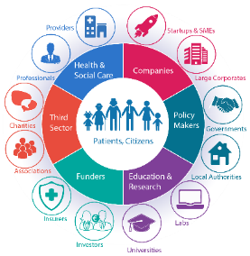

The Ecosystem
Establish a new Ecosystem for the Highlands & Islands
Creating a consortium to bid to upcoming Innovate UK call on rural active healthy ageing
International Conference in Inverness – 12th/13th August
Lobby for new funding to tackle isolation and loneliness in rural Scotland
Brokerage; information; links to relevant websites & organisations; useful resources, toolkits; research; and crucially become ‘bid ready’
Rural mental health now on the ECHAllaince's agenda
The Ecosystem will bring together a community of multi-sector stakeholders interested in developing and delivering a joint agenda around rural mental health and active healthy ageing. We’ll seek to collaborate, identify and address some of the key gaps/challenges, and ensure that we are ‘bid ready’ for opportunities as they arise.

Slide 13

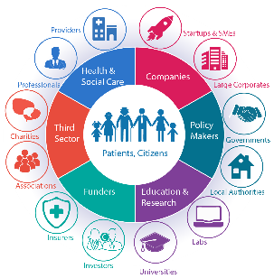

H&Is Ecosystem
Vehicle for informal and formal collaboration amongst partners interested in our themes & rural and remote healthcare more generally
Working Group established – calls every 6 to 8 weeks
Themes are rural mental health & active healthy ageing
Meetings quarterly in Inverness
  13 May – mental health stigma & discrimination – young people/workplace
  12/13 Aug – International Rural Mental Health Conference
  7 Oct - tbc
Notes:
Permanent alliance
Part of the European Connected Health Alliance – Ecosystems all over the world
Second meeting next month – healthy active ageing in partnership with DHI
Focus Innovate UK’s ISCF Healthy Ageing Challenge

Slide 14
Contact
SRHP@uhi.ac.uk
Follow us @scotruralhealth
www.uhi.ac.uk/srhp
Scottish Rural Health Partnership
Centre of Health Science
Old Perth Road
Inverness
IV2 3JH
Notes:
So early days but a lot of collaboration underway some informal but increasingly more formal partnerships, alliances and joint projects

