Slide 1

Co-producing Public Health:
A joint Voluntary Health Scotland (VHS) and Scottish Public Health Network (ScotPHN) case study

Slide 2


Two different worlds
MARS
VENUS

Slide 3
ScotPHN’s Role & Remit
To undertake prioritised national pieces of work where there is a clearly identified need.
To facilitate information exchange between public health practitioners, link with other networks and share learning.
To create effective communication amongst professionals and the public to allow efficient co-ordination of public health activity.
To support and enhance the capabilities and functionality of the Scottish Directors of Public Health Group.

Slide 4
ScotPHN previous involvement in co-production
Patient focus and public involvement
Scottish Community Development Centre: Assets Based Approaches to Health Improvement - Creating a Culture of Thoughtfulness
Generally, everything ScotPHN does is in collaboration with others – but to date primarily Public Health and health professionals

Slide 5
Background to case study
ScotPHN Advisory Board workshop:
  Health and Social Care Delivery Plan, Community Empowerment Bill etc will influence the work of public health greatly in forseeable future.
  Public Health Review - What is role of voluntary sector in the new PH landscape?
  ScotPHN has role to understand whole contribution to public health and ‘join up’ all those contributors. But how?
Explore further in a round table event between VHS and ScotPHN
  Focus on 3 forthcoming ScotPHN projects (chronic pain; gender re-assignment; ophthalmology)

Slide 6
ScotPHN Perspective on Roundtable
Good attendance in relation to each project area – some crossover
Generated discussion on key issues for voluntary sector representatives
ScotPHN found it incredibly useful / challenging
Roundtable discussion has informed all three projects
Especially opportune discussion round gender

Slide 7
So what happened next?
Influenced all projects and in particular changed direction of proposed project on gender re-assignment:
  No longer focus on gender re-assignment services but on service user experience
  More service user views – shift balance of project membership and dynamic

Slide 8
Voluntary Health Scotland
National network and intermediary for third sector organisations involved in health
Vision: that the third sector be an equal partner in creating a healthier, fairer Scotland
A platform for ‘less heard’ third sector voices to gain greater recognition in health
A bridge between government, NHS and third sector – e.g. ScotPHN Advisory Board and the PHOB

Slide 9
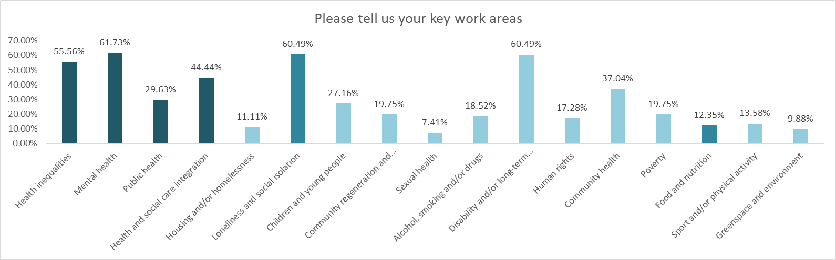
What is the voluntary health sector?

Slide 10
Third Sector Perspectives
Co-morbidity, social isolation and loneliness identified as shared concerns
Desire to see the public health effort more joined up across policy areas, e.g. accessible and affordable housing, good public transport
Capacity to take a holistic, joined up view of health e.g.
  Ophthalmology: thinking beyond sight loss charities to involve organisations that support older people to stay mobile/independent, that work with BEM communities, that raise awareness about diabetes
  Chronic pain: identify and address causes & consequences – e.g. older person has feet problems but poor access to podiatry services (no bus), falls, fractures hip, experiences chronic pain, leads to mobility loss, loses social connectedness, becomes isolated and depressed
  Gender reassignment: third sector has significant expertise, evidence and experience concerning people’s needs and what matters to them, and the availability of person centred, accessible and appropriate services

Slide 11
Opportunities for Collaboration
Opportunities for CPPs to co-produce public health with communities should be identified and developed, especially in less privileged communities & using community empowerment approach
Third sector is a natural ally and partner in public health because we build community capacity, take a holistic approach to meeting need/solving problems, work through networks and alliances
Public health infrastructure and machinery is complex and challenging for third sector to understand and engage with - stretches capacity of both large and small organisations
Can ScotPHN help the third sector navigate a meaningful route into/relationship with public health structures/bodies?

Slide 12
Summing up
Enthusiasm for meaningful co-production
Each has unique perspective and knowledge
We find the other world complex
We both affected by changing public health landscape
We both lack local visibility
We have shared values – people are at the centre of what we do - therefore -
We should share experience and good practice more, and collaborate more to achieve better advocacy for the health of the population

Slide 13




Slide 14
Contact details
Ann Conacher
ScotPHN Manager
Scottish Public Health Network
0141 414 2757
ann.conacher@nhs.net
@NHS_ScotPHN www.scotphn.net
Claire Stevens
Chief Officer
Voluntary Health Scotland
0131 474 6189
claire.stevens@vhscotland.org.uk
@VHSComms www.vhscotland.org.uk

