Slide 1

National Health and Social Care Standards
Fiona Wardell

Slide 2




Why review?
2002 Standards only for
registered services
23 sets of Standards for
different service types
Care is changing
Human rights and wellbeing
Expectations increasing

Slide 3
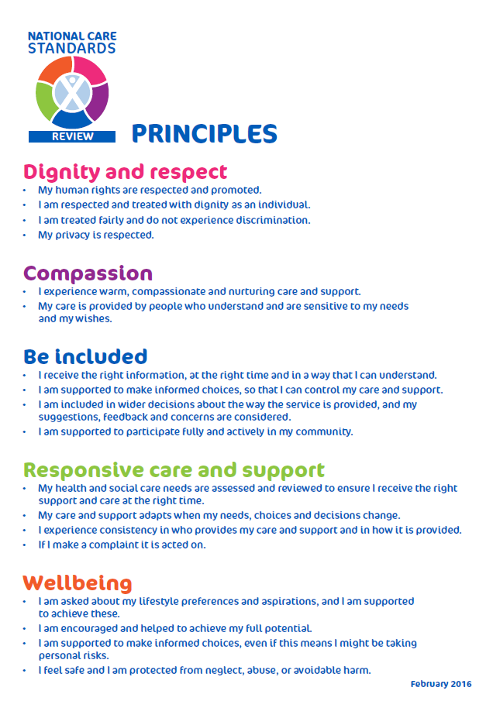
5 Principles
Following public consultation
in 2015 the Principles were agreed
and signed by the Minister
in February 2016:
Dignity and respect
Compassion
Be included
Responsive care and support
Wellbeing

Slide 4




7 Standards
1. I experience high quality care & support that is right for me
2. I am at the heart of decisions about my care and support
3. I am confident in the people who support and care for me
4. I am confident in the service that I am using

Slide 5



7 Standards
5. And if the organisation also provides the premises I use
And where my liberty is restricted by law
7. And if I am a child or young person needing social work care and support

Slide 6
What’s new? scope
Based on needs of people experiencing care and support rather than settings being inspected
Every person, every time
Same high quality of care for all
For all health and social care settings
Replace and streamline previous Standards
Service and strategic level inspections
Integrated approach to care
Notes:
23 to 7
2402 to 177

Slide 7
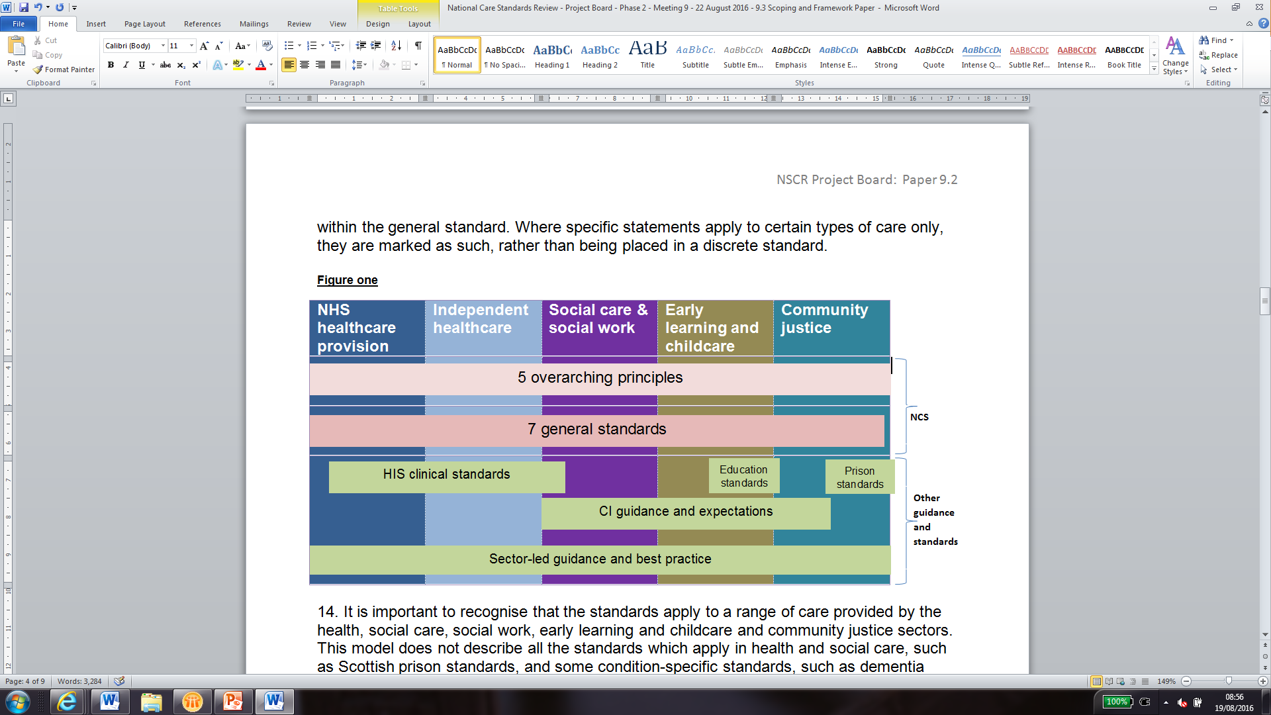
Scope

Slide 8
What’s new? approach
Focus on compassion
Human rights, wellbeing and empowerment expressed in plain and direct language
Individual personal outcomes rather than technical provider inputs
Owned by people using and working in care
Designed for improvement, not just compliance
Support future innovation and flexibility
Will need new ways of inspecting

Slide 9
1. I experience high quality care and support that is right for me
1.13 “My emotional, psychological and physical needs are assessed by a qualified professional at an early stage, regularly and when my needs change.”
1.25 “I experience proper planning and am helped when using a new service, or when I move between services.”

Slide 10
1. I experience high quality care and support that is right for me
1.42 “I am helped to develop personal resilience and ways to keep myself safe.”

Slide 11
1. I experience high quality care and support that is right for me
1.11 “I am recognised by people who support and care for me as an expert in my own experiences, needs and wishes.”

Slide 12
2. I am at the heart of decisions about my care and support
2.9 “If I need or want to move on and start using another service, I will be fully involved in this decision and helped to find a suitable alternative. If I am moving from a service for children to one for adults, I am helped with this transition.”

Slide 13
3. I am confident in the people who support and care for me
3.1 “I experience people speaking and listening to me in a way that is courteous and respectful, with my care and support being the main focus of people’s attention.”

Slide 14
4. I am confident in the organisation providing my care and support
4.15 “If I am supported and cared for by a team or more than one organisation, this is well co-ordinated so that I experience consistency and continuity.”

Slide 15
4. I am confident in the organisation providing my care and support
4.18 “I am confident that the service I use and the organisation providing it are well led.”

Slide 16
4. I am confident in the organisation providing my care and support
4.1 “I am confident and experience that my human rights are central to the organisation that supports and cares for me, and that it helps tackle inequalities.”

Slide 17
4. I am confident in the organisation providing my care and support
4.2 “I receive an apology if things go wrong with my care and support or my human rights are not respected and the organisation takes responsibility for its actions.”

Slide 18
5. And if the organisation also provides the premises I use
5.5 “I have a secure place to keep my belongings.”

Slide 19
5. And if the organisation also provides the premises I use
5.12 “I experience a service as near as possible to people who are important to me and my home area if I want this and if it is safe.”

Slide 20
6. And where my liberty is restricted by law
6.2 “I am helped to understand how and why my behaviour affects my rights, including the use of any physical intervention, sanctions or incentives.”

Slide 21
6. And where my liberty is restricted by law
6.8 “The environment is specially designed and managed to minimise the risk of me harming myself or others.”

Slide 22
How can I get involved?
12 week consultation (ends 22 Jan 2017)
  online survey
  roadshow public meetings
  facilitated events
enquiries@newcarestandards.scot

Slide 23
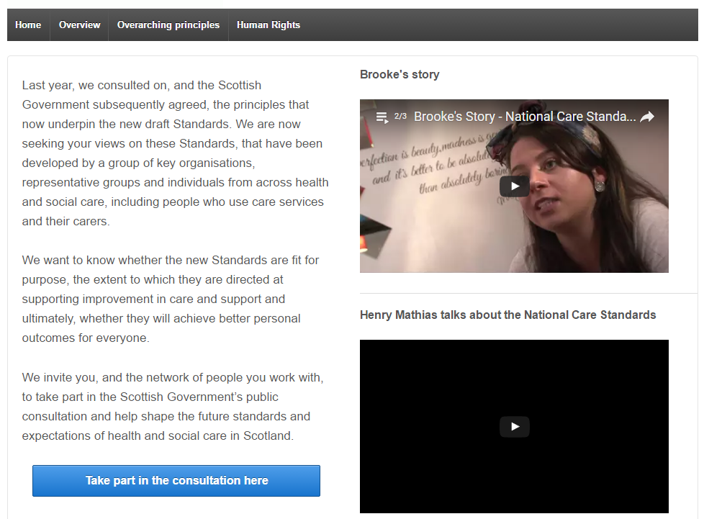

Where can I find out more?
www.newcarestandards.scot

