Slide 1

Health and Social Care integration
Gordon Neill, Senior Manager
March 2016

Slide 2
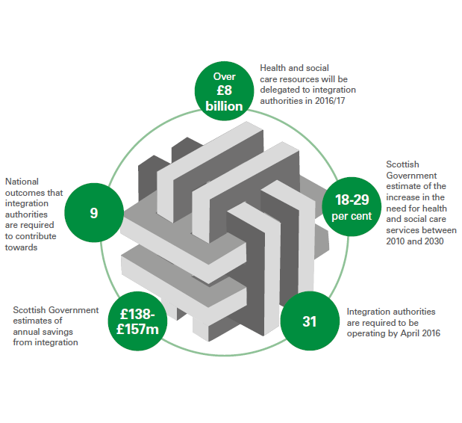
Significant reform

Slide 3

Three planned audits of integration
December 2015 on emerging risks.
  analysis of key documents
  visits to 6 partnerships
  interviews
2. A more comprehensive audit looking at progress in 2017
3. An audit on the impact of the reforms on outcomes

Slide 4
Current position
  Great deal of activity:
    Appointing key officers
    Appointing board members
    Agreeing formal integration schemes
    Scottish Government guidance & finance
  All 31 expect to ‘go live’ by April 2016
  Wide range of variations in:
    Scope of services being integrated
    Governance arrangements
    Stages in agreeing underlying strategies, finance, appointing key officers.
    Size and number of localities

Slide 5
Emerging risks
Governance and Accountability
Finance
Service redesign
Workforce
Performance management

Slide 6
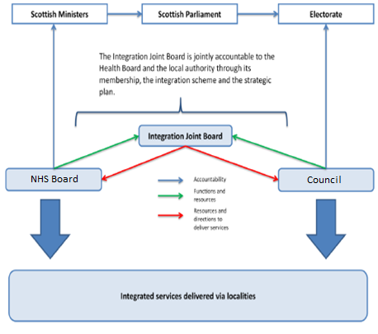
Governance and Accountability

Slide 7
Finance
Some Year 1 budgets still to be agreed:
  Public sector reductions and uncertainty
  Set-aside budgets for acute services
  Different planning cycles for councils and NHS boards
Budgets still to be agreed for localities
Greater uncertainty over longer-term funding, at a time of rising demands

Slide 8
Service redesign
Strategic plans – tend to be descriptive and aspirational
Not yet clear how services will change:
  Reduction in hospital beds
  Investment in community facilities
  Shifts in workforce
Role of:
  clinicians & GPs?
  voluntary sector?
  carers?
Continuing focus on acute sector?

Slide 9
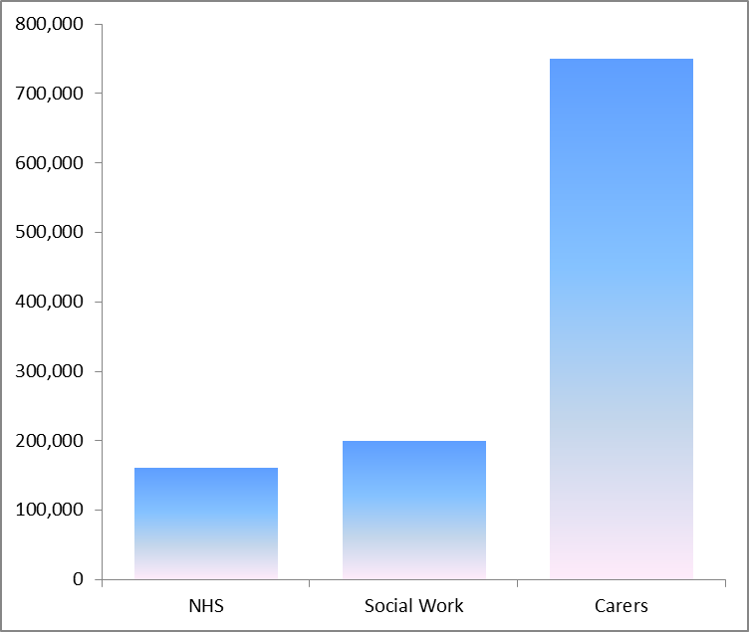
Workforce
Need for workforce strategies
Coordinate diverse range of:
  carers
  voluntary
  NHS
  social work staff
Shaped by budget cuts rather than future needs?
Different NHS and council cultures (cuts, private sector).
GP resources and workload

Slide 10
Performance management
Focus on outcomes
Baseline information?
Are the right measures being used?
  Shift towards prevention?
  Shift from acute to community-based care?
Targets? What will success look like?
Need for networking and sharing of good practice
Nine outcomes, including:
1. People are able to look after and improve their own health & wellbeing and live in good health for longer.
4. Health & social care services contribute to reducing health inequalities.
6. People who provide unpaid care are supported to look after their own health & wellbeing.

Slide 11
Contacts
Copy of the December 2015 report on Audit Scotland’s website: http://www.audit-scotland.gov.uk/uploads/docs/report/2015/nr_151203_health_socialcare.pdf
Gordon Neill
Senior Manager, Audit Scotland
gneill@audit-scotland.gov.uk Tel: 0131 625 1819
Claire Stevens, Voluntary Health Scotland
Claire.Stevens@vhscotland.org.uk Tel: 0131 474 6189

