Slide 1
Tackling health inequalities and later life:
Reshaping Care for Older People and Integration of Health and Care
Richard Lyall
Scottish Goverment
Notes:
Hello(s)
External engagement events in a few weeks – good chance to test out our ‘story’
Overview from myself, then a couple of areas in a bit more detail from Richard, then questions.

Slide 2
Care for older people has been changing…
Scottish Government, Local Authorities and local health boards have made changes over time to adapt – with third sector involvement
Services have improved and evidence of innovative ideas making a difference
Regulations and standards are tighter and processes have improved
Always room for improvement and working together better!
Notes:
Programme launched in 2011, but not necessarily a ‘standing start’
32 LAs delivering care to very different populations in different geographical areas = inevitable innovation
Policies, Legislation and regulations have contributed to improving quality and standards

Slide 3
Impetus
65+ and 90+ population expected to be much bigger in 20 years
Christie Commission for the Future Delivery of Public Services
Remit to consider models of service delivery in public sector against increasing demand and resource constraint
Notes:
Doing nothing is not really an option
Population expected to change shape drastically between now and 2035
Christie Report also stated we needed to drastically reform how we deliver services to cut out inefficiences

Slide 4
Key Points from Christie Report
Involve individuals and communities who use public services in their design and delivery.
Have a ‘joined up’ approach to delivering services, to reduce duplication and save money.
Spend money to prevent problems and inequalities over the longer term, rather than spending money on solutions = PREVENTION better than a cure
Improve efficiency to get more value for money.
Notes:
Messages of empowerment; integration and preventative spend.

Slide 5
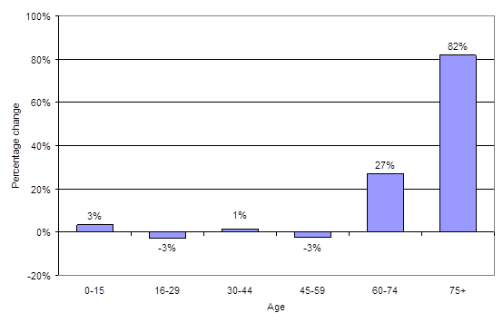
The shape of our population in 20 years…
The projected percentage change in age structure of Scotland's population, 2010-2035
Notes:
It’s great news that more of us will be living longer. It could be an indication of us taking better lifestyle choices as individuals, healthier environments, or the success of policies that support our health and independence. The likelihood is that it is actually down to a mix of all three.
Our population as a whole is expected to change shape however, not just those aged over 65. There will be a sharp decline in the number of children, and people in their 20’s and 30’s. This suggests that we need to think now about how we will deliver health and social care for those who need it 20 years from now, as it would be wrong to pretend that everyone will lead healthy, active and independent lives up until they die.

Slide 6
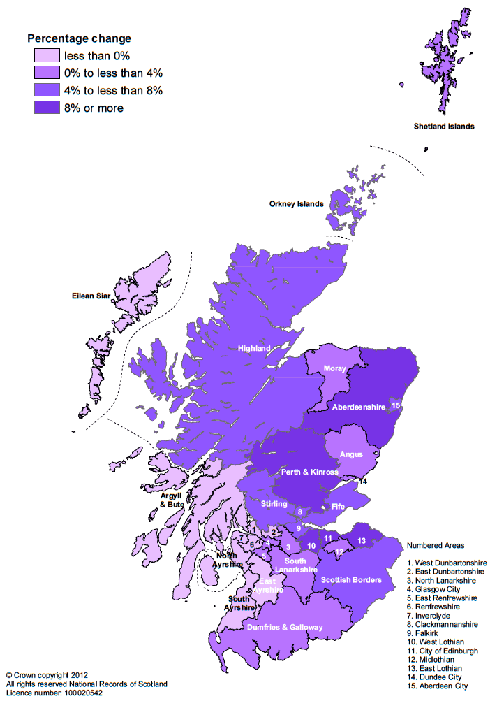

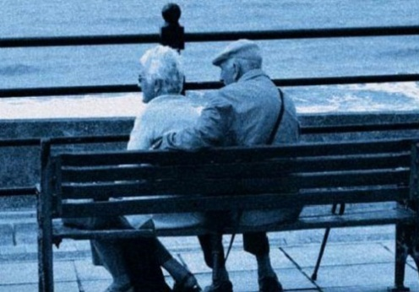


Scotland’s Population

Slide 7
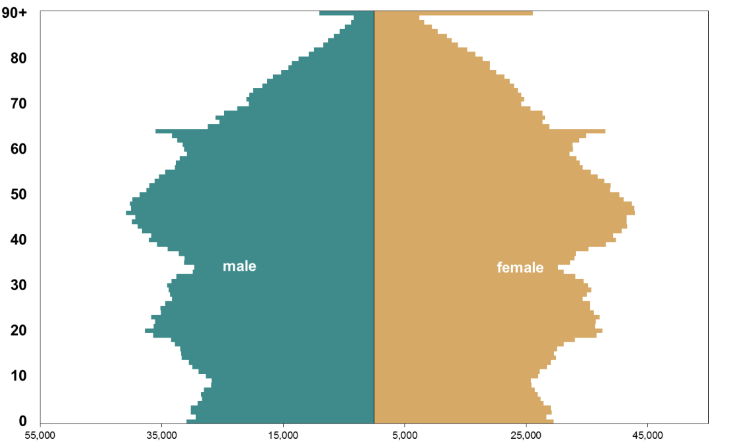
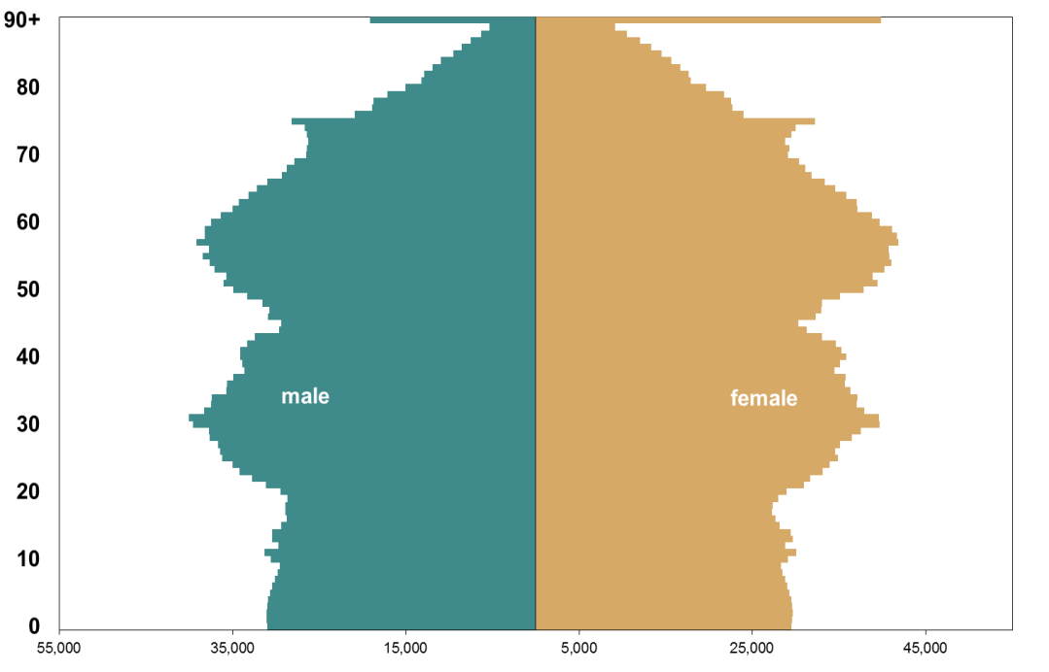
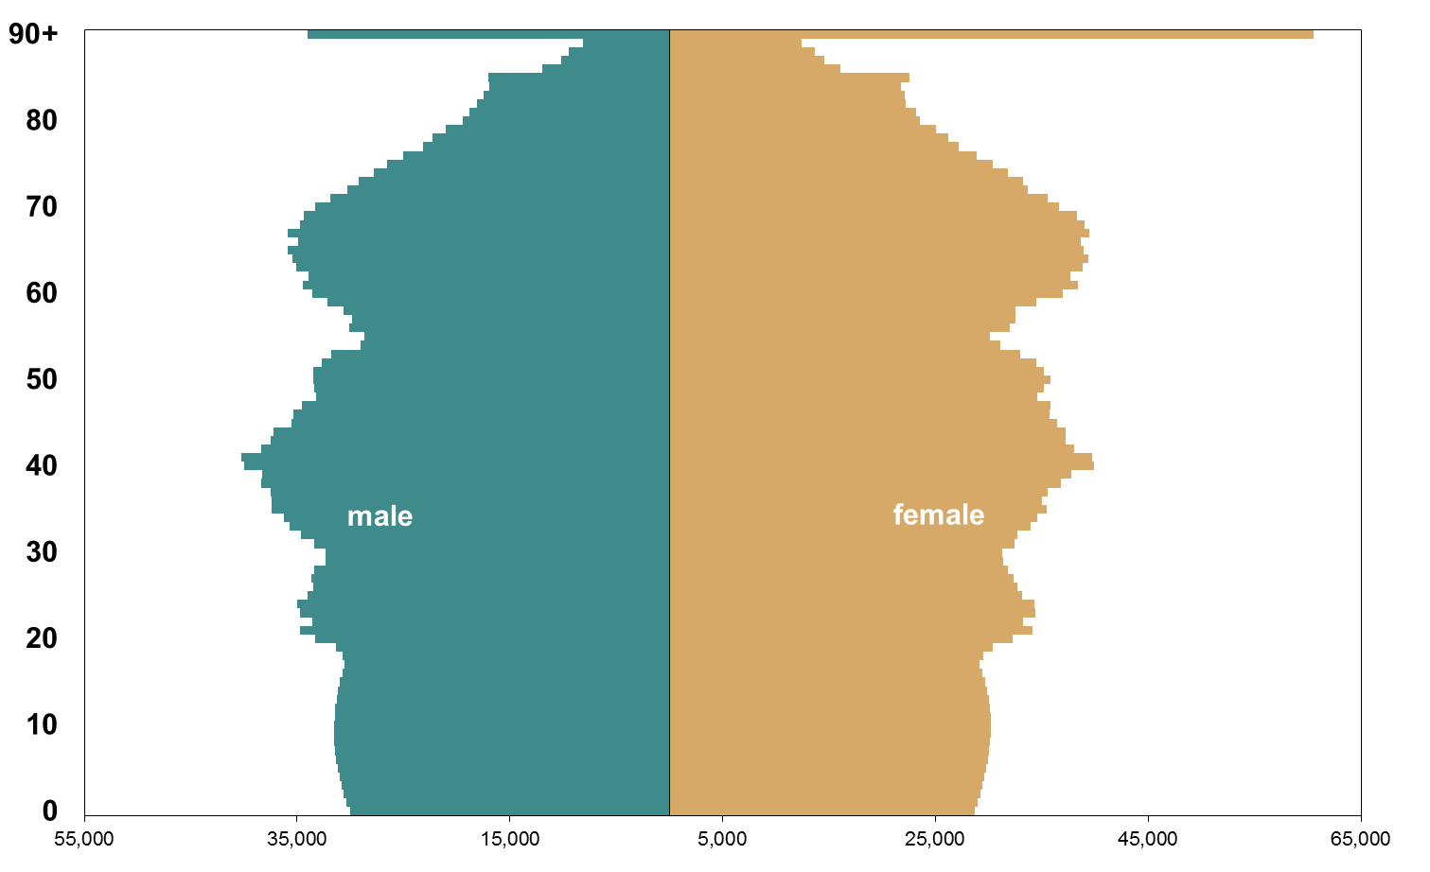
2012
2022
5.3 Million
5.5 Million
2032
5.7 Million
By 2032:
1 in 4 will be 65+
94,000 will be 90+
Source: NRS

Slide 8
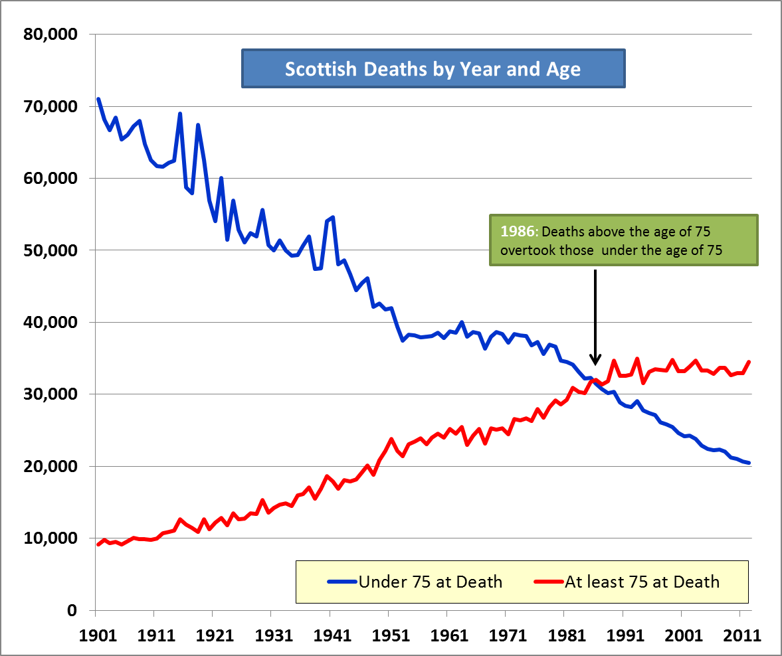
On current trends, it’s possible that deaths >85 will overtake those <85 in 2014
Source: NRS: Deaths by Age Group, 1901-2012

Slide 9
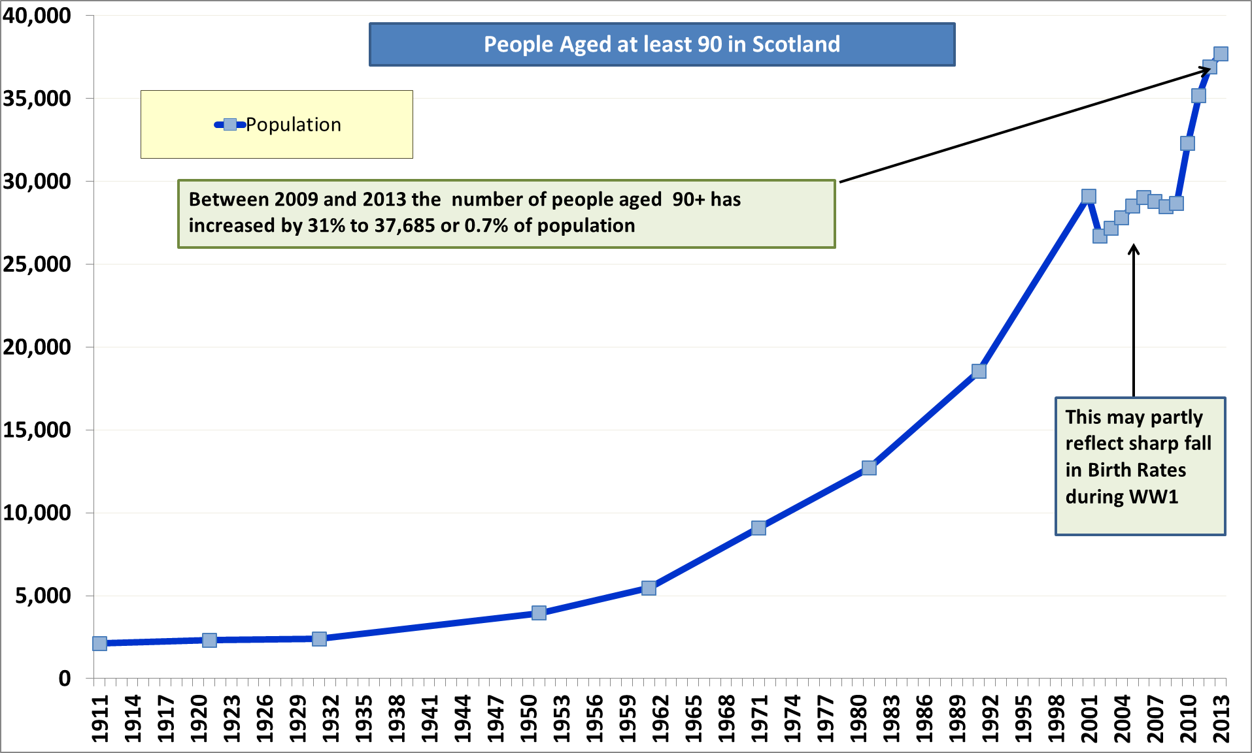
Source: NRS: Combination of Census Results and Mid Year Population Estimates

Slide 10
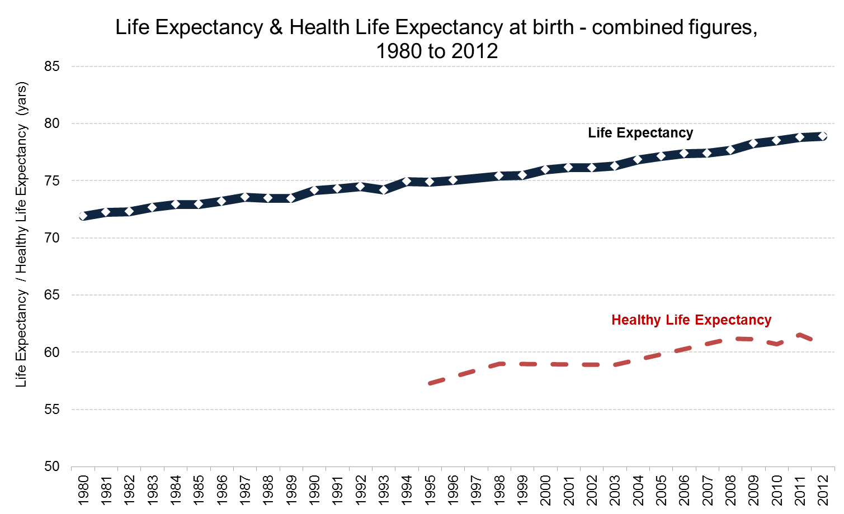
♀ 80.9 yrs
♂ 76.9 yrs
♀ 62.0 yrs
♂ 59.4 yrs
Source: Scotland Performs

Slide 11
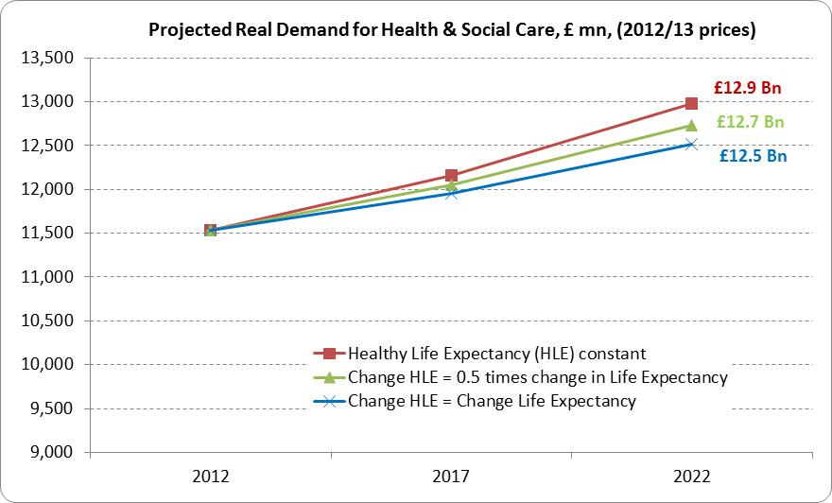
Source: Scottish Government

Slide 12
What drives demand for Health & Social care in Scotland?
Population
Health
Behaviours
Supply

Slide 13
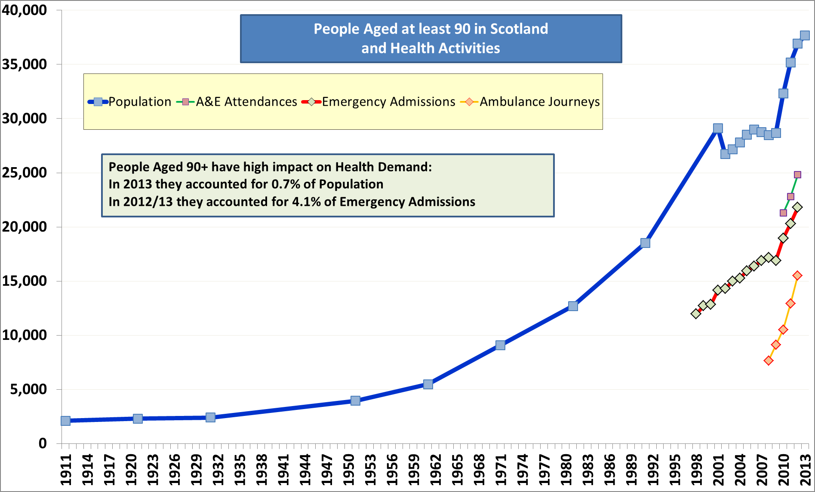
Source: As previous slide + ISD SMR01 (Admissions), A&E Data Mart & Ambulance MI

Slide 14
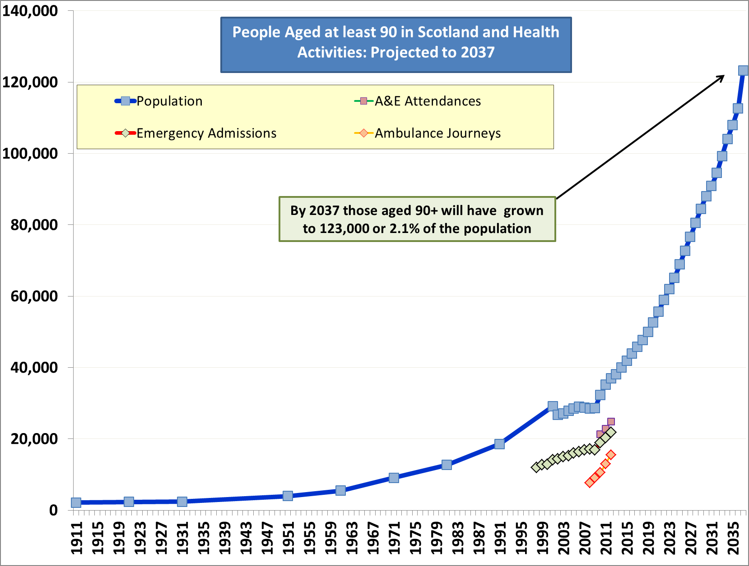
Source: As previous slide + NRS Population Projections (2012 Based) to 2037

Slide 15
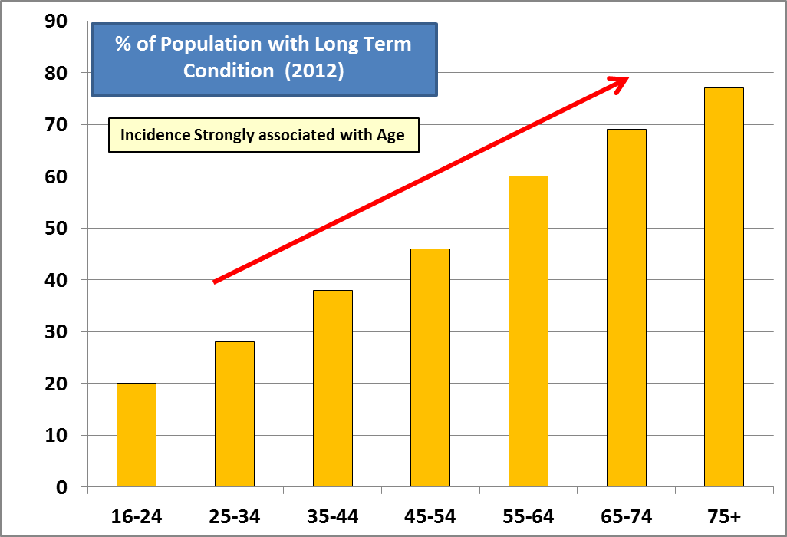
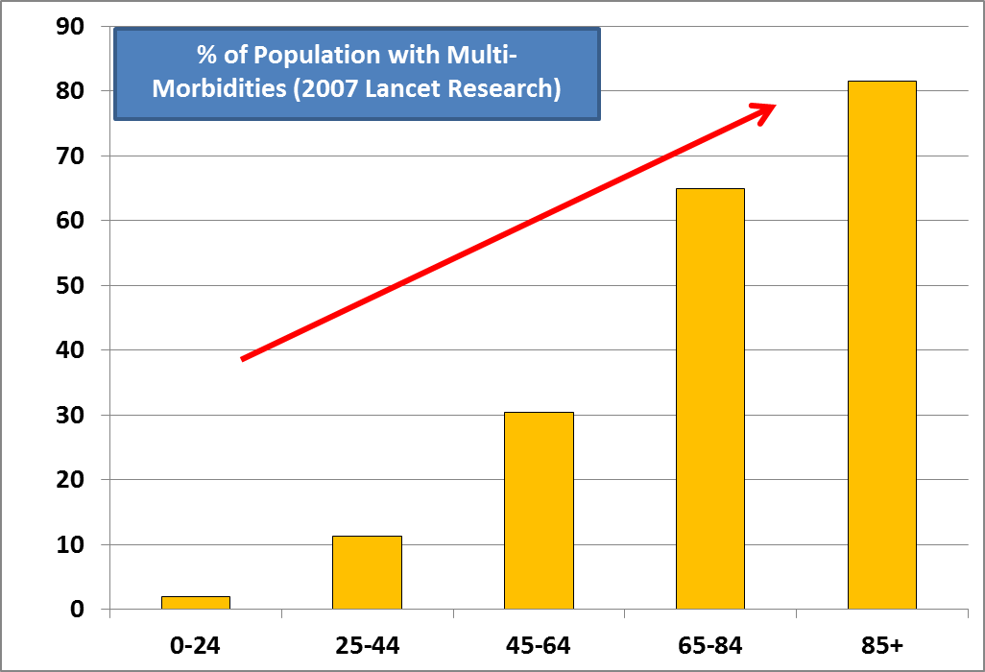

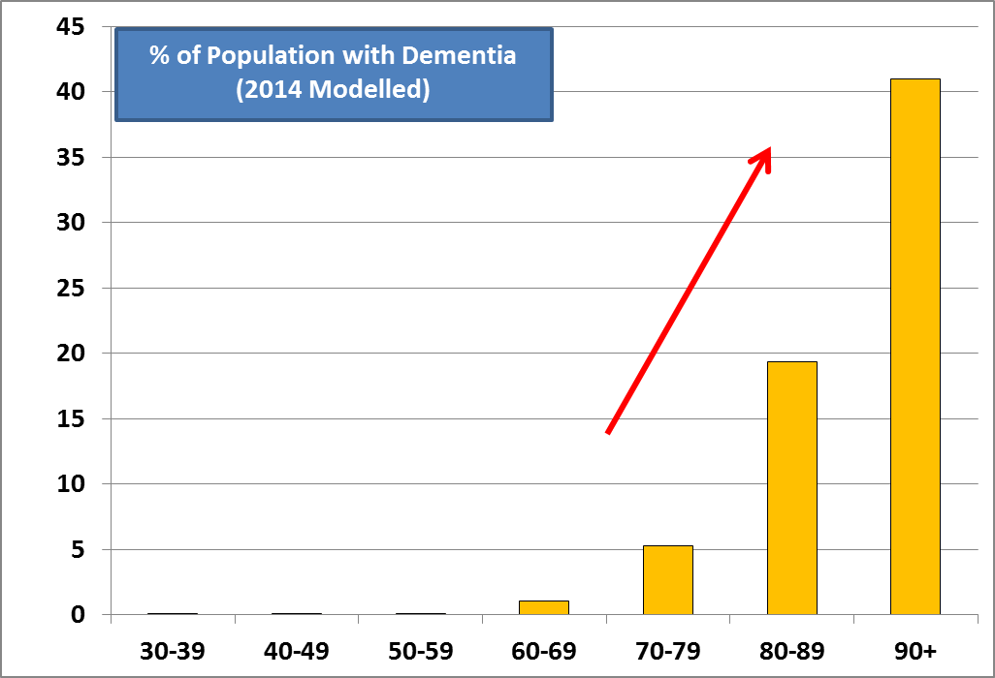
Other Age-Linked Health Demands
↑
46% of Population with LTC in 2012, ↑ from 41% in 2008
← 50,000 Consultations in 2012/13, ↑ from 30,000 in 2006/07 (GP/GN)
Dementia
Source: SHeS (LTC)
Source: MM
(Lancet Paper)
Source: ISD QOF (Dem)

Slide 16
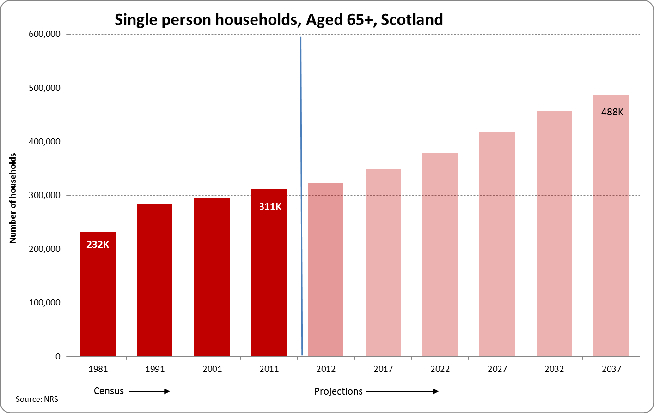
1 in 10 are lonely
Increased likelihood of engaging in unhealthy behaviours
More likely to use services
Source: Victor, 2011
Age UK, 2010

Slide 17
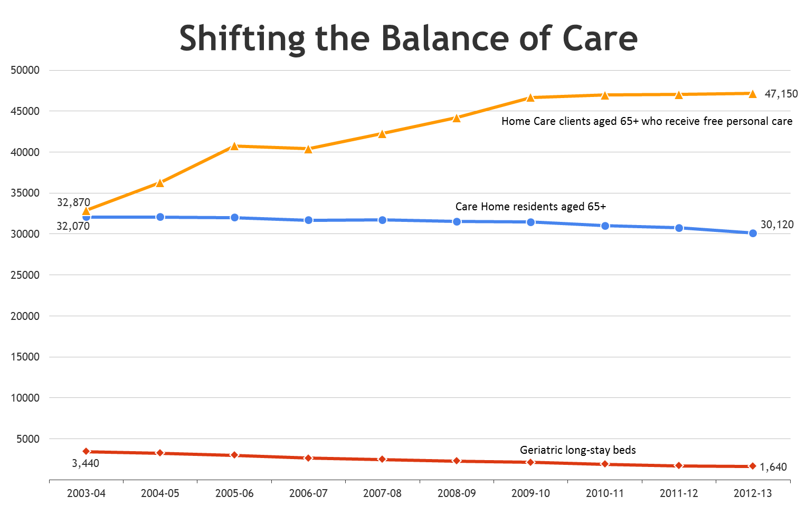
Reshaping Care for Older People:
…. moving away from 'institutional' care towards care in the home or a homely setting that is designed around the needs of the individual
Source: Community Care Quarterly Monitoring Return, ISD(S) 1

Slide 18
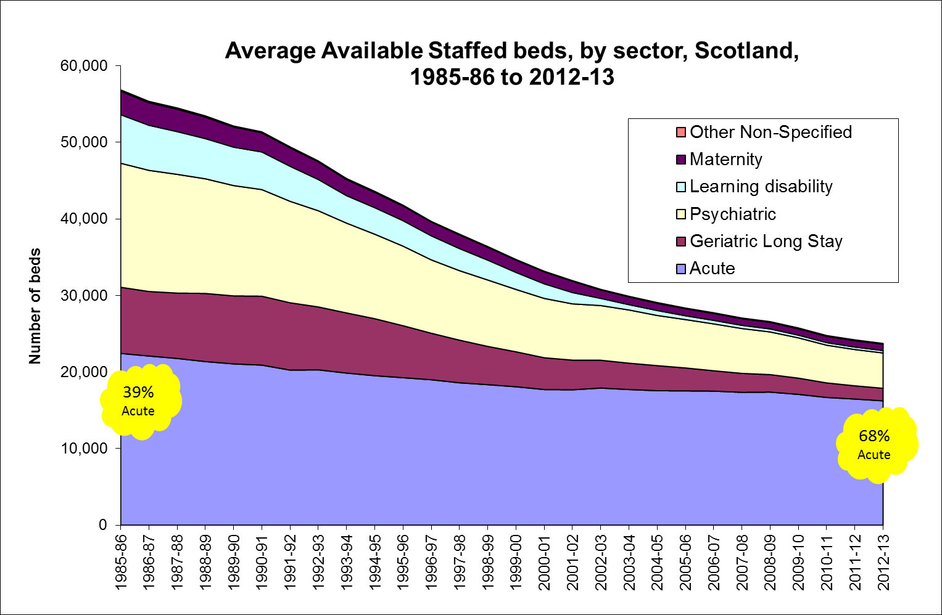
Source: | Source: ISD Scotland [Form ISD(S)1]

Slide 19





Behaviours and their Impact on Demand for Health Services
36% smoke
20% smoke
26% of adults are in ‘not good’ health
74% of adults are in ‘good’ health
63% failed to meet the physical activity recommendation
29% failed to meet the physical activity recommendation
39% are obese
23% are obese
16% are hazardous or harmful drinkers
23% are hazardous or harmful drinkers
Source: Scottish Health Survey, 2012
Notes:
In this section we’ll have a look at how behaviours can affect the demand for health, and also touch on the effects of deprivation (which also are often linked with harmful behaviour)
This first slide presents self-reported data on health status and health behaviours.
As you can see roughly ¾ of the population report to be in good health and about ¼ of the population report to be in not good health. We can also see how the patterns of behaviours such as smoking, levels of physical activity, obesity and drinking fall in these two groups. Today we are going to look at health behaviours individually but before that lets see what the impact of deprivation are on health.
There are issues around alcohol with self reported data, we know that the most hazardous and harmful drinkers are very hard to reach and are normally underrepresented in the survey. We also know that people under report in the amount of drinking they do.
But we can also see here that there is a proportion of people in Scotland who drink to hazardous or harmful levels but still think that they are in good health.
Alcohol
Hazardous drinking: woman – 14-21 units per week Men - 21-50 units per week // Harmful drinking: woman - 35+ Men – 50+
People in poor health are more likely to be unable to drink to excess due to their health condition.
The effects of alcohol misuse are long term, so current health status is more likely to be related to drinking patterns over the course of a life-time.
An academic (Linsay Gray) has done work linking the Scottish Health Survey to participants medical health records to adjust for the ‘hard to reach’ groups who are missed from the survey. This allows consumption for those missed groups to be imputed. Her work shows that by far the largest reason for the gap between sales and self-reported consumption is overall under-reporting, not the missed hard-to-reach groups.
Although self-reported survey estimates are typically lower than estimates based on sales data, surveys can provide valuable information about the social patterning of individuals' alcohol consumption which sales data cannot. The evaluation of the implementation of minimum pricing will use evidence from the SHeS to help assess the impact on consumption patterns across different groups in society.
Physical Activity recommended levels
The previous recommended level of activity for adults was that they should do at least 30 minutes of moderate activity on most days of the week (i.e. at least 5). The new guidelines are that adults should be moderately active for a minimum of 150 minutes a week (just under 22 min a day if you split this daily).
The impact of this change has been an increase of around 24 percentage points in the proportion of adults meeting the recommendation. It is not possible to calculate adherence to the new guideline back over the time series (due to new questions being added in 2012 for the purpose of monitoring the new guidelines) but figures using the old guideline have been produced for 2012 and show no real change over time (39% in 2011, 38% in 2012).

Slide 20
Impact of deprivation on health
Source: Scottish Health Survey, Scottish Household Survey, National Records Scotland
Notes:
In this slide we can see life expectancy and the number of years spent in not good health which is a good indication of demand on the health services. We could say that the cumulative effects of behaviours is most evident in the most deprived areas where people will live on average double the years in not good health relative to people in the least deprived area and their life expectancy is on average around 12 years less.
But lets have a more detail look at the individual behaviours.

Slide 21
Reshaping Care for Older People
In a nutshell: a move away from institutional care being the ‘default’ option
Focus on the person, their tastes and preferences
Money spent on preventing situations arising and conditions worsening, rather than being spent on care “after the event”.

Slide 22
Wide ranging initiatives…
Dementia
Volunteering
Housing
Telecare
Telehealth
Residential Care
Palliative Care
Transport
Carers
Reablement
Handy Person Services
Pharmaceuticals
Nutrition
Digital Agenda
Buddying

Slide 23
Some good examples…
Third Sector Interfaces – community engagement and capacity building
Hospital at Home in North Lanarkshire
- multi agency team
- quick response to emergency to avoid admission
- same service delivered at home as would be received in hospital.
Anticipatory Care Plans in Aberdeen
- 1500 ACPs developed between GPs and those deemed most at risk of emergency admission
- fall in admissions and good anecdotal evidence

Slide 24
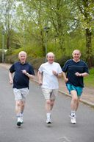
What have we done?
RCOP - 10 year programme to 2021
- Change Fund
- Legislation
- Strategies
- Getting On Report
- Measuring success
Working together
Notes:
The Programme was launched in 2011 and has a lifespan of 10 years, which is obviously not to say the job will be completed at that point, but there are certain things we expect to happen in that timescale. A key enabler of the Programme is the Change Fund, which has grown from its original figure of £350m, with £230m spent since 2011/12 alone and more than two years of the fund left to go. The money is spent on preventative services and initiatives at local level that really make a difference, some good examples buddy services that tackle loneliness and re-ablement packages that get people home and independent as quickly as possible after surgery in hospital.

Slide 25
Early Success…
- A reduction of 6.8% in the emergency admissions bed days rate for the over 75s
- 55,000 people over 50 are benefitting from a new telecare and telehealth programme
- £300 million of Change Fund monies distributed to Local Partnerships since 2011/12.

Slide 26
Public Bodies (Joint Working) (Scotland) Act (2014)
Principles for integrated health and social care
Nationally agreed outcomes for health and wellbeing
Integrated governance arrangements for health and social care: delegation to a body corporate or lead agency
Integrated budgets for health and social care
Integrated oversight of delivery
Strategic planning
Locality planning
Notes:
Key features of the Act.
Are integrated from the point of view of service-users
Take account of the particular needs of different service-users
Take account of the particular needs of service-users in different parts of the area in which the service is being provided
Take account of the particular characteristics and circumstances of different service-users
Respect the rights of service-users
Take account of the dignity of service-users
Take account of the participation by service-users in the community in which service-users live
Protect and improve the safety of service-users
Improve the quality of the service
Are planned and led locally in a way which is engaged with the community (including in particular service-users, those who look after service-users and those who are involved in the provision of health or social care)
Best anticipate needs and prevent them arising
Make the best use of the available facilities, people and other resources

Slide 27
Timescales
Consultation on Regulations and development of Guidance
MAY– AUGUST 2014
Regulations and guidance complete
NOVEMBER 2014 – FEB 2015
Integration goes live locally
APRIL 2015
All integrated arrangements must be in place
APRIL 2016

Slide 28
What should partnerships be doing now?
Agreeing which model to use
  So far: 1 lead agency, 30 bodies corporate, 1 undecided
Establishing strategic planning groups
Consulting on and agreeing localities
Starting work on the integration scheme and delegated budgets

Slide 29
Key challenges
Engaging clinicians, particularly GPs
Agreeing delegated budgets

Slide 30
What next?
Outcomes approach
Move to Integrating Care Fund in preparation for wider changes – focused on health inequalities, multi-morbidities and not just older people
Update on RCOP - 2016/17 including reflecting on mainstreaming of change
Joint strategic commissioning

Slide 31
From Personal to National Outcomes
Outcome Level | Focus | Example
Individual / Personal | Defined by a person as what change/improvement is important to them in life | I want to be able to get back to my walking group
Service / Project | Defined by a service as a key change to work towards with clients/users | We work with older people to improve their ability to get out & about
Organisational (local authority, NHS board, 3rd sector) | Defined by organisations as a priority aim/goal to work towards | The older people we work with are more socially included/ connected
Local Partnership (CPP, H&SC) | Defined across organisations as a shared outcome to work towards | Older people are able to maintain independent living for longer
National | Defined by government as priorities for cross-govt activity | We live longer, healthier lives
Source: Talking Points: Personal Outcomes Approach, JIT June 2012
Notes:
Moving to an outcomes approach needs to be meaningful to people at whatever point in the system they work – whether front-line service delivery, as a service manager, as a funding organisation, as a local H&SC partnership or as a policy maker in local or national government.
In taking forward an outcomes approach, it is vital that improving outcomes for individuals (the primary driver for services) are linked to improving outcomes for the population (the primary focus of the government’s National Performance Framework and SOAs).
JITs Personal Outcomes approach focuses on what change/improvement is important to the individual.
The Health & Social Care Integration outcomes focus on changes/improvements that services are seekingt o achieve for their clients/users
The strategic outcomes model (considered here) focuses on the changes/improvements sought across a population as the consequence of coordinated whole system efforts.
Note:
JIT’s ‘Personal Outcomes’ approach is for those working with older people in front-line service delivery roles n the health and social care sector. In this context, an outcomes approach means “working with the person to identify what is important to them or what they want to achieve, and then working backwards to identify to how to get there. It means supporting the individual to be as independent as possible, while paying attention to their quality of life.“

Slide 32
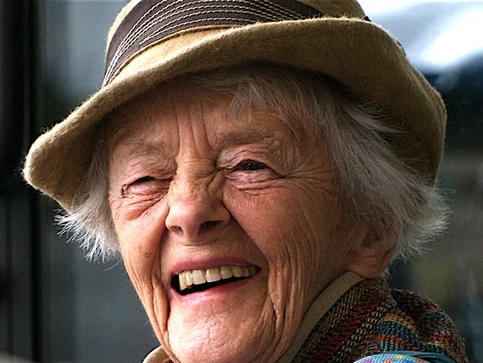
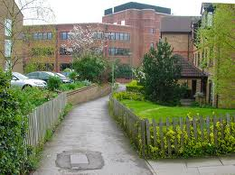
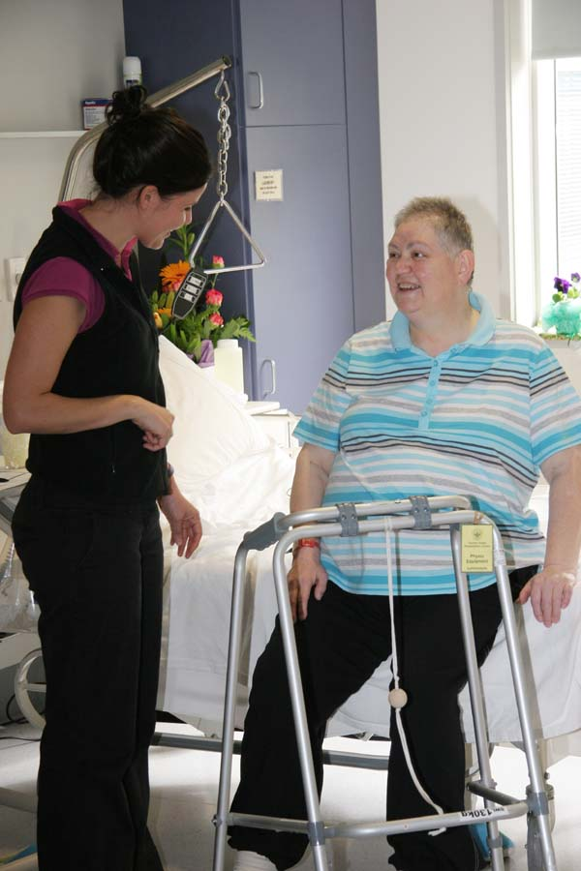
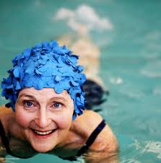

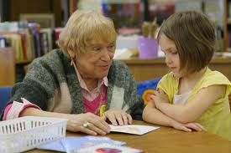

Physical health & function
Mental health & wellbeing, staying positive and in control
Physical environment
Housing, neighbourhood,
Transport/mobility
Feeling safe
Independent living
What Outcomes are valued?
Healthy lifestyle,
Keeping active, eating well
Financial/material security,
Social environment
Secure & supportive
relationships
Participation in
community life
Making a positive
contribution
Notes:
What outcomes are valued by older people themselves?
The strategic outcomes framework brings together the experience of older people themselves (what outcomes they value), the knowledge and experience of practitioners and relevant organisations about actions required and formal research evidence on what works to improve these outcomes.
Older people are by no means a uniform group, yet what they value in terms of the quality of later life is remarkably consistent:
self-determination and involvement in decision-making; secure and supportive personal relationships; social interaction; a good physical and home environment; being able to keep active and get out and about; having timely and accessible information; financial security.
In addition, for those with high support needs, having support from, and good relationships with, carers is also highly valued.
Older people often make a wealth of positive contributions to families, local communities and society. Yet negative ageist attitudes are pervasive, especially toward those with high support needs, although there are some signs of change.

Slide 33

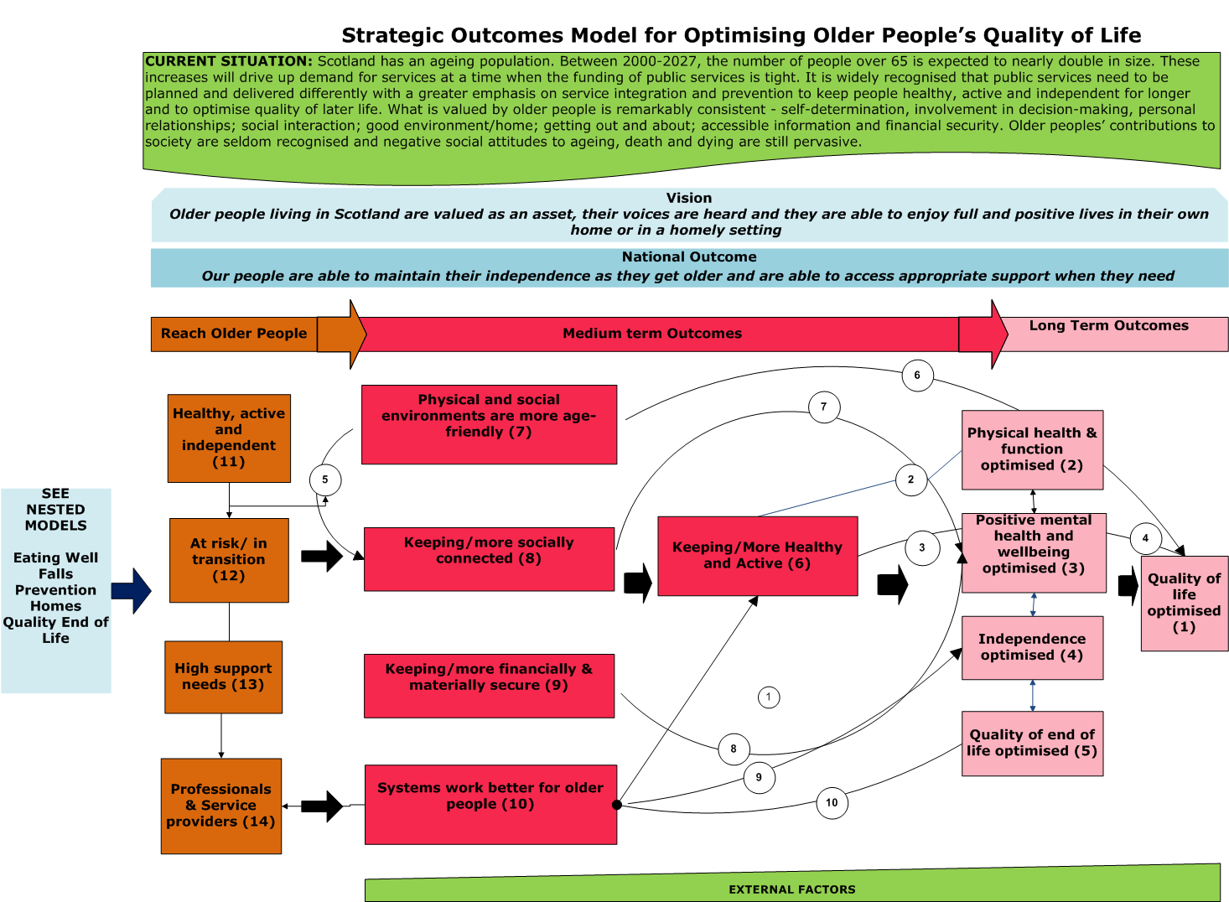
Strategic outcomes model
oooooooooooooo
Notes:
How will this National Outcome be achieved?
The National Outcome will only ever be realised through making changes across a number of key determinants. No single group, agency or service can do this on their own. It has to be a collective effort combining the resources and actions of many across a number of fronts.
The purpose of the outcomes framework is capturing the whole system response to improving outcomes for older people. It can therefore be used by a range of sectors/ partnerships to plan, commission and monitor local efforts to improve outcomes for older people.
Highlight in turn boxes in strategic outcomes model:
Box 1: Quality of life optimised (the ultimate goal) –
This is made up of four main dimensions:
Box 2: Physical health and function
Box 3: Positive mental health and wellbeing
Box 4: Independence
Box 5: Quality of end of life
In turn, these end outcomes are shaped/influenced by:
Box 6: Keeping/being more healthy and active
Box 7: Physical and social environments are more age-friendly
Box 8: Keeping/being more socially connected
Box 9: Keeping/being more financially and materially secure
Box 10: Systems working better for older people

Slide 34
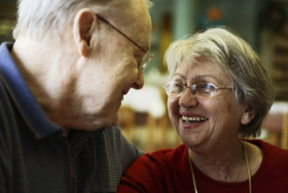
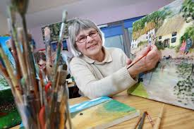
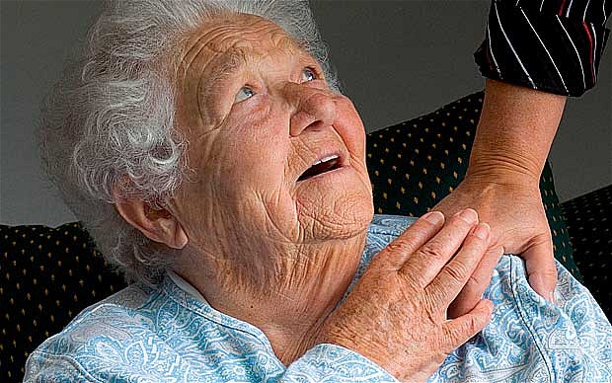
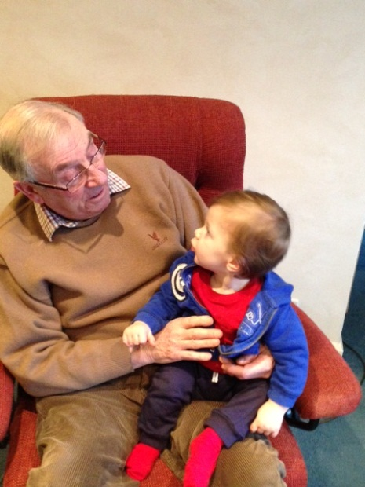
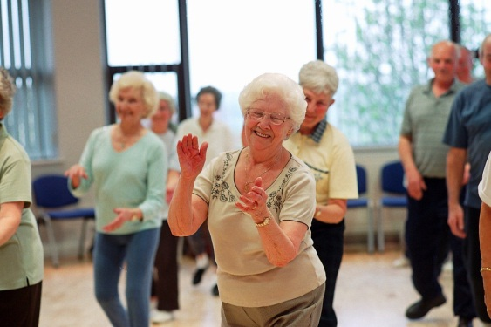
Key population groups
PREVENTION - Keeping people healthy, active and independent for longer
EARLY INTERVENTION - those whose health and independence is at risk /in transition
TREATMENT AND CARE - those with high support needs and their carers
Notes:
Key population groups - not everyone over 50 has the same experience and needs as they get older.
Some important differences in the experience of later life are connected with socio-economic variations in those with multiple chronic conditions at age 50 vs fit and healthy; urban/rural differences in the distribution of the older population; ageism in employment.
The model therefore differentiates three main groups in the older population whose needs are necessary to plan for:
Box 11: Older people who are healthy, active and independent, including carers
Box 12: Older people who are at risk/in transition, including carers
Box 13: Older people who have high support needs, including carers
Why is it so important to consider these three population groups?
Reach or Engagement is the first level outcome – it’s the first change necessary for all other results to happen. It is the vital link inks between the range of actions taken and services provided and the Outcomes we are seeking to achieve.
To highlight prevention and early intervention – this is an important policy goal of Re-Shaping Care
Joint strategic commissioners will inevitably be concerned with improving outcomes for current users of health and social care services and carers and managing demand. This means also attending to prevention - keeping people active, healthy and independent for longer – and early intervention – being able to identify those whose health and independence is at risk so that effective and timely help can be mobilised.
2. To avoid exacerbating inequalities
The experience of later life as healthy, active and independent is unevenly distributed across society. For example, multi-morbidity (having two or more chronic health conditions including mental health disorders) begins 10–15 years earlier for people living in the most deprived areas (11% in the most deprived areas compared with 5.9% in the least deprived). A critical question for Joint Strategic commissioners is to ensure services reach and benefit the more socially isolated rather than the easier to reach people who are already supported socially active and engaged.

Slide 35
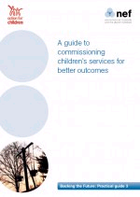
Good practice in outcomes-based JSC
Requires the capacity to –
Co-produce an outcomes framework with partners Change/re-design procurement processes so that effective services/actions are commissioned
build the awareness and capacity of local providers to support and promote this approach.
Notes:
Good practice in outcomes-based commissioning includes service users in a co-production process to develop insight into what outcomes are important to people, the range of different experiences and what range of services are most likely to be effective in achieving these outcomes – both preventative services as well as healthcare treatment, self-management of long term conditions and social care.
Outcomes-based commissioning requires the capacity to:
co-produce an outcomes framework with partners that reflects local population needs and aspirations
encourage providers to consider the full range of social, environmental and economic outcomes that contribute to improving the quality of later life for older people and ensure that these are reflected in the joint strategic vision of the partners
Change/re-design procurement processes and paperwork to support the procurement of services/actions that are most likely to be effective in contributing to achieving the outcomes in the co-produced framework
build the awareness and capacity of local providers to support and promote this approach.

Slide 36
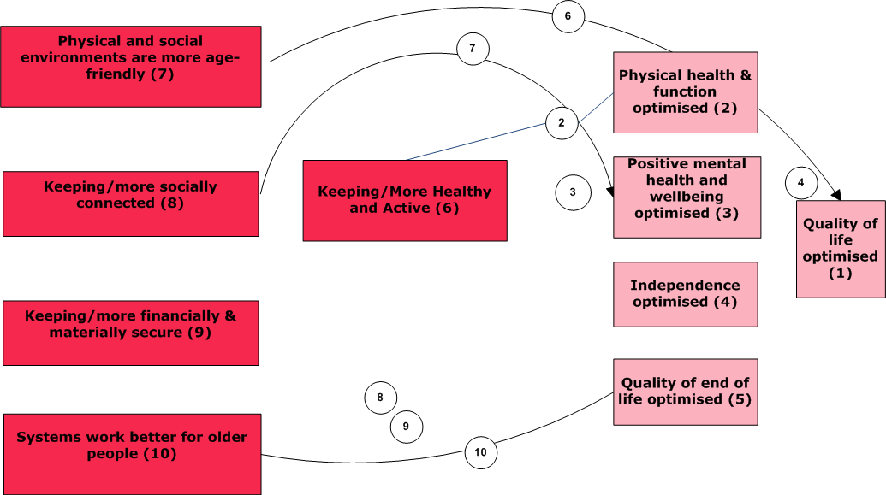
Most effective contributions
Notes:
Diagram in slide needs attention
Identifying the most effective contributions
A key question in JSC is therefore what range of actions and services are required to achieve these strategic outcomes? The numbered links in the strategic outcomes model provide summaries of existing ‘what works’ evidence from systematic reviews for the key strategic outcomes.
For example, …
This information is essential when considering what might be the most effective services and best value for money. Without this, there is a tendency to commission the usual configuration of services from the usual agencies (and get the usual results).
N.B. The task of summarising the evidence is ongoing – more work to be done.

Slide 37

A Stitch in Time?
To explain the third sector's contribution to Reshaping Care for Older People
Overview model
Nested models – e.g. Day care in West Lothian, Community Transport in Edinburgh
Case studies – e.g. Community Connecting (Edinburgh), Reducing social isolation for older people in Midlothian
Literature reviews
Indicator bank
http://www.evaluationsupportscotland.org.uk/how-can-we-help/shared-learning-programmes/stitch-time/

Slide 38
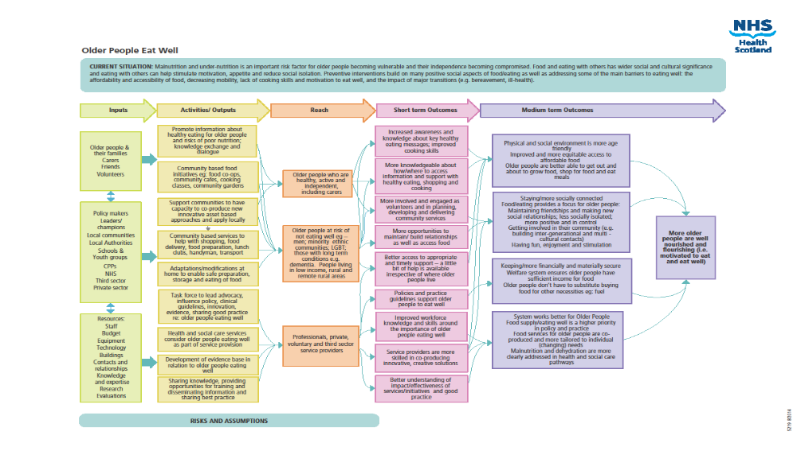
Nested models
Notes:
Nested models
‘Nested’ models map out how a range of specific services and/or actions contribute to one of the main strategic outcomes. A series of four ‘nested models’ have been developed for a selection of the strategic outcomes in the overall model in order to illustrate what might be the most effective range of contributions and how these can be set out. The four nested models are:
1. Older people eat well
2. Falls prevention
3. Age-friendly homes
4. Optimising the quality of end of life
Each nested model shows a series of service-related actions for particular population groups and the short-term results that might be expected to arise and be monitored. The actions and outcomes identified in the models are underpinned by a series of risks and assumptions that need to be managed.

Slide 39

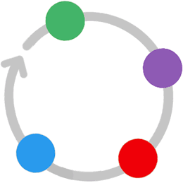
Monitoring and evaluation
Setting
Outcomes
Collecting information
Evaluation Pathway
Learning from your findings
Analysing and Reporting
www.evaluationsupportscotland.org.uk
Notes:
Monitoring, evaluation and improving service delivery
An important part of the joint strategic commissioning process is agreeing how service delivery performance will be monitored and what adaptations or improvements might be needed to better achieve key outcomes.
This process includes agreeing with partners:
• key indicators for monitoring the health, social, economic and environmental strategic outcomes and who/how these will be brought together, analysed, reported and reviewed
how to co-produce service assessments with service users
• how to gather the necessary information in relation to service-related outcomes to learn what’s working and what doesn’t and to make use of the learning to improve services over time. The evidence gathered is likely to involve using customised self-evaluation tools and a combination of quantitative measures and qualitative case studies, including the experience of service users and carers. For example, you might use a combination of peer assessment, interviews and focus groups, surveys, direct observation, mystery shopping, etc.

