Slide 1
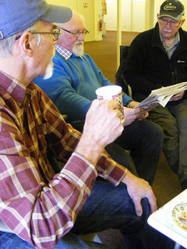
Men’s Sheds

Slide 2
Before we even heard of Men’s Sheds
Barriers to successful matching of volunteers to opportunities
(no available volunteering placements, inability to travel, perceived lack of skills and reluctance to try something new in a gender/age group where confidence can be low)

Slide 3
What is a Men’s Shed?
Community based version of the shed at the bottom of the garden
A place where men with time to spare can share their skills and interests, work on projects together, have a laugh and a cuppa amongst friends.

Slide 4
Where did the idea come from for a Men’s Shed ?
Started in Australia 12 years ago
Now spread across the world
Now over 60 in England
First sheds in Scotland opened last year

Slide 5
What activities can take place in the shed?
The list is endless and depends on what the members of the shed are interested in

Slide 6
Sheds have been used for:
Restoring furniture
Tool renovation
Model engineering
Gardening
Cooking
Fixing bicycles
Computer classes

Slide 7
Does it have to be a traditional wooden shed?
No – a Men’s Shed can be located in any building which has heating, lighting and can be locked up (village hall, community centre etc)

Slide 8
Benefits
Health/Community/Social
Something to do
Somewhere to go
Meet new people
Learn new skills
Share knowledge
Make things
Combat isolation/loneliness
Enhance self esteem/personal achievement

Slide 9
Quotes from some men involved in Sheds – (Taken off UK Men’s Shed Association website)
“It’s wonderful here I just wish you could have done it 30 years ago” (Harry Aged 91)
“ Men’s Sheds fill the hole in my life left by retirement, it makes me feel valued again and it’s great to be part of a team again”
“ Coming to the Shed is the best thing that has happened to me since retirement and I’m proud to be a member”

Slide 10
The Galashiels Shed
The journey so far

Slide 11
September 2013
A chat with partners
A public meeting to gauge demand

Slide 12
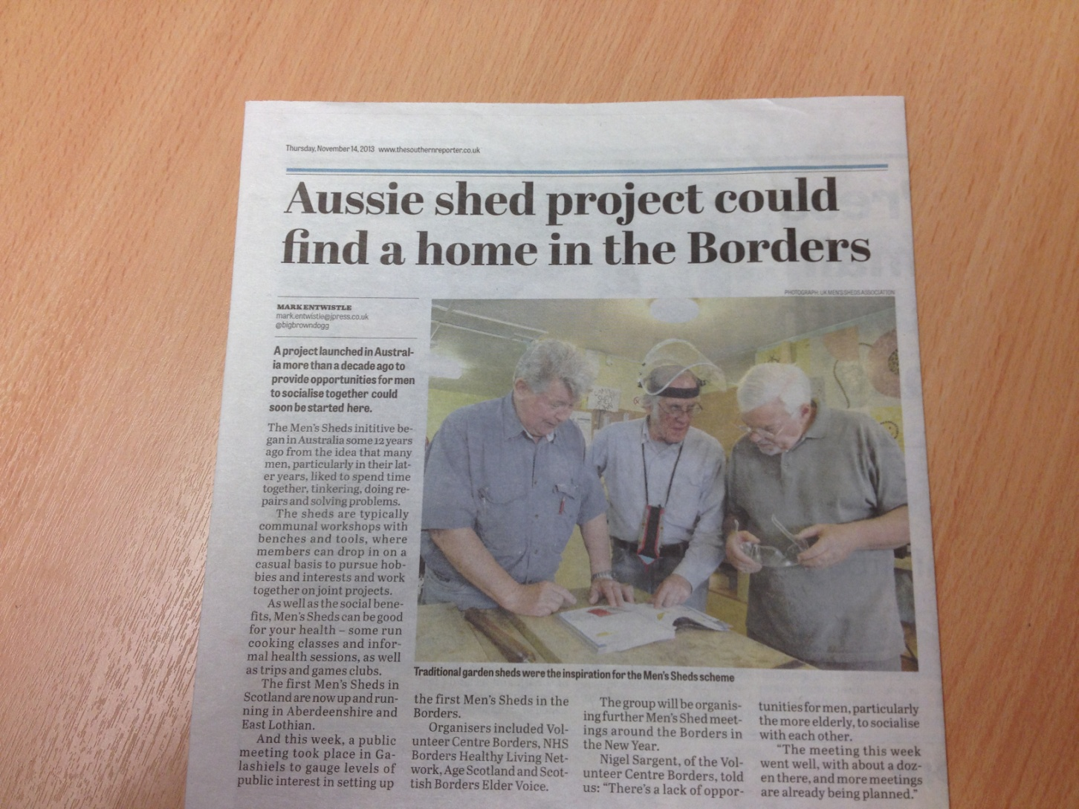

Slide 13
November 2013
Public meeting
12 attended (although 8 from other service providers)

Slide 14
December 2013
Core group of ‘shedders’ formed
Regular meetings in run up to Christmas
Trip to Macmerry

Slide 15
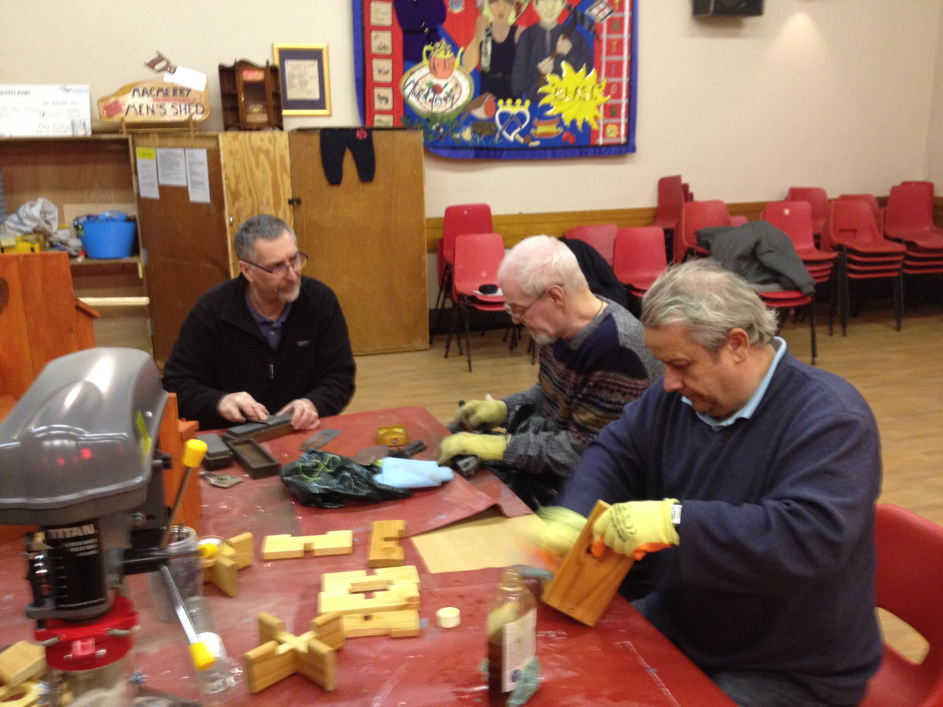

Slide 16
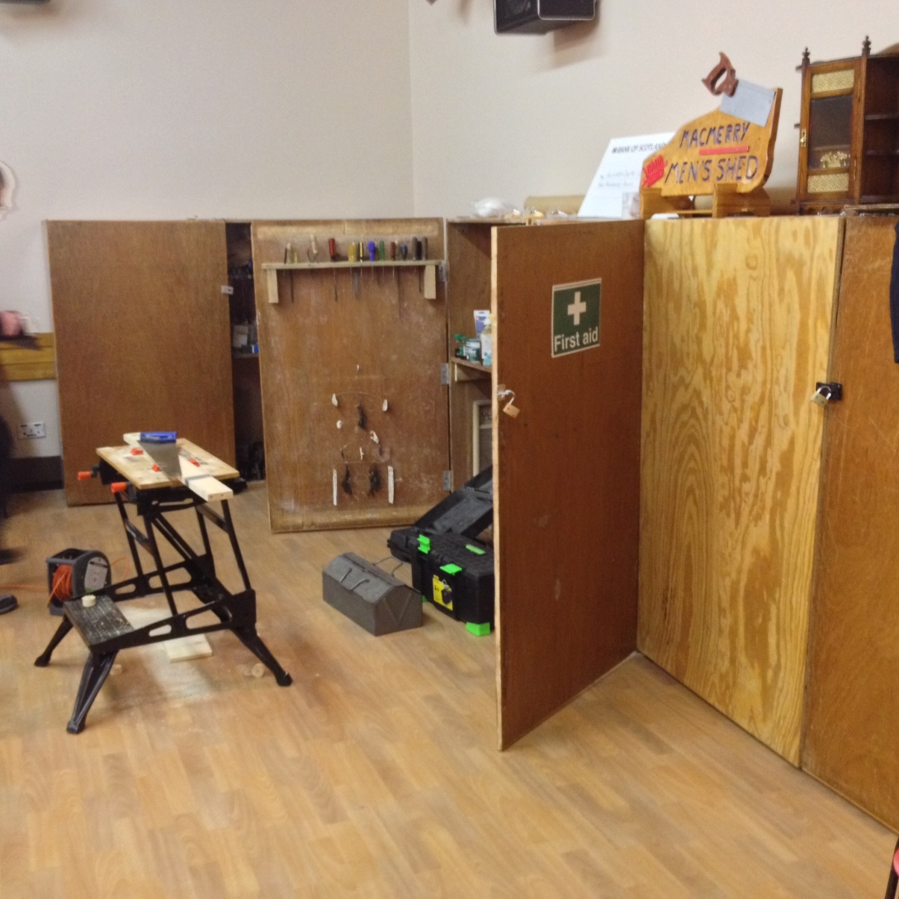

Slide 17
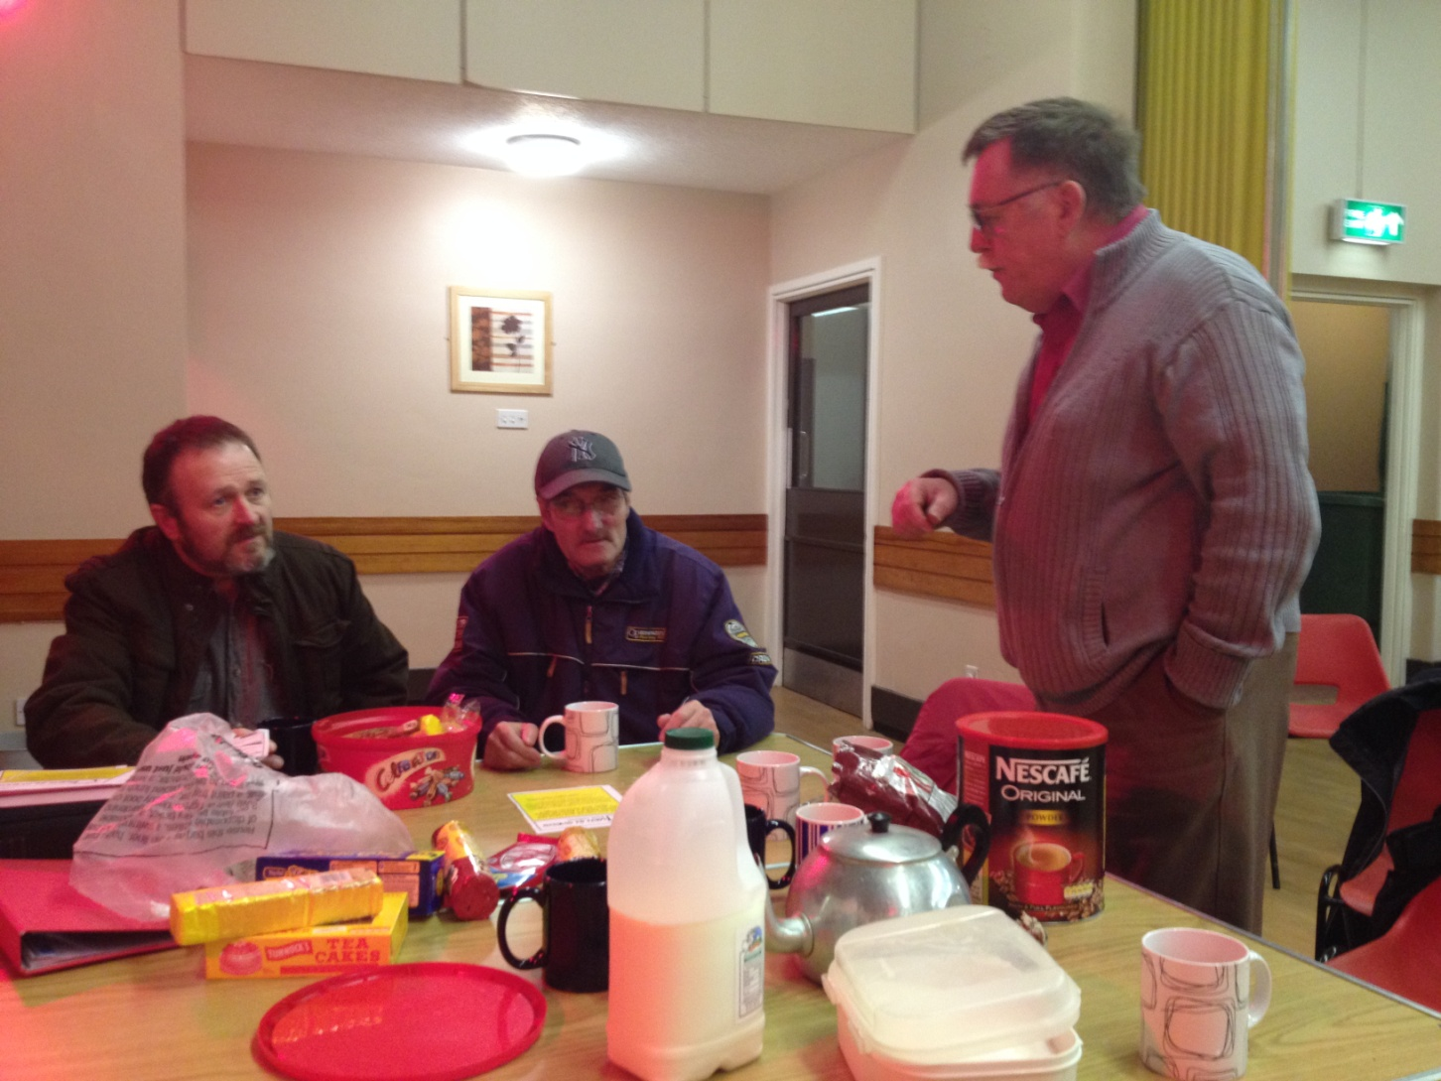

Slide 18
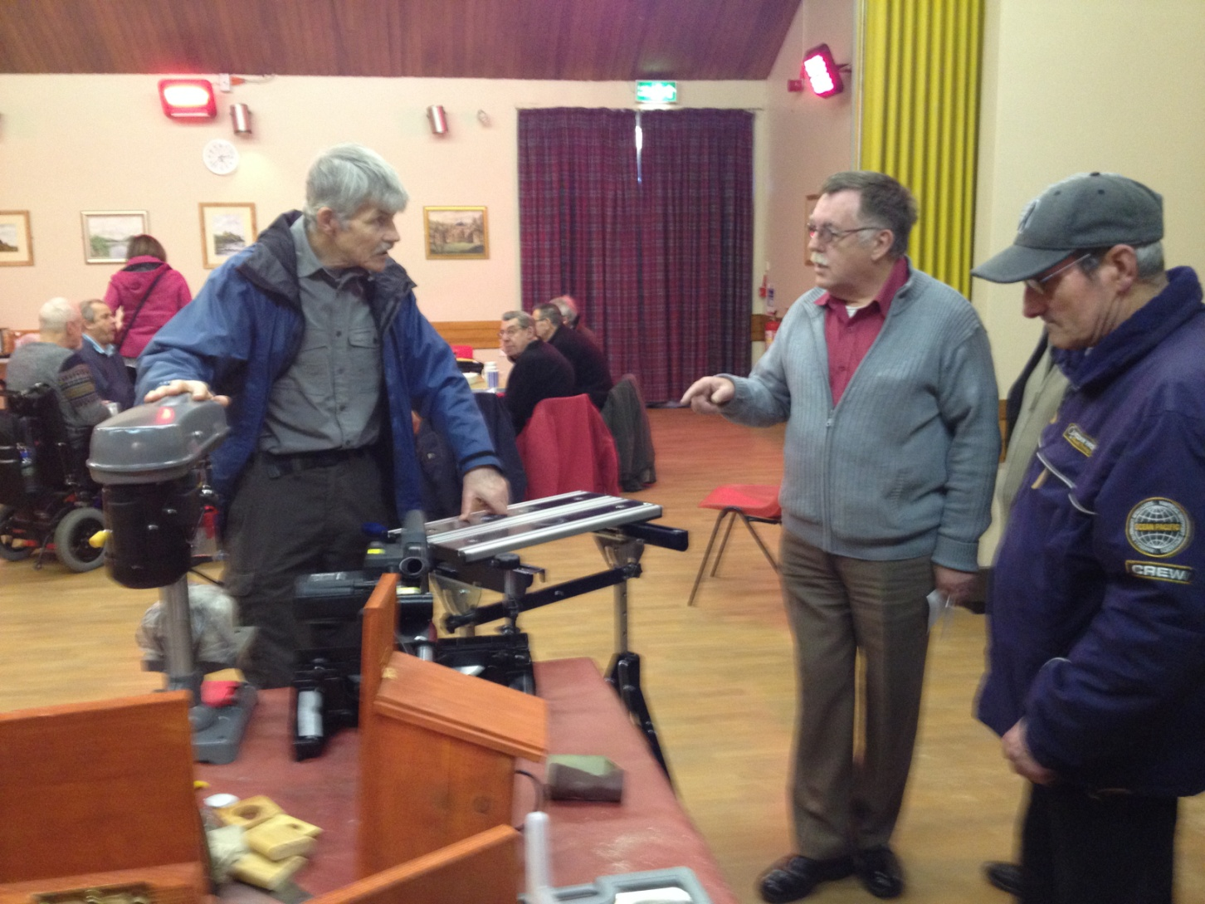

Slide 19
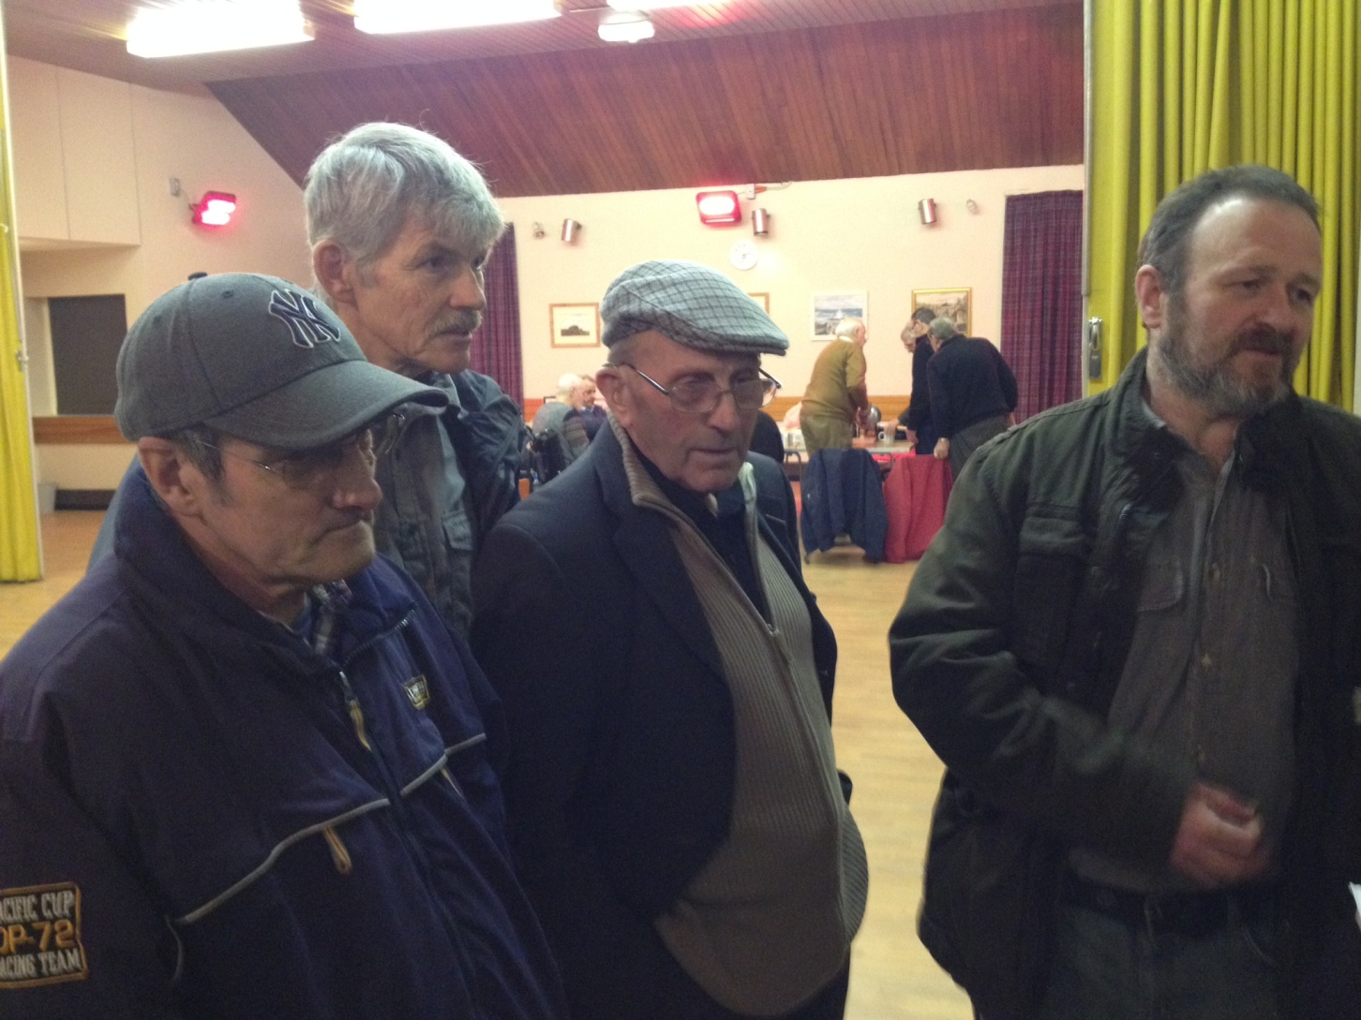

Slide 20
January 2014
Meeting with local Community Centre Management Committee
Use of room
Numbers growing – enthusiasm high

Slide 21
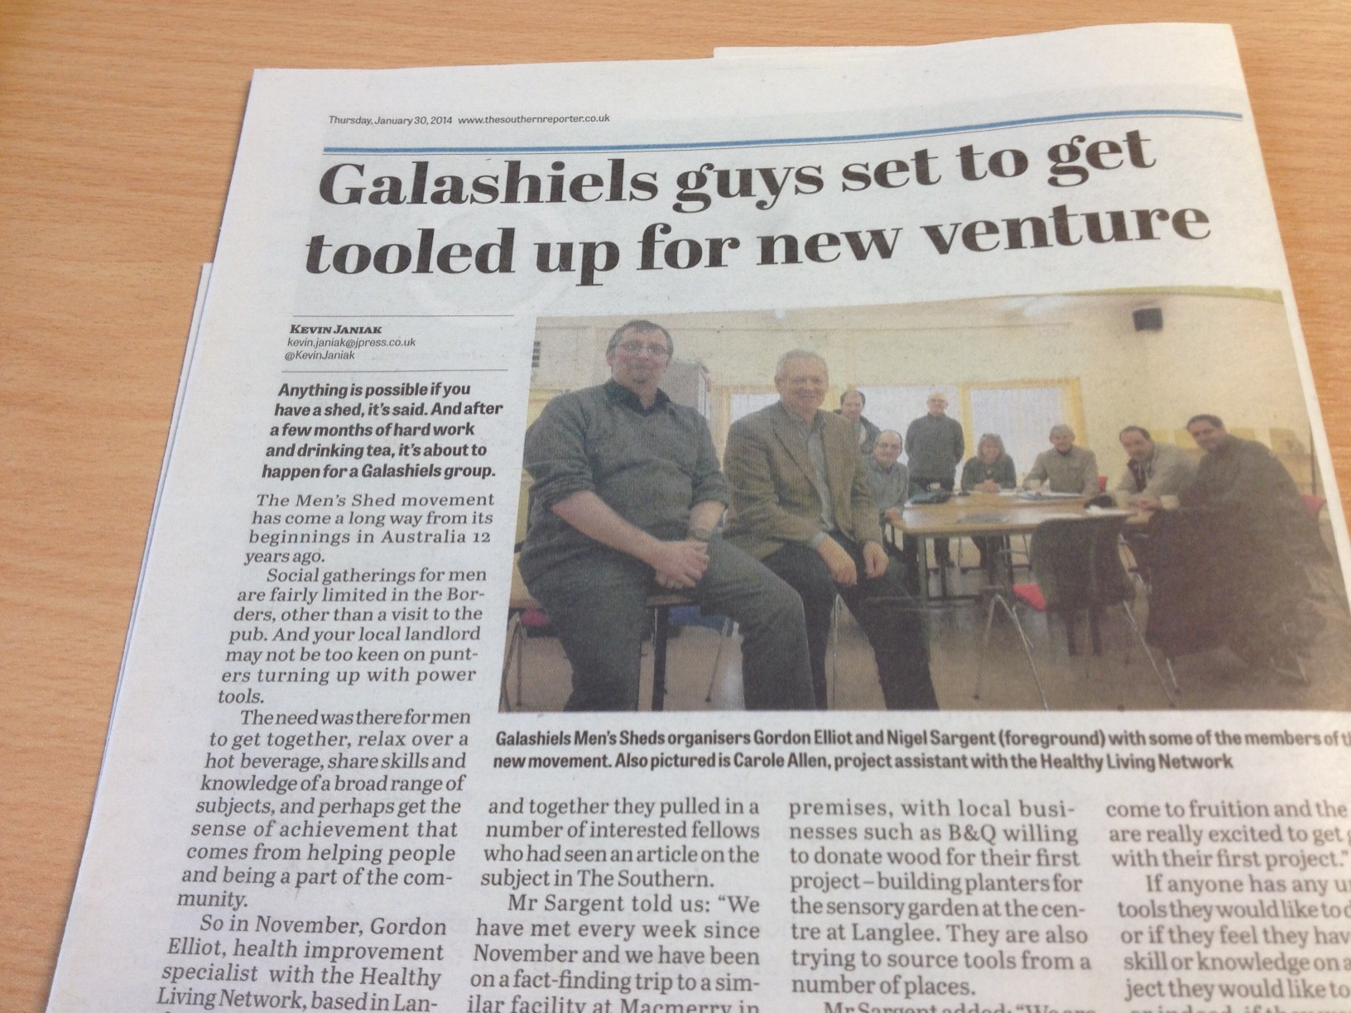

Slide 22
February/March 2014
Funding & Donations
Formation of Committee (rules, H&S etc)

Slide 23
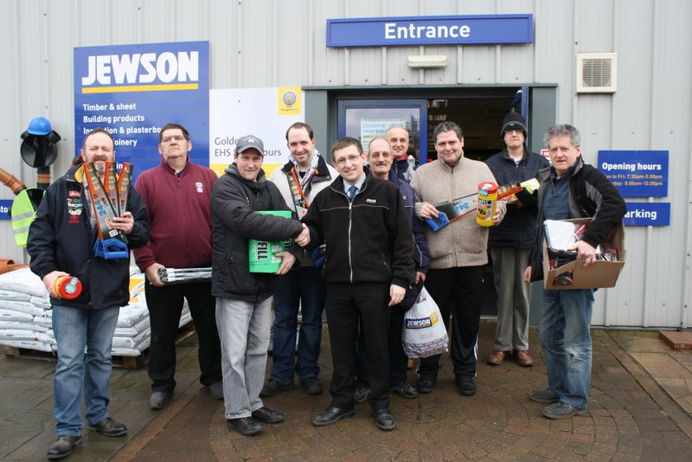

Slide 24
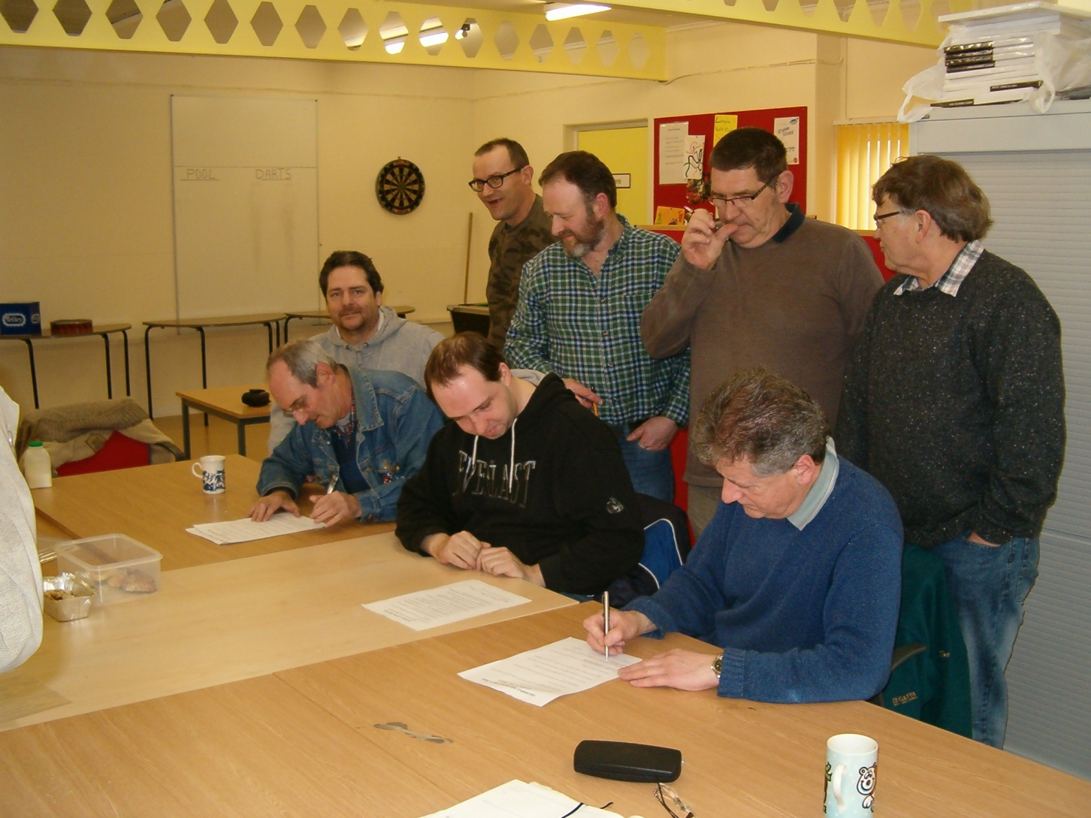

Slide 25
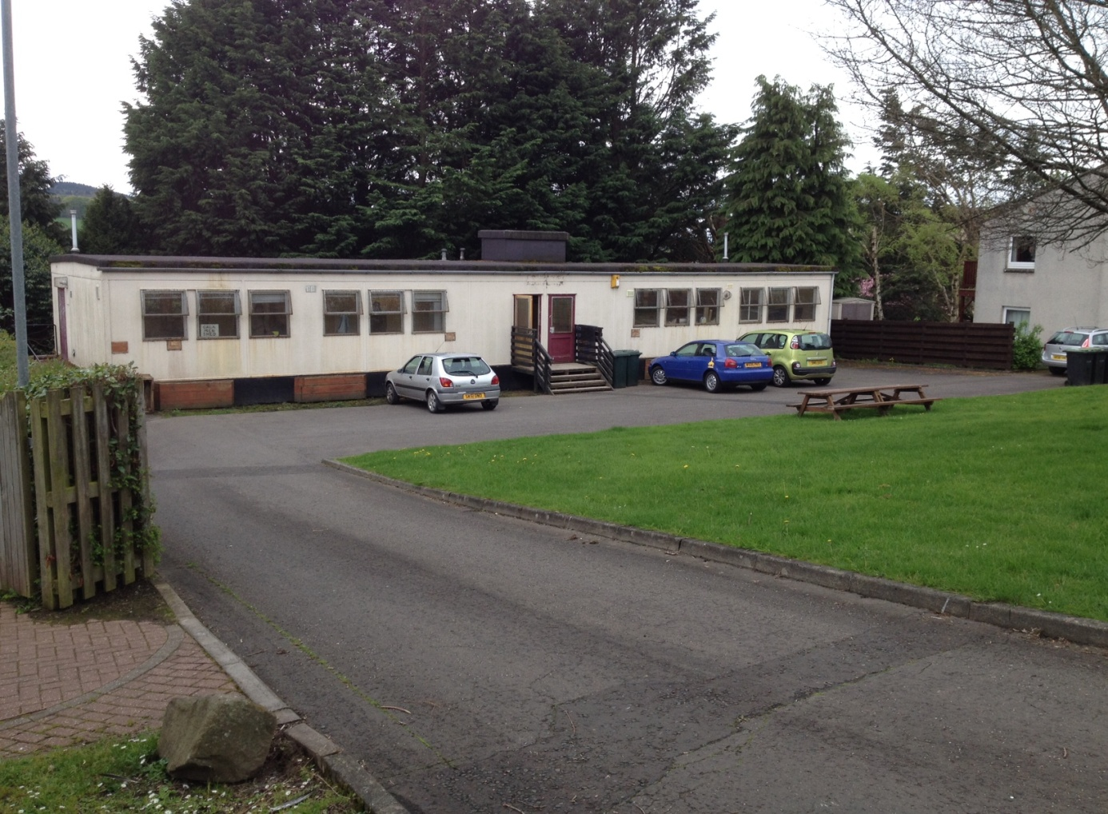

Slide 26
April - June 2014
Council agree lease of building
Core group established (range of ages, backgrounds, skills)
Projects underway / Health Checks
Referrals & enquiries continuing to grow (local and wider)
Official opening - 3rd July

Slide 27
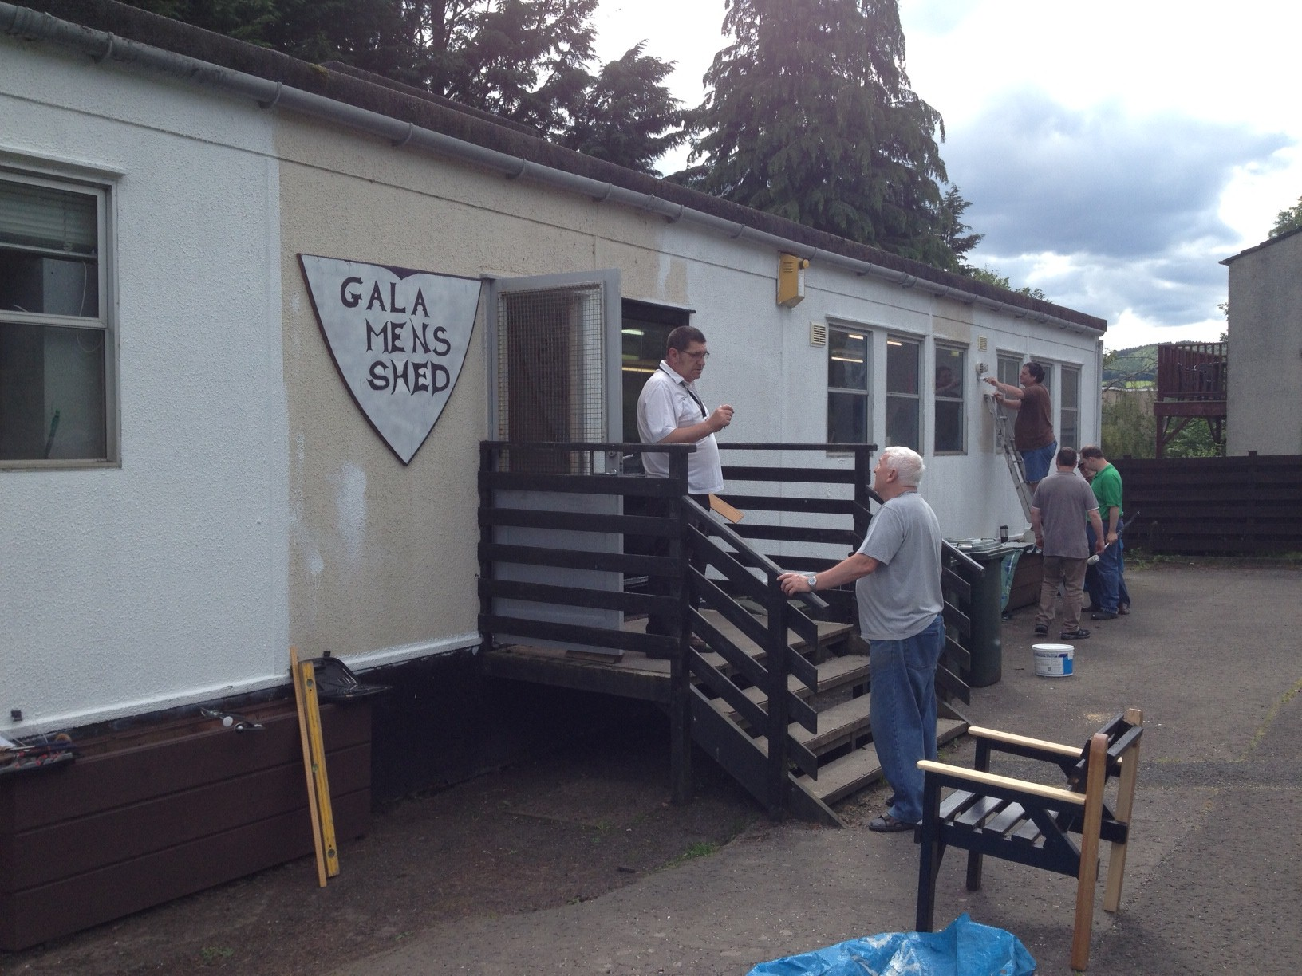

Slide 28
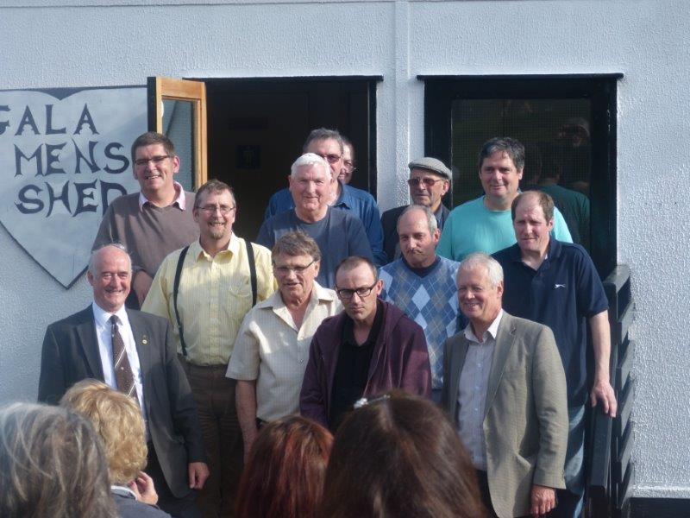

Slide 29
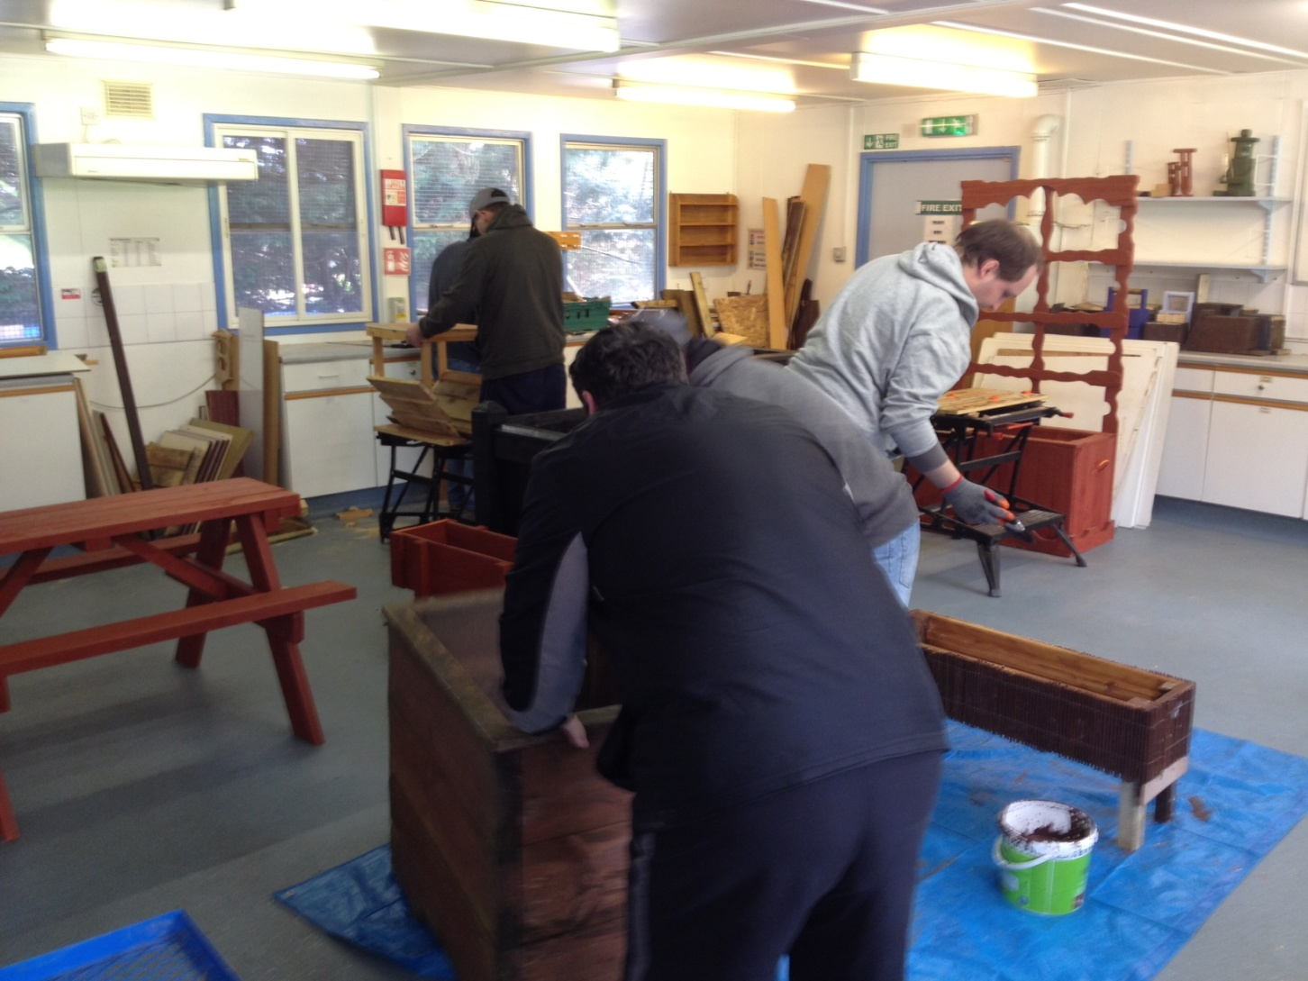

Slide 30
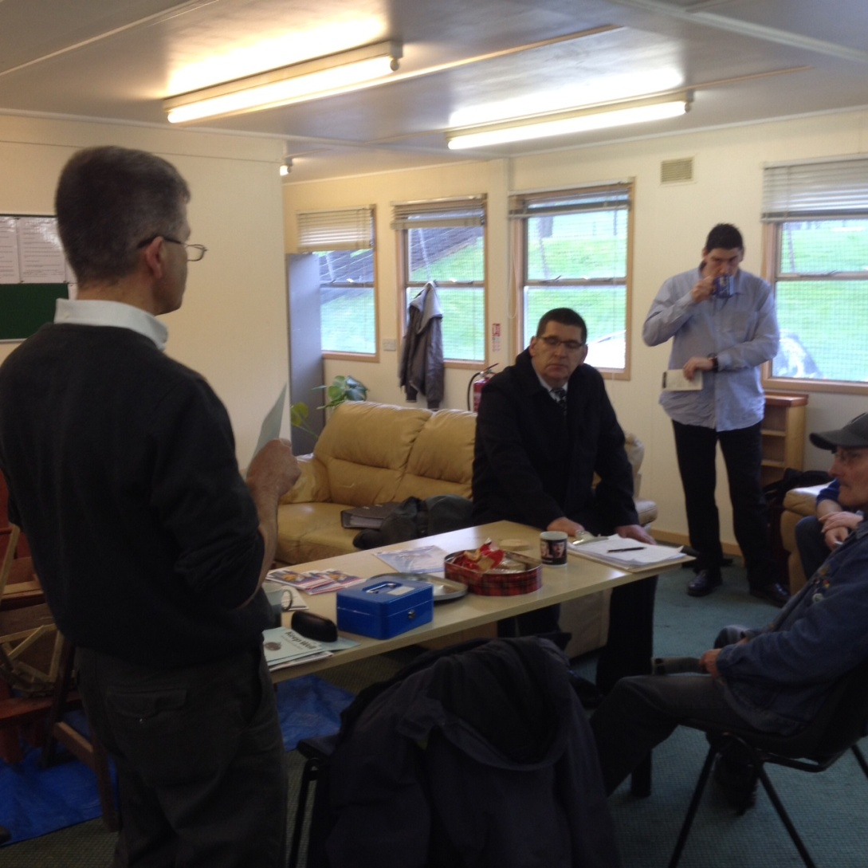

Slide 31
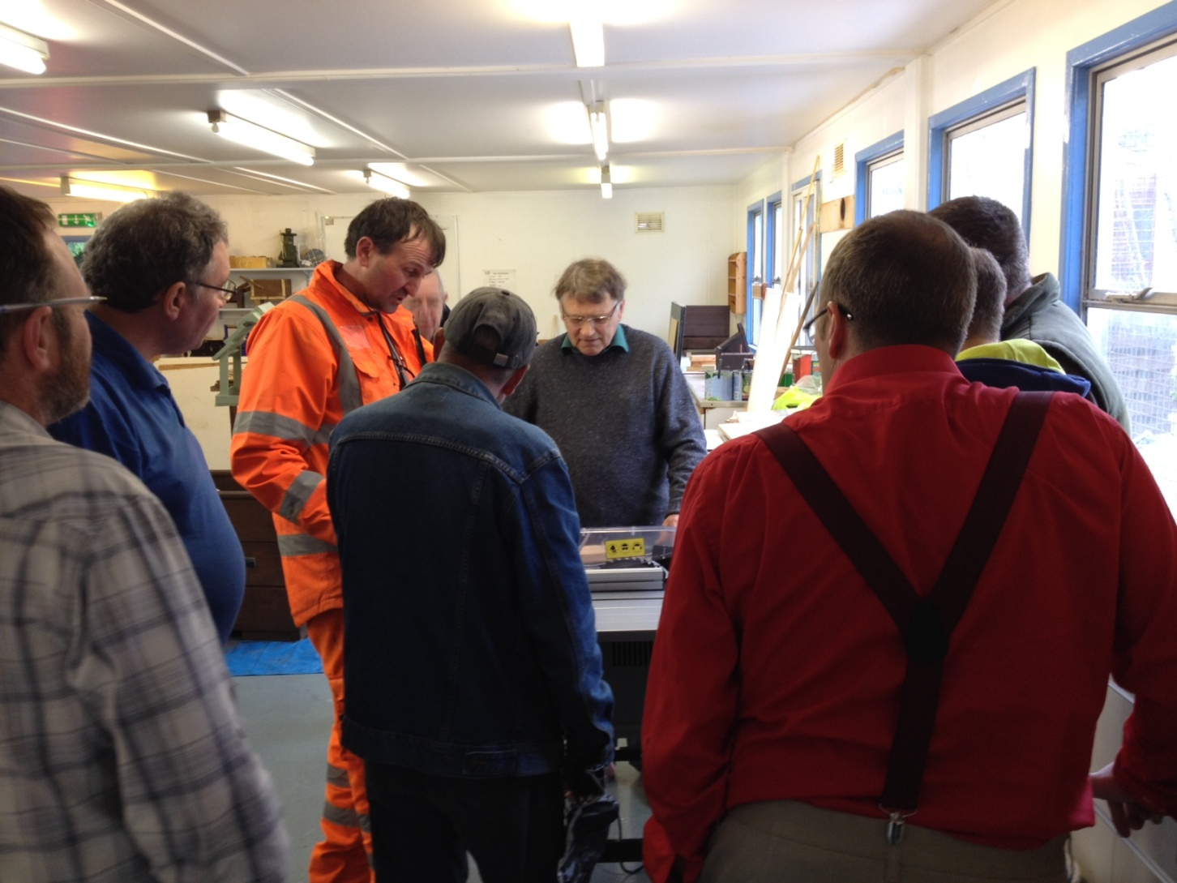

Slide 32
The Shedders
22 through the door
Core Group established
Age range 19 - 81 (but most over 50)
Range of backgrounds and skills
Some retired, some unemployed
Health issues
Confidence issues/isolation
Evolving dynamic
Growing integration
(Latent?) Abilities and interests emerging
Positive energy

Slide 33
Some challenges ahead
Membership
Sustainability
Ownership

Slide 34
Hidden demand
Don’t underestimate the energy
Grasping an idea... embarking on a journey!
Funding applications – need to be kept simple
“Shed is working as it allows men to gather socially, regularly, voluntarily, happily, safely and do hands on things together”
Everyone is equal – inclusive and welcoming of all men – “no patients/clients/customers – shed is not patronising”
Enquiries re. ‘service provision’
Filling a gap – range of referrals
Outcomes are diverse and powerful - Meets varied agendas ..... but dangers here
Engage range of partners
Who’s shed is it?

Slide 35
......and helping to tackle health inequalities in later life.

Slide 36
