Slide 1
Unequal lives, unjust deaths
Vulnerable adults: tackling health inequalities
Dr Andrew Fraser
Director of Public Health Science
Norton Park Conference Centre
August 2014
Notes:
Latest of a series
Children
Young people in transition
Now Vulnerable adults
Section – who are they?
illustrate the risks – mortality, the most unfortunate of many unfortunate events
Draw together a picture of the groups
Tackling the challenges they face

Slide 2
Who are vulnerable adults?
The law – Adult Support and Protection (Scotland) Act 2007
‘…adults who may be at risk of harm or neglect and who may not be able to protect themselves.’
Equality and Diversity groups – protected characteristics
Each group tends to experience poorer mental health, and higher (mortality) risks than the general populations
  Some exceptions
  Some examples
Notes:
Vulnerable adults are often the people you have identified in transitions in youth
They talk of ‘falling off a cliff’
Study of YP in transition, meeting patients and clinicians in CF services – so, designed CF for adults services

Slide 3
Age*, Asylum seekers and refugees, Carers, Disability* (mental and physical), Ethnicity*, Language, Literacy, Migrants, Poverty, Prisoners, Religion* and belief, Sex and gender*, Sexual orientation*
From: Dimensions of diversity, NHS Health Scotland, 2010
* Equality Act, protected characteristics
Notes:
Focus on a few – prisoners, homeless people, p w MH probs
But first a map…we look at inequality geographically in many cases

Slide 4
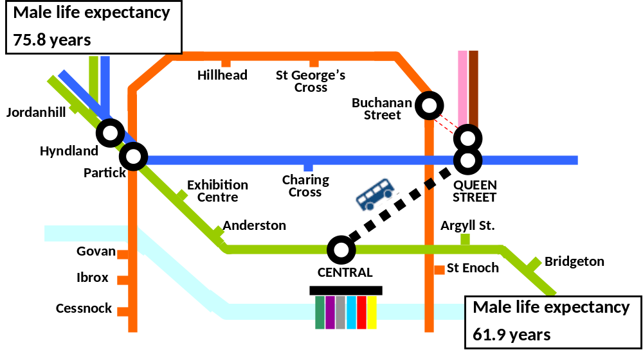
Source: McCartney G. Illustrating Glasgow’s health inequalities. JECH 2010; doi 10.1136/jech.2010.120451 .
Notes:
The stark health inequalities in Glasgow are demonstrated by the drop in life expectancy of 2.0 years for males and 1.2 years for females for each station on the railway line between Jordanhill and Bridgeton
These are adults, and they’re vulnerable to dying before their time –men, but the gap for women is equally large
Drawing State pension at 65 – minority….80%

Slide 5
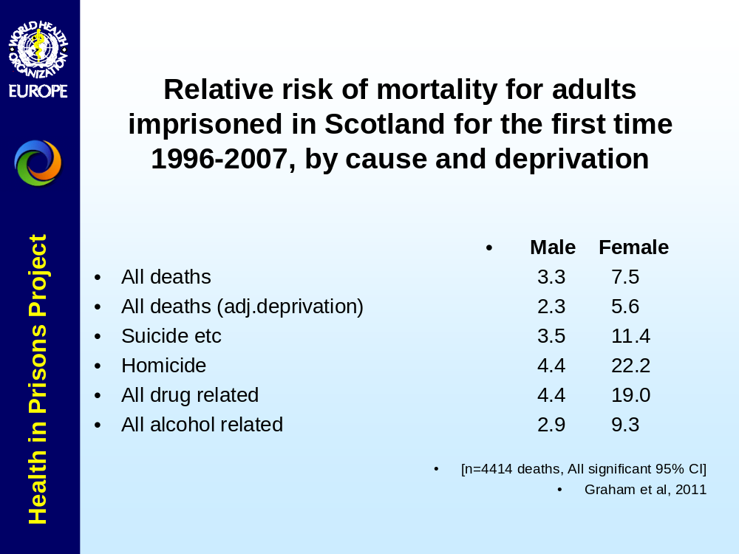
The rising population
Notes:
AF
Is prison a social determinant? A risk factor separate from being poor? Went to see Michael Marmot
£1/3bn – is it worth it?
50% of LAYP in trouble spend some time in prison
50% of people in prison say they’ve been in care at point in their early lives – a poor start marks you out for a poor transition, poor start to adulthood, parenthood – it’s a risk; it’s NOT inevitable.
Are prisoners vulnerable ? –yes.
They’ve lost their liberty, they’re in the company of other criminals, or detained people (18% in prison on remand are innocent until proven guilty)
They are very interchangeable – perpetrators one minute, victims often the next; the families they leave behind….are vulnerable.

Slide 6

Number of weeks between Prison Release and Death
Source: NDRDD 2009 data, Scotland
Notes:
AF

Slide 7
Homelessness Kills
Homeless death rate 4.5 times (3.2, matched with people from most deprived areas)
Mean age at death 41: 42 yrs (men), 37 yrs (women)
Cause of death –
  drugs 20-fold, alcohol 5-fold & circulatory – 2/3
  intentional self-harm 8-fold, assault 7-fold
Added risk of being homeless & dying
  drugs 7-fold, chest-related 3-fold, circulation 2-fold
David Morrison, Int J Epidemiology 2009
Glasgow Cohort, av.age 32 in 2000, n=6323 homeless:12625 non-homeless controls followed for 5 years, 2:1 men
Notes:
Even greater risk being homeless than having been in prison
But wait, they’re often both, the risks stack up
In Glasgow last year (13/14), there were 6,652 registered homeless
Vs 1600 Glaswegians in prison at any one time, 350 released each month
These figures have been replicated eslewhere

Slide 8
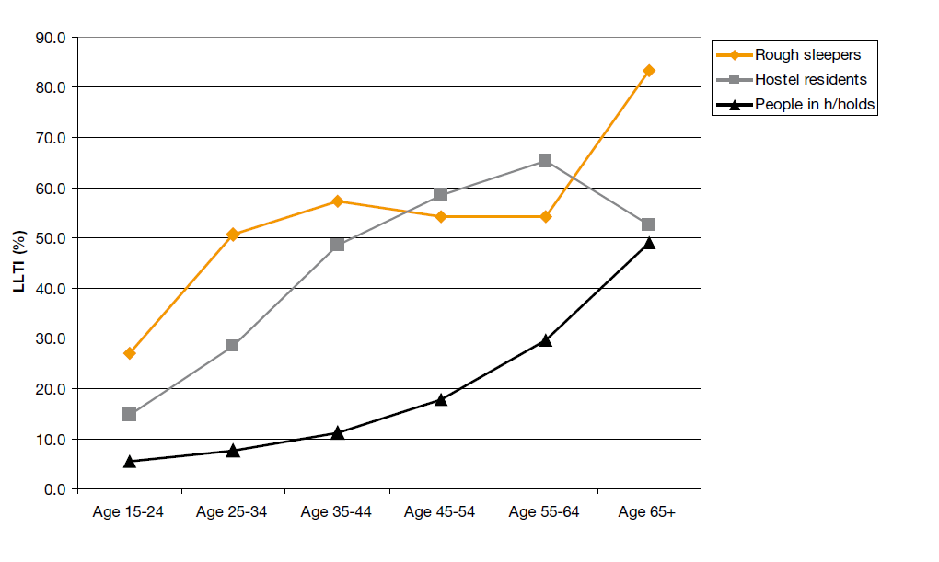
Self-reported limiting long-term illness (LLTI) rates by age and housing status
Source: Thomas B. Homelessness kills: An analysis of the mortality of homeless people in early twenty-first century England. Crisis: London; 2013.
Notes:
Mortality….illness

Slide 9
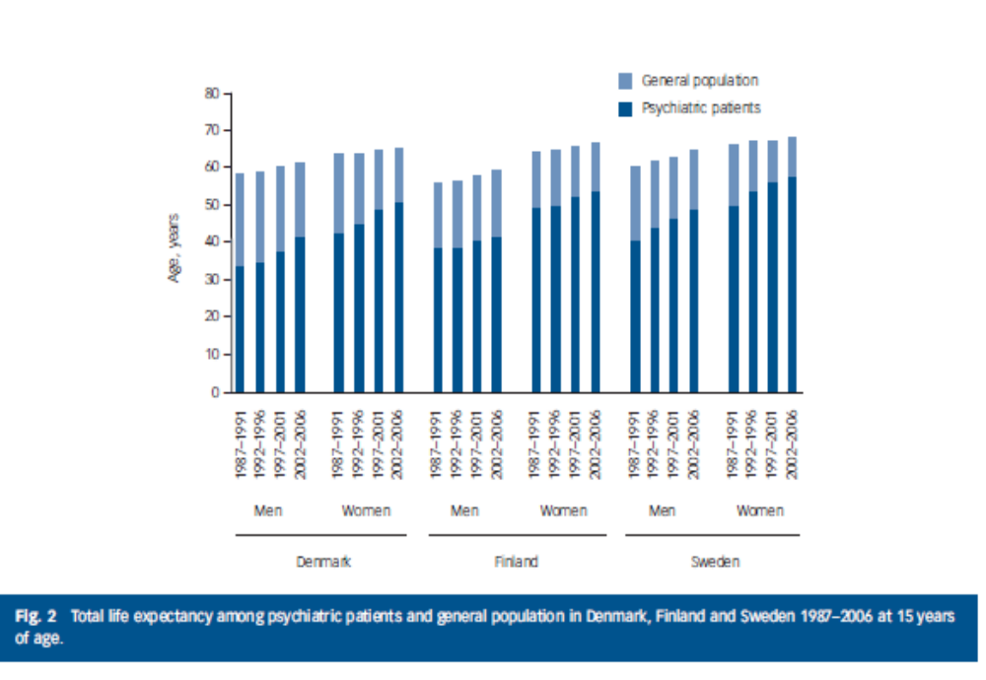
Mental health:
Shorter life expectancy, 3 Scandinavian Countries
Notes:
The casualty of any vulnerable group: The sort of stresses that vulnerable people and groups experience affects MH adversely, whatever the characteristic.
Mortality 2-3 times the general population
Life expectancy over 10 years shorter* - pale blue extra bar length is the additional life expectancy in the Gen. Pop.
*severe and enduring mental health problems, surveys of ‘patients’

Slide 10
‘Burglar Bill’s Problem List’
Drugs - Addiction
Drugs, Alcohol + Everything
Drugs - Debt
Accommodation
Partner, Parents, Children
Mental Health
Past Behaviour
Abuser and Abused
Reading, Writing, Counting
Teeth ……
……
Smoking
……
Employability – Get a Job
Effects on Victims

Slide 11
Multiple challenges
Multi-morbidity
Mental, Physical, Social dimensions to health
Social and economic determinants
The self-
Family and relationships
Communities
Experience of services
The services
‘The causes of the causes’
Notes:
And which comes first, especially with mental health?

Slide 12
What is most and least effective in reducing health inequalities?
Most likely to be effective
Structural changes to the environment, legislation, regulatory policies, fiscal policies, income support, improving accessibility of public services, prioritising disadvantaged population groups, intensive support, and starting young.
Least likely to be effective
Interventions such as information-based campaigns, written materials, campaigns reliant on people opting in, campaigns/messages designed for the whole population, whole school health education approaches, approaches which involve significant price or other barriers, and housing or regeneration programmes that raise housing costs.
Notes:
We know what is most and least likely to work (principles developed by Sally McIntyre for the first ministerial taskforce, and supported by more recent synthesis of health inequalities effectiveness evidence)
A substantial proportion of what we do is likely to have been effective in improving average population health, but may have also contributed to an increase in health inequalities. That’s basically because the least deprived have been able to benefit from the health improvement messages and campaigns, whilst those in the most deprived circumstances, with the least resources, have benefited least.
Stress that this poses a particular challenge to Health Scotland to review and revise what it has been doing-
Also important to stress that a lot of what we do is because it is what we have been asked to do it and it was right for the time, but that we now all need to recognise the need for a change in emphasis and be up for influencing that change.

Slide 13
Unequal lives, unjust deaths
Vulnerable adults: tackling health inequalities
Dr Andrew Fraser
andrew.fraser2@nhs.net
Norton Park Conference Centre
August 2014
Notes:
Voluntary sector –
If it understands the phenomenon just as well, it understands the challenge better, and is nimbler at finding the people and designing the services that make them easier to reach, help people benefit more.
Multiple
Dealt a bad hand, harder to play it better and succeed
More miles on the clock by the time of reaching adulthood.
Generally speaking, vulnerable people have poorer health experience, with some exceptions. Know your population.
There are things that are worth doing; other things are not.
Intensive support for people with multiple problems.
But look upstream, sort the causes of the causes – income, power, resources.
No knowledge is perfect, make the most of what we have, and add to it – learning as you go helps others in a science sense, as well as experience and insight..

