Slide 1
Evidence base for tackling health inequalities in transition services and critical transition periods
Ruth Jepson, Senior Scientific Advisor, Scottish Collaboration for Public Health Research and Policy (SCPHRP)
John McAteer, SCPHRP

Slide 2

SCPHRP’s Adolescence and Young Adulthood Working Group
Members: Scottish policy makers, researchers and practitioners
Aim: To develop and evaluate interventions to reduce risky behaviours and promote positive youth outcomes.
Three sub-groups:
Protecting young people in transition
School, education and health
Social connectedness (including parenting and families)
Lead Fellow: John McAteer (john.mcateer@ed.ac.uk)

Slide 3

Context around transitions
Post-war socio-economic prosperity and security in advanced societies allowed a sufficiently large number of young people to follow an identical route of transition.
Today’s young people experience transition in an inconsistent set of economic and social conditions.
Subsequently, pathways to adulthood have become more complex and unpredictable and appear to have lengthened
Mary, 2013 http://www.tandfonline.com/loi/cjys20

Slide 4
Many types of transition
Type | Transition from | Transition to
Educational | School | Further education, (un)employment etc
Biological (puberty) | Child | Adult
Cognitive etc (responsibility and control) | Dependent child | Independent adult, with more autonomy and control
Social (identity) | School child | Other identity (e.g. student, worker); also as an independent thinker
Geographical (including housing) | Familiar community | Another community, or geographical area
Financial | Financially dependent | Financially independent
Services | Child services | Adult services

Slide 5
Vulnerability to poor health–related outcomes
Not vulnerable: no need for additional services (majority)
Most transition well
Little effect on health related outcomes
Vulnerable: may or may not be identified; not connected to services (significant minority)
Some do not transition well
Some significant effects on health related outcome
Very vulnerable: already identified and connected to services (approx 10%)
Transition variable, depending on services
Some significant effects on health related outcomes

Slide 6
Interventions for young people already connected with services

Slide 7
Transition for young people using health or social care services
Consequences of poor transitions include broken relationships with health and social care practitioners, disengagement with services and deteriorating health
Young people have said that a good transition process depends more on support from practitioners than what transition model they receive
NICE Guidance in development:
Transition from children's to adult services for young people using health or social care services
Date due: May 2016
http://www.nice.org.uk/media/70C/28/TransitionfromChildrenstoAdultServicesforYoungPeopleUsingHealthorSocialCareServicesFinalScope.pdf

Slide 8
Children using healthcare services
The most commonly used strategies (mainly from diabetes studies)in successful programmes were:
patient education and;
specific transition clinics (either jointly staffed by paediatric and adult physicians or dedicated young adult clinics within adult services).
Crowley et al, Improving the transition between paediatric and adult healthcare: a systematic review http://adc.bmj.com/content/early/2011/03/08/adc.2010.202473.abstract

Slide 9
Transition support services (TSSs)
Types of TSS reported by studies are independent living programs (ILPs) (mainly US) and leaving care services (LCSs) (mainly UK).
Studies that evaluated TSS found young people were more likely to:
complete compulsory education with formal qualifications
be in current employment
be living independently
and less likely to be young parents.
There was no reported effect of the impact of TSSs on crime or mental health, and mixed findings for homelessness.
Limitations: most studies undertaken in the US, and difficult to know which components of the support services were most effective
http://www.gserve.nice.org.uk/nicemedia/live/11879/47413/47413.pdf

Slide 10
Universal approaches to reducing health inequalities:
Importance of resilience and connectedness

Slide 11
The importance of resilience
The evidence suggests that vulnerable young people are often vulnerable because they have lacked a solid emotional base in their early years. Being vulnerable is not just about circumstances (economic etc), but about having the emotional resilience in place, to cope with the transitional stages.
Vulnerable or ‘at risk’ young people are those who have low resilience (at the individual, family, or community level)
Strategies focussed on the early years have the potential to have the biggest impact on resilience, but we still need to help those who have not benefited from these.

Slide 12
Successful interventions to increase resilience
Successful programmes are those that focus on:
competencies
prosocial attitudes and values
individual goals of success
mastery and achievement.
Critical to these efforts is the sustained involvement of caring adults in the context of individual and group-based relationships
McCreanor et al, 2012, Resiliency, Connectivity and Environments: Their Roles in Theorising Approaches to Promoting the Well-Being of Young People. International Journal of Mental Health Promotion

Slide 13
The importance of connectedness
As well as increasing resilience, a key element in effecting change for vulnerable young people is connectedness
Connectedness is concerned with relationships between people and/or groups of people, occurring within a range of settings, including communities, families and peer groups or friendship networks.
There is growing evidence that these are important drivers of health and wellbeing across the lifecourse

Slide 14
Strengthening connectedness in the home, school and community
Services should aim to strengthen, or put in place:
• Strong social support networks
• Presence of a least one unconditionally supportive parent/parent substitute
• A committed mentor or other person from outside the family
• Positive school experiences
• Participation in a range of extra-curricular activities
• Capacity to re-frame adversities so that the beneficial as well as the damaging effects are recognised
• The ability – or opportunity – to ‘make a difference’ by helping others
https://www.actionforchildren.org.uk/media/145693/resilience_in_children_in_young_people.pdf

Slide 15
Considerations
Building resilience is more than just providing individuals with knowledge, skills and positive attitudes, although programmes that do this are helpful.
Resilience is also about the relationships between adults and children and young people. Programmes that strengthen connectedness generally have positive outcomes.
Resilience is shaped by policies that enhance the abilities of families, schools and communities to provide structure and opportunities for young people to contribute, participate and develop skills.
The best outcomes occur when policies ensure that programmes work together across silos.

Slide 16
Conclusions
Transition Support Services for those who are already in contact with health or social care services are effective for a range of outcomes
Resiliency and connectedness (to families, school and the community) are strong protective factors and services should aims to strengthen these factors.
Services should focus on strengthening these factors, especially in vulnerable young people not already identified by the services

Slide 17
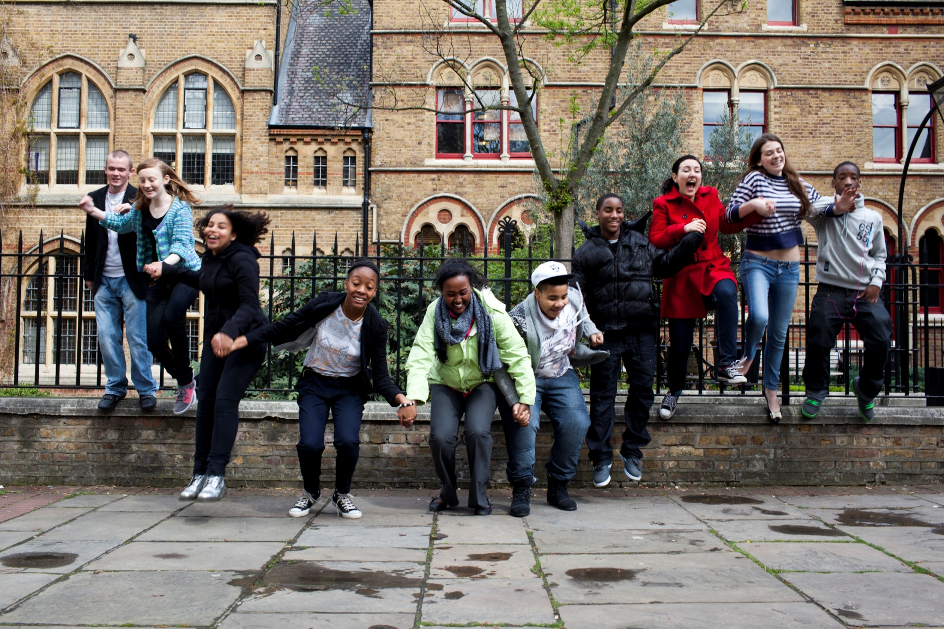
Thank You
Follow us on Twitter: @SCPHRP
YouTube: youtube.com/scphrp1

