Slide 1
School, post-school transitions and young people’s well-being
Helen Sweeting
The new SEED process: aiming to smooth transition from primary to secondary school
Marion Henderson
MRC/CSO Social and Public Health Sciences Unit, Glasgow
Scottish Transitions Forum meeting ‘Unequal lives, unjust deaths’, Glasgow, June 2014
Notes:
I’m focusing on school and post-school transitions and young people's well-being.
I’ll be showing you results from one of our cohort datasets.

Slide 2
School, post-school transitions and young people’s well-being
Helen Sweeting

Slide 3
Primary
Secondary
Notes:
The transition from primary to secondary school has been depicted both as ‘one of the most difficult in pupils’ educational careers’ and as a ‘key rite of passage’ for young people.
It is a move from the smaller, more personal environment of the primary school to the larger, impersonal world of the secondary school .
It involves new educational demands, exposure to many more (older) pupils, associated peer groups and pressures and so poses quite a challenge to identity.
So how much does it matter?

Slide 4
Primary
Secondary
Surveyed | P7 | S2 | S4 | 19

Slide 5
Primary
Secondary
Surveyed | P7 | S2 | S4 | 19
Measures | Pupil characteristics School characteristics | Recalled transition Pupil characteristics School characteristics | Well-being & achievement | Well-being & achievement

Slide 6
Primary
Secondary
Surveyed | P7 | S2 | S4 | 19
Measures | Pupil characteristics School characteristics | Recalled transition Pupil characteristics School characteristics | Well-being & achievement | Well-being & achievement

Slide 7
Primary
Secondary
Surveyed | P7 | S2 | S4 | 19
Measures | Pupil characteristics School characteristics | Recalled transition Pupil characteristics School characteristics | Well-being & achievement | Well-being & achievement

Slide 8
Primary
Secondary
Surveyed | P7 | S2 | S4 | 19
Measures | Pupil characteristics School characteristics | Recalled transition Pupil characteristics School characteristics | Well-being & achievement | Well-being & achievement

Slide 9
Primary
Secondary
Surveyed | P7 | S2 | S4 | 19
Measures | Pupil characteristics School characteristics | Recalled transition Pupil characteristics School characteristics | Well-being & achievement | Well-being & achievement

Slide 10
Primary
Secondary
Surveyed | P7 | S2 | S4 | 19
Measures | Pupil characteristics School characteristics | Recalled transition Pupil characteristics School characteristics | Well-being & achievement | Well-being & achievement
Notes:
Our survey followed pupils from P7 to post-school at age 19.
So we surveyed them before and after the primary-secondary transition.
I’m going to show you some results based on measures obtained from each survey. But the particular focus is on how our cohort, once they were in S2, recalled the transition to secondary. And also on well-being and achievement at S4 and post-school at 19.
So we’ll be looking at recalled primary-secondary transition
And at how it was associated with various P7 and S2 pupil and school characteristics.
And we’ll be looking at how the primary-secondary transition, along with various pupil and school characteristics were associated with subsequent well-being and achievement – both in S4.
And at 19, after leaving school.

Slide 11
Recalled transition concerns – two types
School concerns | Peer concerns
school size | older kids
timetable | bullying
work volume | mixing
different teachers | new friends

Slide 12
Recalled transition concerns – two types
School concerns | Peer concerns
school size | older kids
timetable | bullying
work volume | mixing
different teachers | new friends

Slide 13
Recalled transition concerns – two types
School concerns | Peer concerns
school size | older kids
timetable | bullying
work volume | mixing
different teachers | new friends
Notes:
We included a list of possible transition-related concerns and found they split into two groups.
Some were about the school – its size, timetable, the amount of work, and coping with lots of different teachers.
And some were about peers – things like coping with lots of older kids, bullying, mixing and making new friends.

Slide 14
Correlates of recalled transition concerns
School concerns | Peer concerns
P7 – poor maths ability P7 – low self-esteem S2 – class less engaged | Higher social class P7 – high anxiety P7 – low self-esteem P7 – low aggression P7 – victimised P7 – less engaged from school S2 – unprepared for secondary S2 – fewer pals at secondary S2 – more primaries S2 – class less engaged

Slide 15
Correlates of recalled transition concerns
School concerns | Peer concerns
P7 – poor maths ability P7 – low self-esteem S2 – class less engaged | Higher social class P7 – high anxiety P7 – low self-esteem P7 – low aggression P7 – victimised P7 – less engaged from school S2 – unprepared for secondary S2 – fewer pals at secondary S2 – more primaries S2 – class less engaged

Slide 16
Correlates of recalled transition concerns
School concerns | Peer concerns
P7 – poor maths ability P7 – low self-esteem S2 – class less engaged | Higher social class P7 – high anxiety P7 – low self-esteem P7 – low aggression P7 – victimised P7 – less engaged from school S2 – unprepared for secondary S2 – fewer pals at secondary S2 – more primaries S2 – class less engaged
Notes:
So – who was most likely to have concerns?
School concerns were more likely to be recalled by those who we’d found had poor maths ability and low self-esteem in P7.
They were also more likely among those whose secondary school class was less engaged.
Far more variables were associated with peer concerns.
Higher social class pupils had more peer concerns.
As did those who in P7 had higher anxiety, lower self-esteem, were LESS aggressive, victimised and less engaged with school
And in S2 this group were more likely to say they’d been unprepared for secondary, had fewer secondary-age pals and had more primary school moves.
They were also more likely among those whose secondary school class was less engaged.

Slide 17
Correlates of S4 well-being and achievement
Psychological distress | Antisocial behaviour | Standard grades
Worse school transition Worse peer transition Female High parental control Low parental care Previous distress P7 - victimisation P7 - disengaged from school S2 – disengaged from school | Better peer transition Male Low parental care Previous ASB P7 – aggression S2 – more pals at secondary S2 – more primaries S2 – disengaged from school | Better school transition Female Higher social class P7 – better maths ability P7 – lower aggression S2 – not disengaged from school S2 –pupils rated school ethos better

Slide 18
Correlates of S4 well-being and achievement
Psychological distress | Antisocial behaviour | Standard grades
Worse school transition Worse peer transition Female High parental control Low parental care Previous distress P7 - victimisation P7 - disengaged from school S2 – disengaged from school | Better peer transition Male Low parental care Previous ASB P7 – aggression S2 – more pals at secondary S2 – more primaries S2 – disengaged from school | Better school transition Female Higher social class P7 – better maths ability P7 – lower aggression S2 – not disengaged from school S2 –pupils rated school ethos better

Slide 19
Correlates of S4 well-being and achievement
Psychological distress | Antisocial behaviour | Standard grades
Worse school transition Worse peer transition Female High parental control Low parental care Previous distress P7 - victimisation P7 - disengaged from school S2 – disengaged from school | Better peer transition Male Low parental care Previous ASB P7 – aggression S2 – more pals at secondary S2 – more primaries S2 – disengaged from school | Better school transition Female Higher social class P7 – better maths ability P7 – lower aggression S2 – not disengaged from school S2 –pupils rated school ethos better

Slide 20
Correlates of S4 well-being and achievement
Psychological distress | Antisocial behaviour | Standard grades
Worse school transition Worse peer transition Female High parental control Low parental care Previous distress P7 - victimisation P7 - disengaged from school S2 – disengaged from school | Better peer transition Male Low parental care Previous ASB P7 – aggression S2 – more pals at secondary S2 – more primaries S2 – disengaged from school | Better school transition Female Higher social class P7 – better maths ability P7 – lower aggression S2 – not disengaged from school S2 –pupils rated school ethos better

Slide 21
Correlates of S4 well-being and achievement
Psychological distress | Antisocial behaviour | Standard grades
Worse school transition Worse peer transition Female High parental control Low parental care Previous distress P7 - victimisation P7 - disengaged from school S2 – disengaged from school | Better peer transition Male Low parental care Previous ASB P7 – aggression S2 – more pals at secondary S2 – more primaries S2 – disengaged from school | Better school transition Female Higher social class P7 – better maths ability P7 – lower aggression S2 – not disengaged from school S2 –pupils rated school ethos better

Slide 22
Correlates of S4 well-being and achievement
Psychological distress | Antisocial behaviour | Standard grades
Worse school transition Worse peer transition Female High parental control Low parental care Previous distress P7 - victimisation P7 - disengaged from school S2 – disengaged from school | Better peer transition Male Low parental care Previous ASB P7 – aggression S2 – more pals at secondary S2 – more primaries S2 – disengaged from school | Better school transition Female Higher social class P7 – better maths ability P7 – lower aggression S2 – not disengaged from school S2 –pupils rated school ethos better
Notes:
Importantly, we found that these transition experiences were associated with later well-being and achievement.
In analyses adjusting for heaps of variables – I’ve shown all the significant ones here, but don’t focus on them.
First, we found that psychological distress in S4 was associated with recalling worse school AND peer transitions.
Interestingly, antisocial behaviour in S4 was associated with recalling a BETTER peer transition.
While more standard grades in S4 were associated with recalling a better SCHOOL transition.
Importantly, all these analyses also included prior levels of distress, ASB or ability as appropriate.

Slide 23
Correlates of post-school (age 19) well-being and achievement
Psychological distress | Highers
Worse peer transition Female Lone parent family Low parental care Previous distress P7 – victimisation S2 – researchers rated school ethos poor | Better school transition Female Higher social class Two parent family P7 – better maths ability P7 – lower aggression S2 – not disengaged from school S2 –pupils rates school ethos better
Notes:
And POST-SCHOOL psychological distress was associated with recalling worse peer transitions.
While more highers were associated with recalling a better school transition.

Slide 24
Conclusions
Primary-secondary transition matters!
Vulnerabilities (health/behaviour/ability) =
worse transition (esp peer transition)
Worse school transition =
more distress,
lower achievement.
Worse peer transition =
more distress,
lower anti-social behaviour.
Notes:
So we conclude from these analyses that the primary-secondary transition matters.
More vulnerable children - in terms of health, behaviour and ability tend to have worse transitions.
And transitions impact on well-being and achievement, during and post school.

Slide 25
But what about post-school transitions?
Health at school and post-school transitions
How transitions impact on health
Notes:
But what about post-school transitions?
We can look at these in the same sample. I’m going to show you how health while at school was associated with post-school transitions.
And also how those transitions impacted on health.

Slide 26
Odds of poor health in S4 according to labour market position at 19
 | Psychological distress | Poor self-rated health
Education (HE/FE) | 1.00 | 1.00
Training | 0.85 | 1.85 *
Work | 1.03 | 1.79 ***
Unemployed/’at home’ | 1.04 | 2.35 ***
Odds AFTER ACCOUNTING FOR gender, parental social class and area deprivation

Slide 27
Odds of poor health in S4 according to labour market position at 19
 | Psychological distress | Poor self-rated health
Education (HE/FE) | 1.00 | 1.00
Training | 0.85 | 1.85 *
Work | 1.03 | 1.79 ***
Unemployed/’at home’ | 1.04 | 2.35 ***
Odds AFTER ACCOUNTING FOR gender, parental social class and area deprivation
Notes:
.

Slide 28
Odds of poor health in S4 according to labour market position at 19
 | Psychological distress | Poor self-rated health
Education (HE/FE) | 1.00 | 1.00
Training | 0.85 | 1.85 *
Work | 1.03 | 1.79 ***
Unemployed/’at home’ | 1.04 | 2.35 ***
Odds AFTER ACCOUNTING FOR gender, parental social class and area deprivation

Slide 29
Odds of poor health in S4 according to labour market position at 19
 | Psychological distress | Poor self-rated health
Education (HE/FE) | 1.00 | 1.00
Training | 0.85 | 1.85 *
Work | 1.03 | 1.79 ***
Unemployed/’at home’ | 1.04 | 2.35 ***
Odds AFTER ACCOUNTING FOR gender, parental social class and area deprivation
Notes:
First, how was health while at school associated with post-school transitions?
This slide shows the odds – the likelihood of various measures of health and well-being among S4 pupils according to what they ended up doing by age 19. the comparison group is those who were in full-time education at 19.
Because we know that young people’s health and their economic activity are associated with gender, and differ according to their home circumstances, these analyses have accounted for the effects of gender, parental social class and area deprivation.
So first – was psychological distress in S4 associated with what they were doing by age 19? The answer is no.
What about self-rated health? The answer is yes – compared to those who were in education, young people in training or work had been more likely to report poor health when they were in school. And those who were unemployed or ‘at home’ were much more likely to have previously reported poor health. These differences were statistically significant.

Slide 30
Odds of CHANGE TO poor health according to labour market position at 19
 | Increasing psychological distress | Worsening self-rated health
Education (HE/FE) | 1.00 | 1.00
Training | 0.76 | 1.80 *
Work | 0.87 | 1.33 *
Unemployed/’at home’ | 1.74 * | 3.03 ***
Odds AFTER ACCOUNTING FOR gender, previous poor health

Slide 31
Odds of CHANGE TO poor health according to labour market position at 19
 | Increasing psychological distress | Worsening self-rated health
Education (HE/FE) | 1.00 | 1.00
Training | 0.76 | 1.80 *
Work | 0.87 | 1.33 *
Unemployed/’at home’ | 1.74 * | 3.03 ***
Odds AFTER ACCOUNTING FOR gender, previous poor health

Slide 32
Odds of CHANGE TO poor health according to labour market position at 19
 | Increasing psychological distress | Worsening self-rated health
Education (HE/FE) | 1.00 | 1.00
Training | 0.76 | 1.80 *
Work | 0.87 | 1.33 *
Unemployed/’at home’ | 1.74 * | 3.03 ***
Odds AFTER ACCOUNTING FOR gender, previous poor health
Notes:
So – we’ve established that aspects of secondary school health and well-being seem to predict future transitions.
But are those transitions in themselves associated with changes in health and well-being?
This slide shows the odds of a change in health between S4 and age 19 according to what the young people were doing at age 19.
So first we look at increasing psychological distress between S4 and 19 – again, the odds compared with those in education. And this was more likely among the unemployed or at home group.
Increases in poor self-rated health can be seen in every group compared with those in education – but were much more likely among those unemployed or at home.

Slide 33
Odds of CHANGE TO poor health at age 19 according to worries about unemployment
 | Increasing psychological distress | Worsening self-rated health
Worry about unemployment ....
Not at all | 1.00 | 1.00
A bit | 1.34 | 1.16
A lot | 2.31*** | 1.40*
Analysis limited to those NOT currently unemployed

Slide 34
Odds of CHANGE TO poor health at age 19 according to worries about unemployment
 | Increasing psychological distress | Worsening self-rated health
Worry about unemployment ....
Not at all | 1.00 | 1.00
A bit | 1.34 | 1.16
A lot | 2.31*** | 1.40*
Analysis limited to those NOT currently unemployed

Slide 35
Odds of CHANGE TO poor health at age 19 according to worries about unemployment
 | Increasing psychological distress | Worsening self-rated health
Worry about unemployment ....
Not at all | 1.00 | 1.00
A bit | 1.34 | 1.16
A lot | 2.31*** | 1.40*
Analysis limited to those NOT currently unemployed
Notes:
So – we’ve now also established that post-school transitions – especially into unemployment – are associated with increases in poor health.
But is even worrying about unemployment associated with changes in health?
Again - this slide shows the odds of a change in health between S4 and age 19.
But this time the analysis was restricted to those in education, work or training. So those who WEREN’T currently unemployed.
And it looks at the two health measures according to how worried they said they were about future unemployment.
It shows those who were most worried about future unemployment had the highest odds of increases in distress and in poor self-rated health between S4 and 19.
We can’t be sure from this if worries about unemployment are driving the increasingly poor health – or if increasingly poor health is driving worries about unemployment. But it’s an interesting finding.

Slide 36
Summary
Post-school transition (especially to un/non-employment) also matters!
Poor self-rated health at school associated with future unemployment.
Post-school unemployment associated with increases in distress and poor self-rated health (as are training/work, but less so).
Worrying about unemployment associated with poor health ... may be causal.
Notes:
So we conclude that as well as the primary-secondary transition, post-school transitions also matter for young people's health and well-being.
Poor self-rated health at school is associated with future unemployment.
Post-school unemployment is associated with increases in distress and poor self-rated health (as are training/work, but less so).
And worrying about unemployment associated with poor health ... And although we can’t be sure, this may be causal.

Slide 37
The new SEED process: aiming to smooth transition from primary to secondary school
Marion Henderson
Sarah Tweedie
MRC/CSO Social and Public Health Sciences Unit
24th June 2014

Slide 38

The SEED Trial
MRC/CSO SPHSU, University of Glasgow Research Team
Dr Marion Henderson: Chief Investigator, SEED
Prof Danny Wight: Children Young People Family and Health (CYPFAH) Programme Leader/Co-investigator
Sarah Tweedie: Investigator Scientist/Project Manager, SEED
Susie Smillie: Research Assistant, SEED
Co-applicants:
Dr Caroline Jackson (University of Queensland), Prof Lyndal Bond (CEIPS), Prof Phil Wilson (University of Aberdeen), Prof Lawrie Elliot (Edinburgh Napier University), Kate Levin (University of St Andrews), Prof Sally Haw (University of Stirling), Dr Alex McConnachie (University of Glasgow), Dr Elisabeth Fenwick (University of Glasgow)

Slide 39

What is SEED?
Social and Emotional Education and Development
An evidence based process rather than a prescriptive programme
SEED aims to help primary schools to:
a) identify the social and emotional needs of their pupils and staff, and
b) select the best ways for their school to meet
those needs
Aligned with primary schools’ responsibilities for Health and Wellbeing under Curriculum for Excellence
Notes:
Not a burden on schools, helping them do what they do anyway

Slide 40
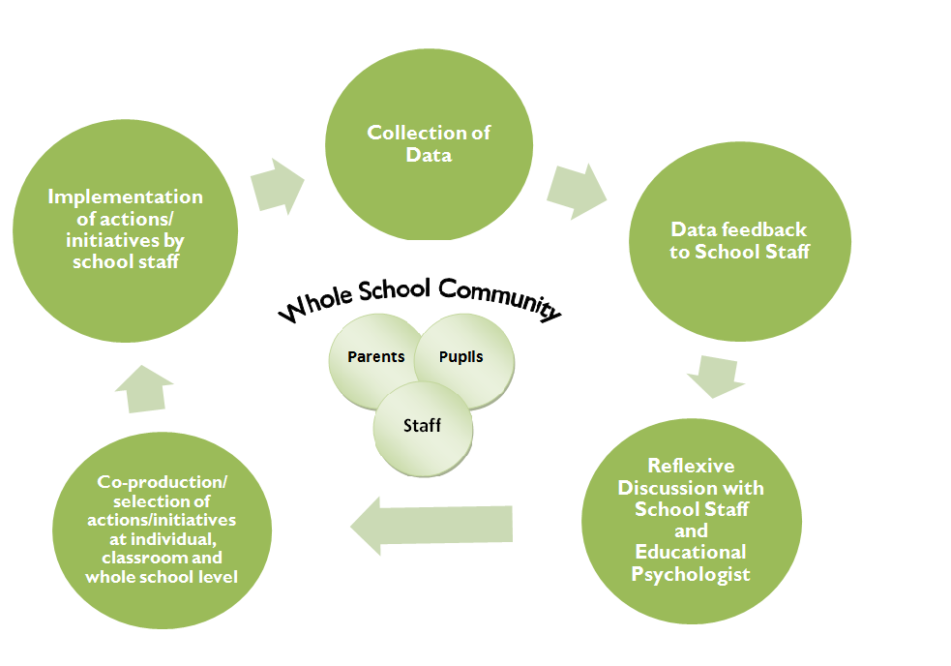
The SEED Intervention Process

Slide 41
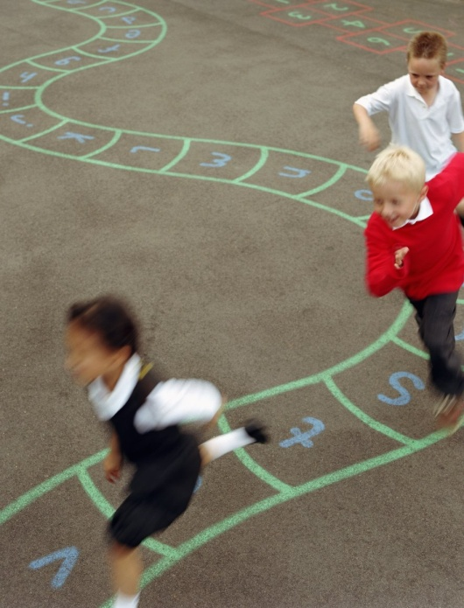
Evaluation of SEED
SEED is being evaluated using a stratified, cluster randomised design (balanced by size, deprivation, denomination and clustered by associated secondary school)
  Funded by NIHR and supported by Robertson Centre for Biostatistics and the Scottish Mental Health Research Network
38 Primary Schools recruited across 3 Local Authorities
  Baseline (2013) and follow up waves of data collection in 2015, 2016 and 2017 following older cohort of pupils over transition to Secondary school
  Primary outcome measure is the Strengths and Difficulties Questionnaire (SDQ)
  Intervention group will receive SEED throughout the life of the trial, the control group will receive all their feedback in 2017

Slide 42

Data Collection: Questionnaires
Teachers of pupils in P1 and P5 complete SDQs about the pupils
P5 Pupils self-complete a questionnaire (that includes SDQ)
Parents of P1 and P5 cohort pupils complete questionnaires (including SDQ about their child)
All school staff complete a questionnaire
Notes:
P5 pupils
Attitudes towards self:
Social resilience
Ability to manage their feelings and behaviour
Respect and empathy for others
Relationships
Connectedness to school
Parents
Perceptions of school
Parent child relationships
Staff
Perceptions of school role
School ethos
Management and support
Teacher pupil relationships
Staff wellbeing

Slide 43
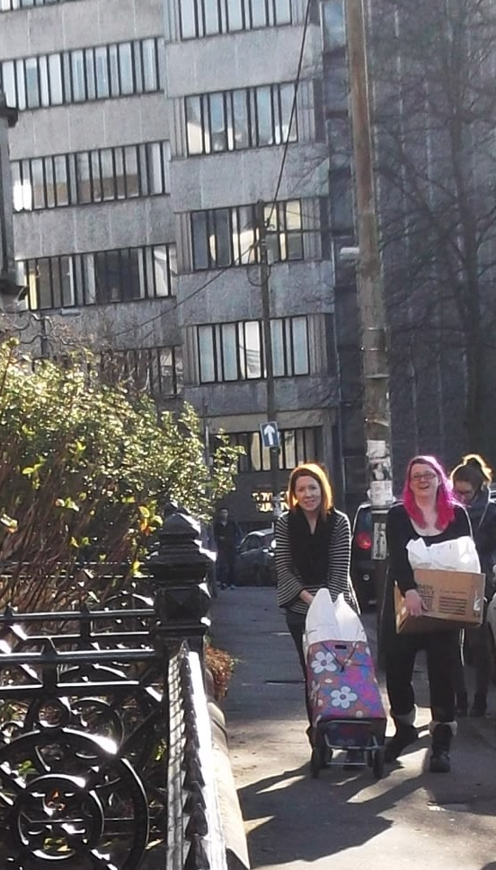
Data Collection: Progress
The Fieldwork team visited 38 schools
in Dundee, Falkirk and South Lanarkshire between mid-January and the end of March
Prepared and sent:
  Recruitment Letters and follow up info packs to 91 schools
  2799 Letters to parents
  8081 Qs to Staff, teachers and parents
Collected:
  1397 P1 SDQs completed by teachers
  1225 P5 SDQS completed by teachers
  1227 P5 self-complete Qs
  664 Staff Qs
  898 Parent Qs

Slide 44
Study Milestones
Date | Milestone | Progress
Spring 2013 | Recruitment of primaries | Complete
Spring 2013 | Baseline data collection and school notification of allocation to intervention or control arm | Complete
Summer 2013 | Feedback of baseline findings to intervention schools, needs analysis and selection of initiatives | Complete
Autumn 2013-Summer 2016 | Implementation of school initiatives to fit pupils’ needs: for older cohort intervention will end Summer 2015 | Ongoing
Autumn 2014 | Qualitative Interviews with 4 case study schools (all schools)
Spring 2015 | Follow up 1
Spring 2016 | Follow up 2 (oldest cohort in secondary 1)
Spring 2017 | Follow up 3 (oldest cohort in secondary 2)
2016/7 | Final outcome analysis and report/paper writing

