Slide 1

The third sector as a partner in preventing, mitigating and undoing health inequalities
Cross-Party Parliamentary Group on Health Inequalities
5th June 2014
Claire Stevens, Chief Officer claire.stevens@vhscotland.org.uk

Slide 2


Who we are
The national network & voice
for voluntary health organisations
Working with all sectors to
create a healthier, fairer
Scotland for everyone
PROMOTING
SUPPORTING
INFLUENCING
Notes:
Voluntary Health Scotland is a national body providing a network and a voice for third sector organisations that have the shared aim of improving Scotland’s health and wellbeing and supporting people to live well.
Our members provide health and social care services, they are involved in health improvement and education, in campaigning and awareness raising, and in community development and capacity building.
You would recognise many of our members because they are national charities like BHF, Samaritans, or ASH Scotland or because they have a strong presence and reputation at a community level like Lanarkshire’s Healthy Valleys or Safe Space in Dunfermline or Good Morning Service in Glasgow.
You might not be surprised to hear that our network includes organisations more usually associated with the arts, the environment or homelessness - their engagement with health agendas, and particularly with inequality agendas, illustrates very well the holistic approach that the third sector takes to supporting people to live well and to their full potential.

Slide 3
Scale & range of third sector
762 organisations focused on health care
  Hospitals and Rehabilitation
  Mental Health
  Other health and wellbeing services
6,139 organisations focused on social care and development
  Social care services
  Pre-school day care
  Services for children and families
  Services for women
  Services for people with disabilities
  Services for older people
  Youth services
  Refugee and Immigrant social services
  Carers organisations
Notes:
I want to use my time today to talk about why the third sector is a crucial partner in the fight to tackle health inequalities, highlight some opportunities and challenges, and give some specific exemplars of what organisations in our own network are contributing.
The starting point needs to be an appreciation of the size, scale and range of the third sector so that we have some idea of the kind of resource that is available.
There are 45,000 voluntary organisations in Scotland - which includes charities, community groups, social enterprises and housing associations.
This slide shows SCVO’s latest estimate of the nearly 7,000 organisations specifically focused on health and social care, which is a better starting point for our discussion today – though I would argue that organisations involved in areas like employability, community development, housing, homelessness, arts and environment mustn’t be overlooked.
The majority of third sector organisations are small and community based, working in just one or two localities. The national ‘household name’ charities may work across a number or all local authority areas, but are not necessarily large organisations.

Slide 4
Added value of third sector contribution
Provider of person centred, asset-based, preventative support
Expertise & approach rooted in the experiences of people who use services
Supports people to have greater control over the factors that impact upon health and wellbeing.
Significant investor in service innovation, redesign & improvement
Includes large service providers, community & grassroots, social enterprises
Employs 5% of Scotland’s workforce and 1.2 million volunteers
Provides 30% of all registered social care services
Notes:
Third sector organisations are typically highly engaged with the communities and individuals they set out to support and work with.
They have been pioneering and using person centred and strength based approaches for many years.
They think of prevention and early intervention as part of their DNA.
They don’t accept there are people who are hard to reach, only services that are hard to reach.
Because they are independent they can innovate quickly, be flexible and responsive in the face of changing needs.
They represent an enormous human resource – 5% of the workforce/1.2 million volunteers
And they bring other resources to the table, through fundraising and independent sources of income.
Finally, high levels of public trust and support and a growing track record in partnership working and co-production.

Slide 5

Third sector perspective on health inequalities
You are sick more
You die younger
Notes:
VHS became aware some time ago that there was a real appetite across our network to understand the evidence on health inequalities and to explore, evidence and articulate what the third sector contribution is.
The publication of NHS HS’s A Fairer Healthier Scotland and the reconvening of the Ministerial Task Force on Health Inequalities gave added impetus to this growing interest
But we soon discovered that there is virtually no material available that discusses or evidences health inequalities coherently from a third sector perspective.
We have set out to address this, in the first instance through holding and recording a series of discussions with third sector organisations, with the aim of raising awareness, exploring issues and sharing learning.
At our first discussion, in October 2013, we asked participants to come up with their own definition of health inequalities and this is what they said – rather less technical than an NHS or academic definition, but it encapsulates exactly what the issue is – this is about the quality of people’s lives, not just the earliness of their deaths.

Slide 6
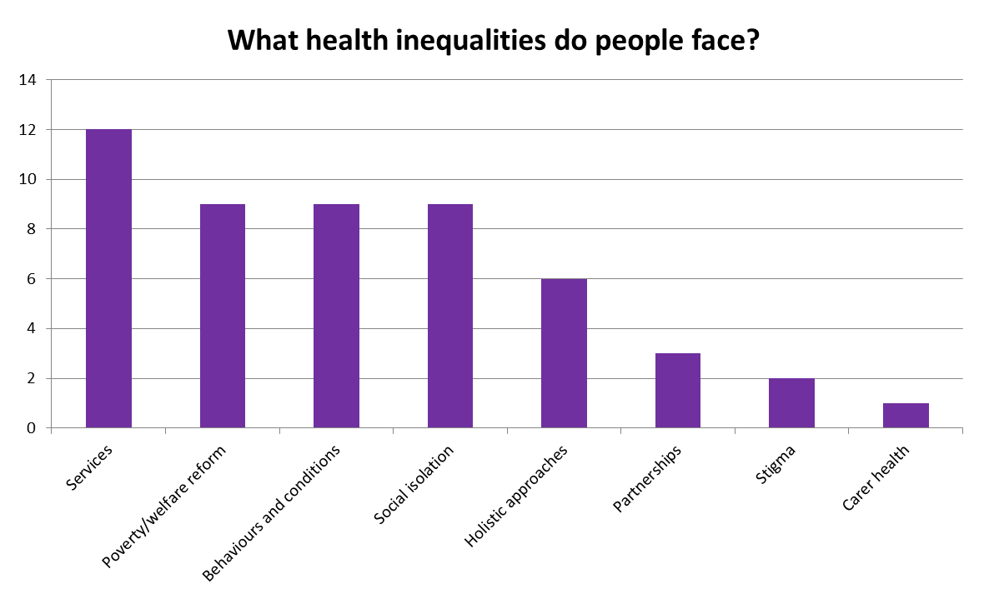
Third sector perception of the issues
Notes:
We also asked participants what the reality of health inequalities is for the people they support.
At the very top of the issues raised was the issue of access to services. By this people meant the difficulties that people face in accessing services, how hard it is for people to navigate different health and social care systems and providers, how postcodes can still determine what support, funding and services people get.
People also talked about the effects of poverty, welfare reform and austerity measures at an individual level.
They understood very well that individuals’ responses to their particular circumstances are complex and result in a downward spiral, where behaviours can lead to or compound illness or long term conditions, disconnect people from families, work and communities, entrench social isolation and stigma.
And they also highlighted the knock on effect on carers’ health, that health inequalities affects the whole family not just the individual.

Slide 7
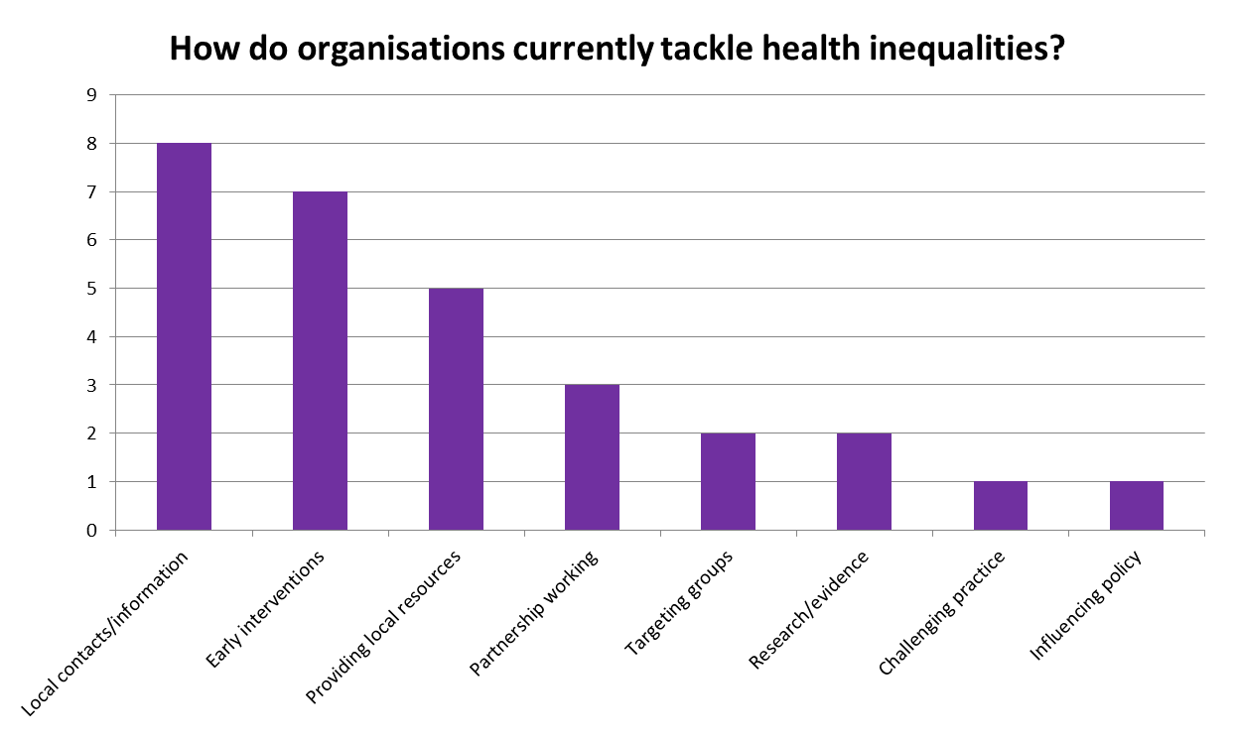
Preventing, Reducing, Undoing
Notes:
At the same event and subsequent events we’ve asked participants to articulate what their organisation is doing to tackle prevent, mitigate or undo health inequalities.
We ‘ve always set the context for this question by explaining the fundamental causes of health inequalities and rehearsing NHS HS’s arguments that power, resources and money have to be shifted, if the inequality gap is to be narrowed.
Our participants’ responses always focuses most strongly their role in creating social capital, building networks and providing or levering additional resources and support for people at a local level. In effect, shifting power towards individuals and communities.
They also talk about targeting interventions at those furthest from mainstream help, as you would expect the third sector to do.
Less encouragingly, many feel their contribution to transformational change at a more strategic, national level is currently limited, partly for reasons of capacity, but largely because they don’t feel considered to be an equal partner by the statutory sector.
They expressed huge appetite for working up much better evidence to demonstrate what is working well, because they know they have important learning to undertake and to share.

Slide 8

Creating social capital and networks
Scottish Families Affected by Drugs
families affected by someone’s drug misuse
reduces isolation & stigma, connects to support
Neighbourhood Networks
- learning disability, physical disability,
mental health issue
- mutual support & skill-sharing networks
Notes:
Moving on, I want to quickly give some practical exemplars of third sector initiatives that I think illustrate how our sector prevents, mitigates and undoes inequalities.
I’ve taken as themes three of the priority areas for action from the Task Force report reviewing Equally Well.
Firstly, the TF prioritises the need to develop much greater social capital in those communities worst affected by inequalities, because social capital is associated with higher educational achievement, better employment, lower crime – and with better health.
My first example here is Scottish Families affected by Drugs, an organisation that supports families where someone’s abuse of drugs impacts on the whole family’s health. In these situations, family members often become very isolated from support systems, they are weighed down by the stigma of having a drug user in the family, encounter barriers in accessing services, can be ostracised by neighbours/community.
SFAD run family support groups, which enable people to meet with others in same situation, build connections, find strength and confidence from others, get support to access help.
Also based in West of Scotland is Neighbourhood Networks, which brings together people facing similar challenges in small groups at a community level, creating a self-supporting network that builds encourages skill sharing and builds people’s confidence to undertake activities in the community.

Slide 9
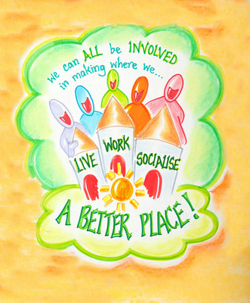
Creating quality neighbourhoods
Living Streets
Working with communities
to create safer, healthier streets
where it’s good to walk
Tullibody Healthy Living
- A one stop shop for community health
reduces social isolation,
builds community involvement,
supports healthy eating
Notes:
The TF has also prioritised the creation and sustaining of good places – introducing a Place Standard.
Living Streets: Communities know best and asset based approach, led by and enabling communities to shape how their streets work and are managed
Those who depend most on local streets for transport, leisure and health needs most have the worst traffic pollution, road safety dangers, poorest quality environment. Especially the young and old.
45% of adults on low incomes walk to work compared to 13% overall. 50% households in Glasgow and Dundee have no access to a car.
Tullibody Healthy Living
Part of Clackmannanshire Healthier Living and the Clackmannanshire Alliance, so a good example of community based partnership working. Shop front premises in Tullibody, and are specifically focused on tackling health inequalities - they use community development approaches to reduce social isolation, support people to reconnect to their community, eat well and undertake exercise.

Slide 10

Supporting young people in transition
Fast Forward
Assets based: young people lead
education to reduce harm from
alcohol, tobacco and drugs
Rowan Alba – Stramullion
- homeless young women without functioning
support systems
- builds the skills, resilience & resources to live well
Notes:
The TF also recommended that a life course approach to health inequalities was valuable and seemed to highlight age 15 as a crucial turning point in some young people’s lives.
Fast Forward
National charity: train and deploy young people themselves as peer educators to other young people, with the aim of reducing harmful behaviours involving alcohol, drugs or tobacco.
Rowan Alba – Stramullion service:
Supported tenancies – young women 16+ - LAC, homeless, offenders, drugs/alcohol, chaotic. 10 years in West Pilton, partnership with CEC.
Care Inspectorate rated for user involvement and person centred approach.
Provide:
Welfare and benefits advice
Budget and debt management
Life skills training
Social resettlement activities

Slide 11
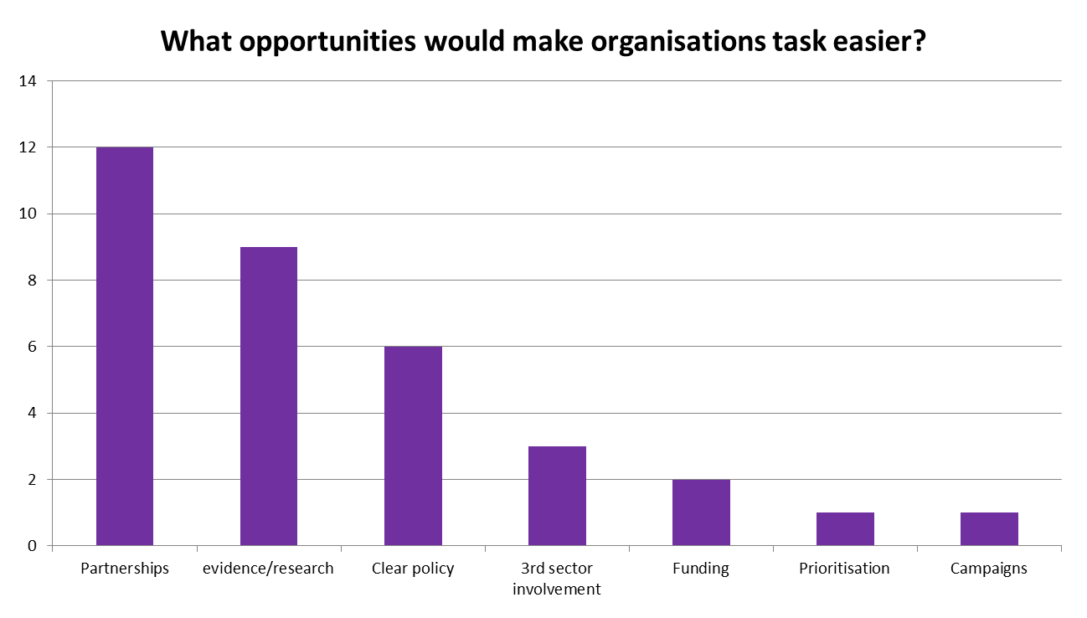

Challenges and opportunities
Notes:
Throughout our discussions with our members, we’ve asked participants what opportunities they would like to see.
What is top of everyone’s list is the desire for much more partnership working to ensure that all available resources are harnessed and deployed much more effectively. By this, people mean more - and more equal – partnership working with statutory partners, more co-design and co-production, more community led solutions. The pre-requisite for this being the need to continue to break down the institutional, cultural and professional barriers that work against recognising and valuing our sector.
Second on everyone’s list is the appetite to contribute to the evidence of what works in order to influence policy and practice - and a recognition stronger connections with academia and other researchers would enable our sector to marshall its evidence more effectively.

Slide 12
Our current work
PROMOTING, SUPPORTING, INFLUENCING:
Dialogue and learning events:
  Young people in transition – 24th June
  Vulnerable adults (mental health, prison) – 21st August
Evidence gathering and reporting:
  NHS Health Scotland funded research and report
Partnership and collaboration:
  Third sector health and social care integration – e.g. East Dunbartonshire
  Other working groups – e.g. social prescribing and mental health
Notes:
Finally, what is VHS doing in response to this?
Our focus continues to be to raise awareness in the third sector of developments and evidence in relation to the health inequalities agenda, and to support them to analyse and articulate their own contribution to a much wider audience.
Unequal Lives, Unjust Deaths events:
2. We have also responded to the repeated request for support in gathering and presenting evidence:
NHS HS research – survey and case studies, event
3. Partnership working:
TS H&SC Integration agenda – pleased to see that health inequalities will be embedded into H&SC at national policy and local partnership levels.
Finally……

Slide 13
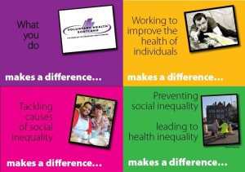
One goal, many sectors, unlimited potential
Join our network: http://www.vhscotland.org.uk/get-involved/
Access resources: http://www.vhscotland.org.uk/health-inequalities/

