Slide 1
Evidence base for tackling health inequalities?

Slide 2

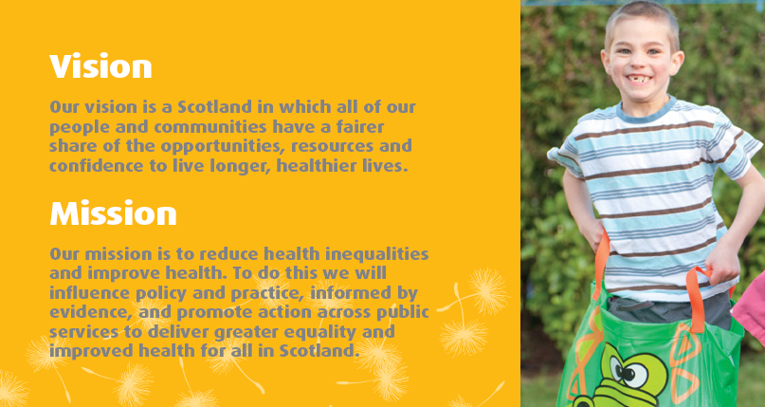
Our vision and mission
Our Strategy 2012-17:
“A FAIRER HEALTHIER SCOTLAND”

Slide 3
What do we mean by health inequalities?
Health inequalities are:
Unfair differences in health within the population across social classes and between different population groups
These unfair differences:
Are not random, or by chance, but largely socially determined
Not inevitable.

Slide 4
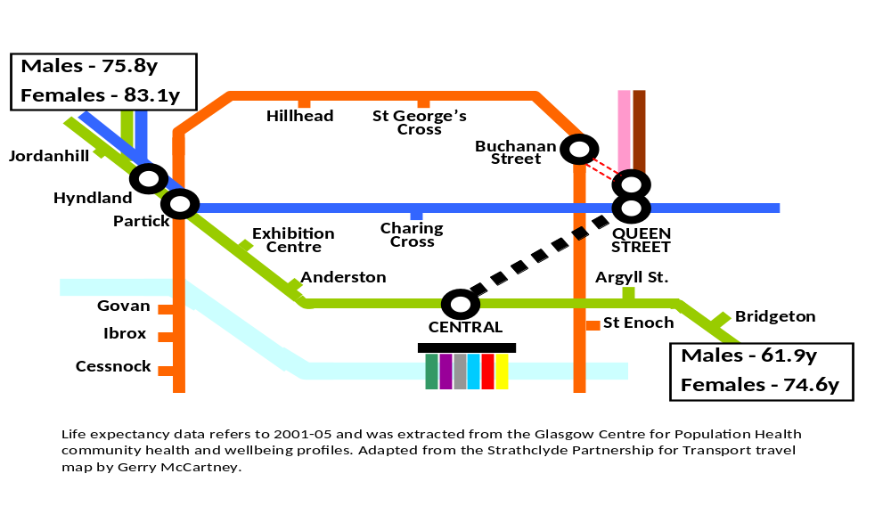
The evidence of the effect of inequality on life expectancy is stark and indisputable

Slide 5
What do we mean by evidence?
Knowledge/experience- including ‘lived’ experience
How good are we at putting together all that we know?
How we turn what we know works into action- is what really matters!
“Poetry is just the evidence of life. If your life is burning well, poetry is just the ash.” ― Leonard Cohen

Slide 6
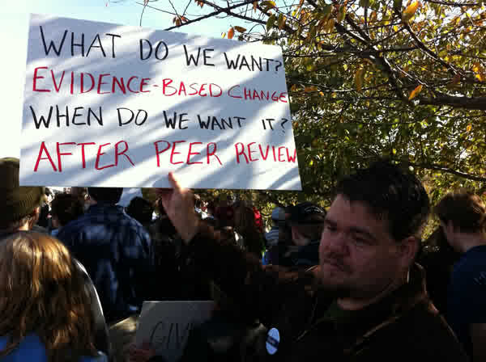

Slide 7
The power of ‘third sector’ evidence
Rapid and person centred….brings the voice of people affected by inequality and injustice…brings a sense of humanity to our work
‘My daughter suffers severe asthma attacks due to the overcrowding. Every month she misses one, two, or three weeks from school.’ (Shelter Report)
“ I don’t mind my choices being limited but my sons are and that’s frustrating” (Respondent, Poverty Alliance Report)

Slide 8
What about principles and values?
Do we need evidence to embed principles of fairness, equality and human rights?
How do we work together to improve practice- making sure it is driven by the principles of human rights, fairness and equality?
‘We hold these truths to be self-evident, that all men are created equal’ (Jefferson, Declaration of Independence 1776)

Slide 9
What is most and least effective in reducing health inequalities?
Most likely to be effective
Structural changes to the environment, legislation, regulatory policies, fiscal policies, income support, improving accessibility of public services, prioritising disadvantaged population groups, intensive support, and starting young.
Least likely to be effective
Interventions such as information-based campaigns, written materials, campaigns reliant on people opting in, campaigns/messages designed for the whole population, whole school health education approaches, approaches which involve significant price or other barriers, and housing or regeneration programmes that raise housing costs.

Slide 10
What works in early years to reduce inequalities?
Improvements in housing quality and security of tenure
Access to safe areas for children to play
Intensive pre- and post-natal home visiting involving highly skilled staff, encompassing continuity of care and carer
High quality, early years education and care - full-day programmes provide most gain for children who are at greatest risk of poor outcomes and half-day programmes for children at lesser risk
Access to affordable childcare
Access to high quality employment that is flexible
Intensive parental support to promote
  enhanced maternal/infant attachment
  provision of an enriched home environment
Interventions to promote physical, social, emotional, language and cognitive development that is proportionate to need

Slide 11
Finally
We want to work with the third sector to achieve the outcomes we all want to see- children having a fair and equal chance to live long, happy and fulfilling lives, to do that we want to work with you to drive:
Fairer and improved policy
Stronger support for action
Improved practice
‘Coming together is a beginning; keeping together is progress; working together is success’ (Ford 1901)

